Slide 1
CONSIDERATIONS ON MEDIUMSHIP
Illustration kindly provided by the “Image Project” (Projeto Imagem) http://www.projetoimagem.com.br/
LESSON 11
2012 © United
States Spiritist Council

Slide 2
MEDIUMSHIP

Slide 3
MEDIUMSHIP

Slide 4
Within the work of mediumship, there are two areas of activity:

Slide 5
Material and spiritual activities complement each other, so forming the sanctification of all duties which brings with it elements of defense and protection, of sustenance and good equilibrium.

Slide 6
PREPARATION OF THE MEDIUMISTIC GROUP
For many “mediumship” suggests the stereotypical séance, but the channeling of discarnate spirits by a medium can and does occur in very ordinary settings, as long as they follow the simple guidance presented in this lesson.

Slide 7
Excerpts taken from the book Dialogo com a Sombras, written by Herminio Miranda.

Slide 8
Excerpts taken from the book Dialogo com a Sombras, written by Herminio Miranda.

Slide 9
Illustration kindly provided by the “Image Project” (Projeto Imagem) http://www.projetoimagem.com.br/
The mediumistic work is protected and assisted by a security team which is comprised of workers from the other side, and it must be understood that once the regular allotted time has finished, they have to leave; accordingly, they have other tasks to attend to elsewhere, which cannot be delayed.

Slide 10
Illustration kindly provided by the “Image Project” (Projeto Imagem) http://www.projetoimagem.com.br/

Slide 11
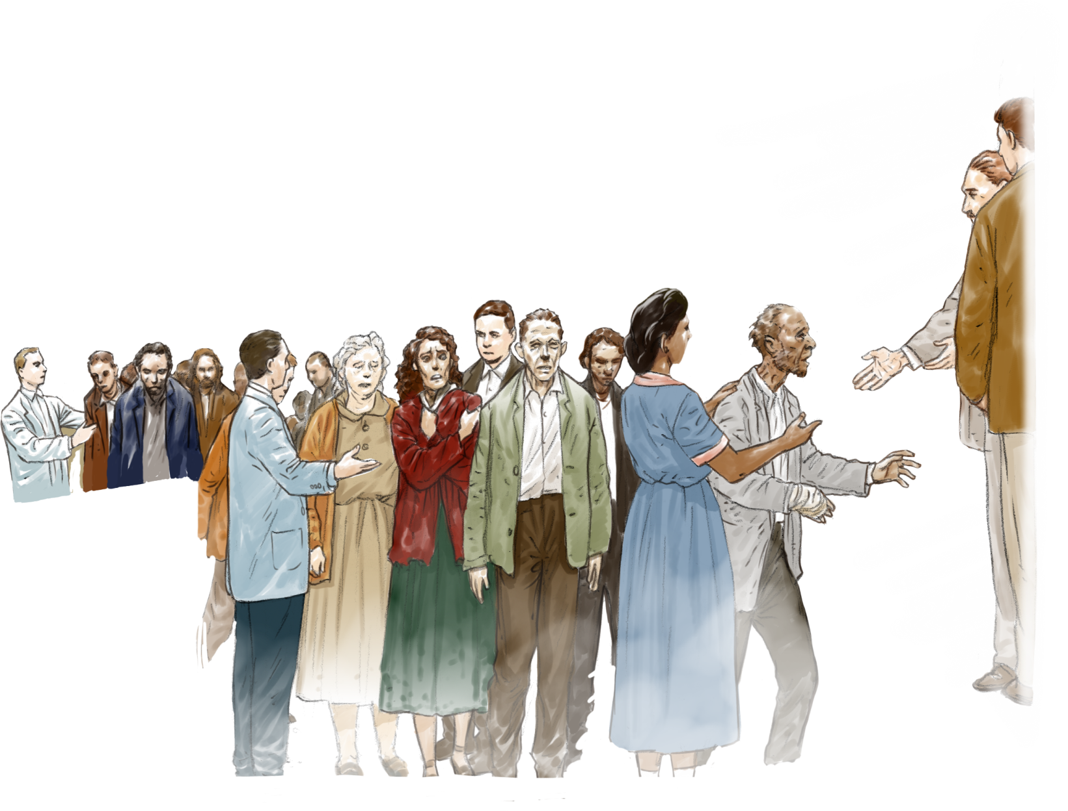
Illustration kindly provided by the “Image Project” (Projeto Imagem) http://www.projetoimagem.com.br/

Slide 12
The Nature of Communications

Slide 13
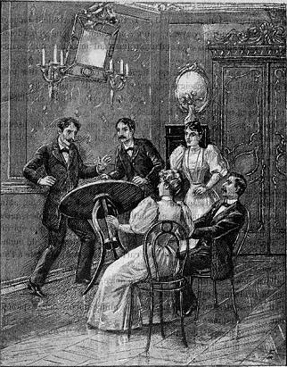
Crude communications

Slide 14
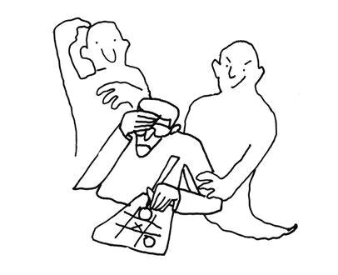
Frivolous communications

Slide 15
Serious communications

Slide 16
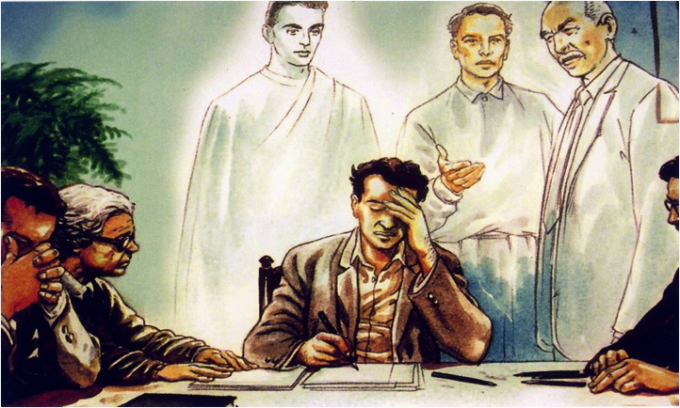
Instructive communications
Illustration kindly provided by the “Image Project” (Projeto Imagem) http://www.projetoimagem.com.br/

Slide 17
What kinds of preparations do a medium need to make to keep away ignorant spirits and to use this gift for good?

Slide 21
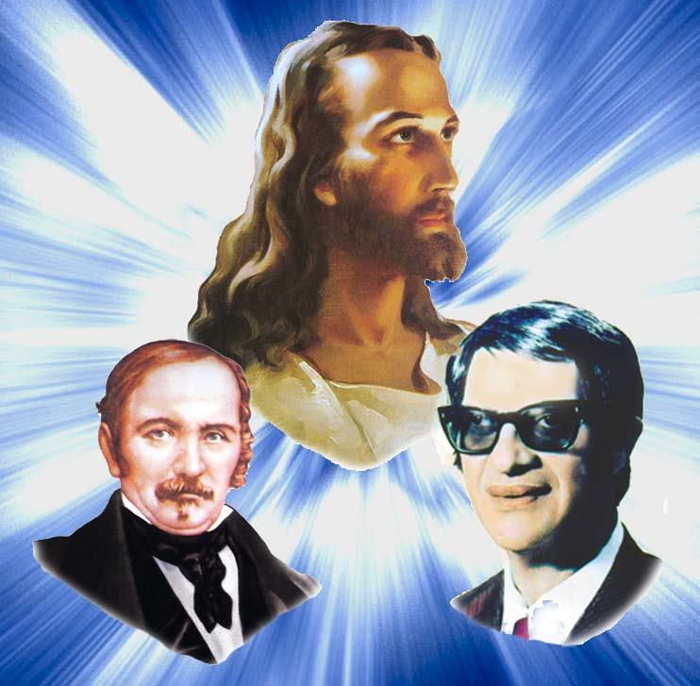
Our spiritual friends and benefactors inform us that:
Mediumship without study and the application of the teachings of Jesus is a phenomenon without love.
Mediumship without the clarifications and education offered by Spiritism is an unenlightened phenomenon.
Mediumship with Spiritism, but without the teachings of Jesus is an incomplete realization.
Mediumship with both the teachings of Jesus and Spiritism is a guarantee or spiritual victory and the valorization of spiritual talents.
Therefore, the forming of the trilogy comprised of the Gospel, Spiritism, and Mediumship is essential.

Slide 22
“In the field of mediumship, do not forget that a duty correctly fulfilled is the compass that will propel you the right direction.”
Emmanuel
(Religion of the Spirits, “Mediunidade e Dever”)

Slide 23
United States Spiritist Council
SATURDAYS @ 10:00 am to 11:00 AM EST
WEDNESDAYS @ 9:00 PM to 10:00 PM EST
Visit our website for
more information:
www.Spiritist.us

