Slide 1


Q & A
MEDIUMSHIP
LESSON 12

Slide 2

1- What is a medium?

Slide 3
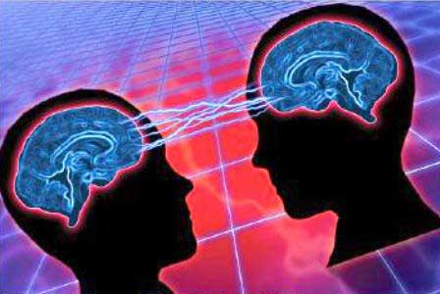
2- How does this awareness occur?

Slide 4

3- Why are some people more in tune to the spirit world than others?

Slide 5

4- Does being an active medium mean I am more evolved than those who are not?

Slide 6

5- If mediumship has nothing to do with a person’s spiritual or ethical evolution, then why is the ability part of our overall evolution?

Slide 7

6- What do you mean when you say mediumship is a tool for learning?

Slide 8

7- Are you saying that there is a right and wrong way of using mediumship, and that we learn from using it not only correctly but also incorrectly too?

Slide 9

8- If I understood rightly, did you just say that mediumship cannot be used for any personal gain?

Slide 10
9-This makes no sense. How can it be wrong to make money from my mediumship when I have every right to make a living from all my abilities?

Slide 11
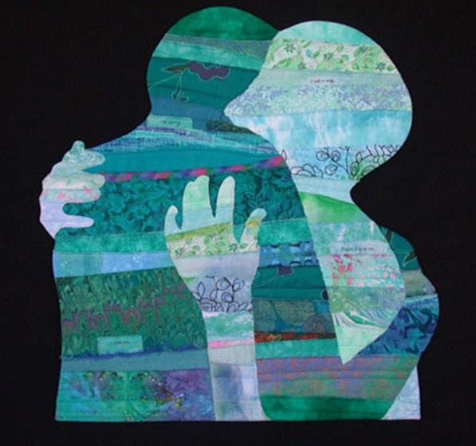
10- In question 5 you said that mediumship is also a tool for making amends for past errors. Can you explain?

Slide 12
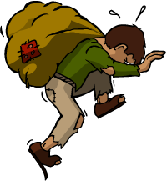
11- So mediumship is a burden?
Mediumship

Slide 13

12- So the way you use your mediumship influences the kinds of spirits who communicate through you?

Slide 14
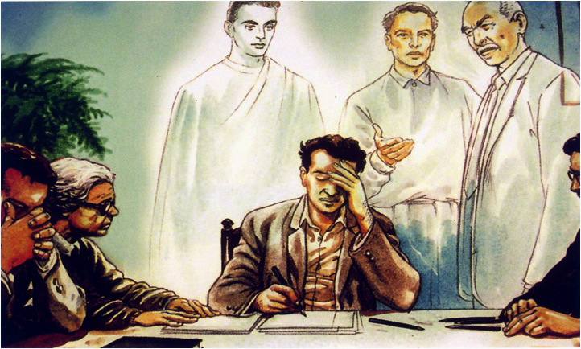
13- Tell me about these helpful, wise spirits who guide some mediums?
Illustration kindly provided by the “Image Project” (Projeto Imagem)
http://www.projetoimagem.com.br/

Slide 15
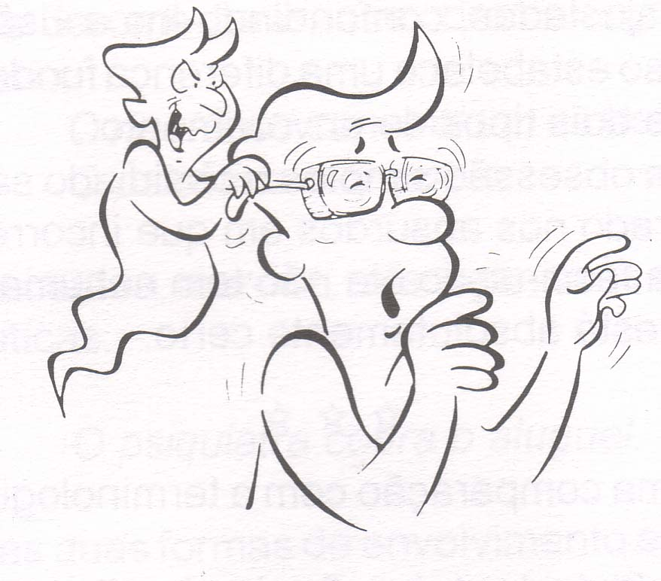
14- Tell me about these selfish, hurtful spirits who use some mediums?

Slide 16
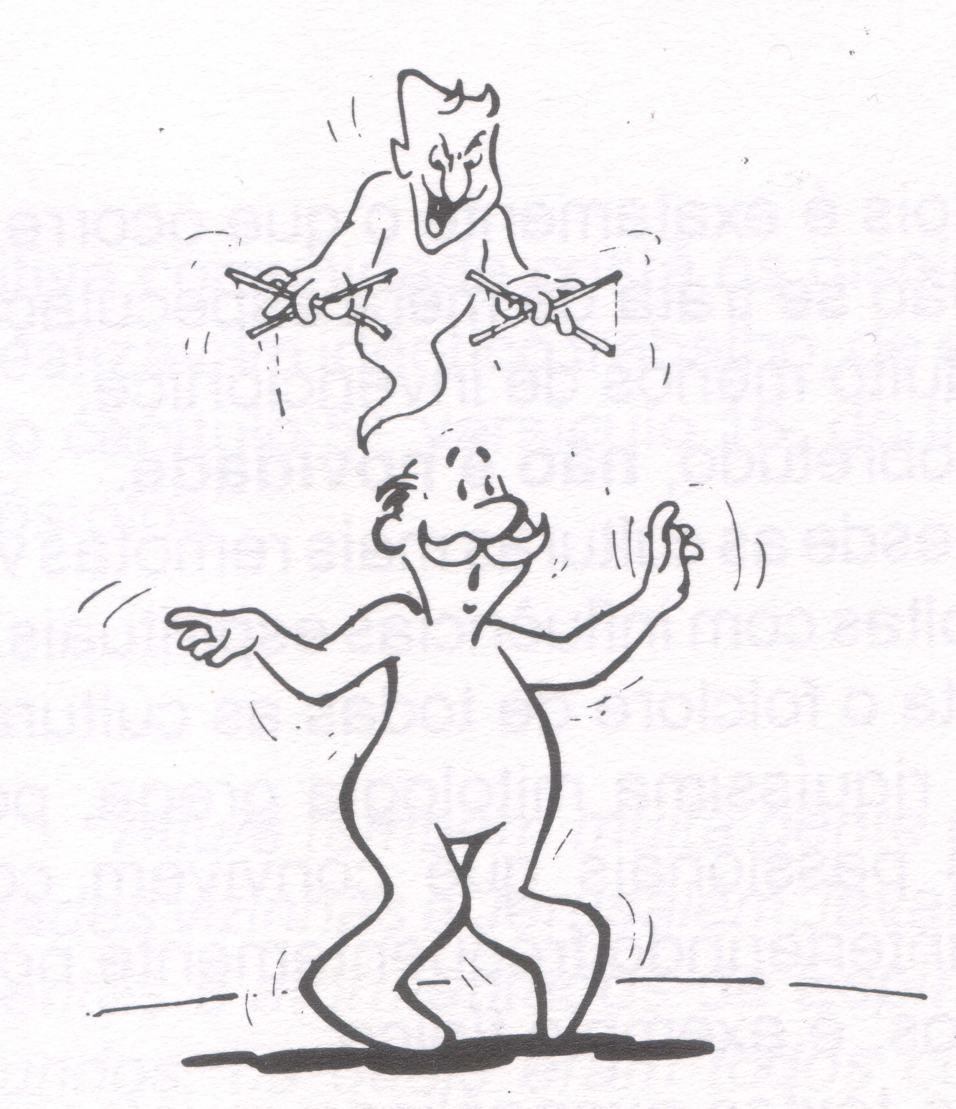
15- I’ve read that mediums have no control over the spirits who choose to communicate through them, is this true?

Slide 17
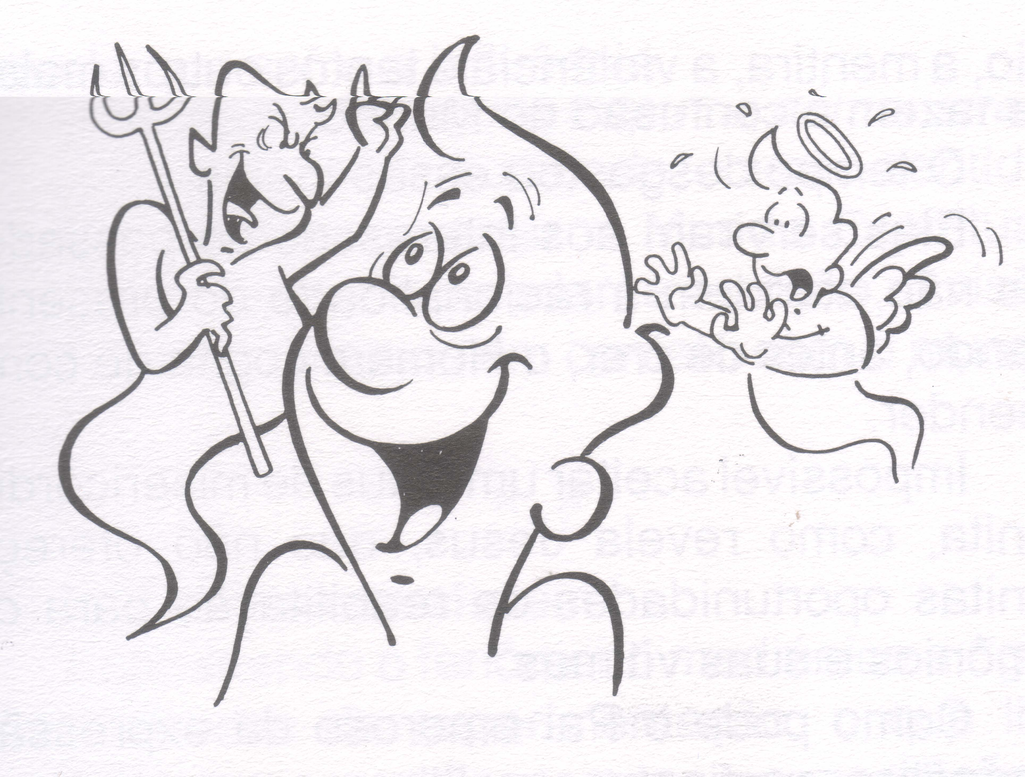
16- So you are saying, then, that mediums are always in control, but wouldn’t spirit possession be an exception to this rule?

Slide 18

17- Once a medium has allowed a spirit to communicate, is the medium responsible for what happens next?

Slide 19

18- Am I expected to become a saint in order to be a good medium?!?

Slide 20
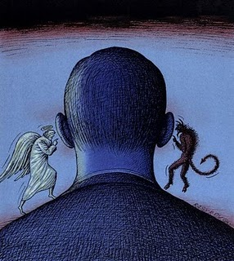
19- How does Spiritism fit into my ethical growth and my use of this mediumship gift?

Slide 21

20- If I see/hear a spirit claiming to be a family member is it a good or bad spirit?

Slide 22

21- I have never seen spirits but I have heard them, when awake and asleep. Am I a medium?

Slide 23
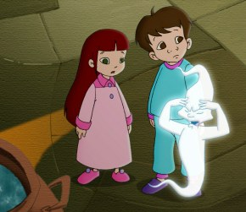
22- When I was a child I could see spirits but now I can’t. Why?

Slide 24
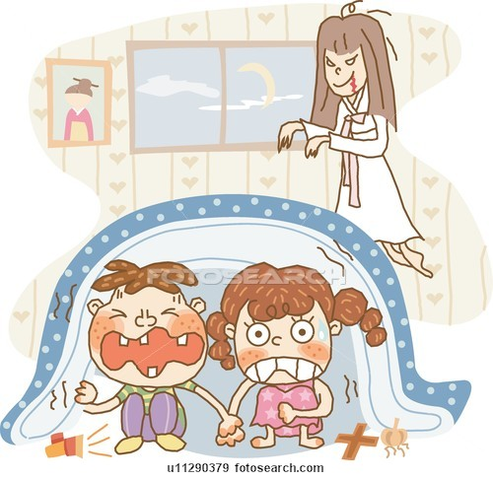
23- I was tormented as a child by cruel spirits. Why? And who were they?

Slide 25
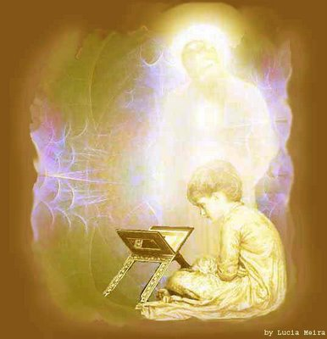
24- What is my guardian angel? How can I recognize this angel when it communicates?

Slide 26

25- I don’t even believe in God, how is it that I am a medium?!?

Slide 27

26- If I can see and hear spirits, then how do my five senses perceive the spirit communications?

Slide 28

27- Can I die, or be severely harmed, during a spirit communication?

Slide 29

28- If I want to be a medium, what do I need to learn so that I can accomplish this goal?

Slide 30

29- If I am a medium, can I communicate with the spirits of people who are still alive?

Slide 31
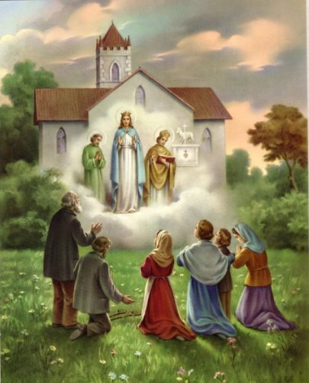
30- I communicated with the spirit of a famous celebrity, or saint; what does that mean?

Slide 32
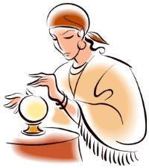
31- A spirit communicated a dire prediction of future events. Should I listen?

Slide 33

32- A spirit told me that someone else wants to hurt me. What should I do?

Slide 34
33- A spirit told me that if I followed his instructions I could get a material thing that I really want. What should I do?

Slide 35
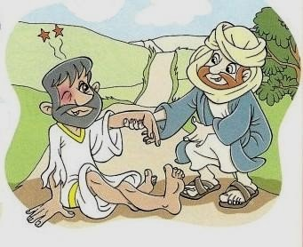

34- I am a medium and I do not want to be one any more. What do I do?

Slide 36

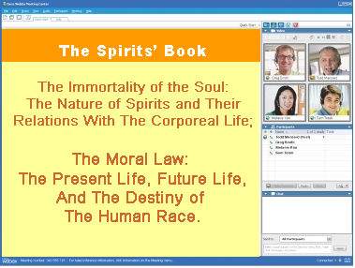
United States Spiritist Council
SATURDAYS @ 10:00 am to 11:00 AM EST
WEDNESDAYS @ 9:00 PM to 10:00 PM EST
Visit our website for
more information:
www.Spiritist.us

