Slide 1
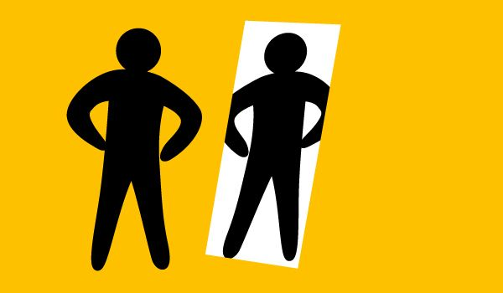
Self-Knowledge Sincerity
Inner Transformation – Lesson 1
2011 © United States Spiritist Council

Slide 2
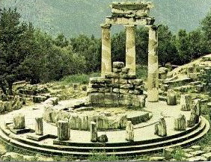
KNOW THYSELF
The Ancient Greek aphorism Know Thyself was once inscribed in golden letters in the forecourt of the Temple of Apollo at Delphi.
The phrase know thyself has become synonymous with self-realization or self-knowledge.

Slide 3
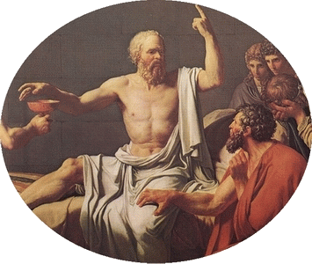
KNOW THYSELF
The origin of this famous aphorism has been attributed to at least six ancient Greek sages:
Chilon of Sparta (Chilon I 63, 25)
Heraclitus
Pythagoras
Socrates
Solon of Athens
Thales of Miletus

Slide 4
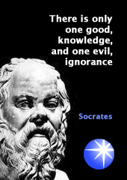
919. What is the most effective means for improving ourselves in this life and for resisting the draw of evil?
The Spirits’ Book by Allan Kardec
A sage of antiquity has told you: Know thyself.
The Socratic approach begins with the assumption a lack of knowledge of self is simply a form of ignorance which must be overcome in the same way that every other form of ignorance is overcome -- that is, by replacing ignorance with knowledge.

Slide 5
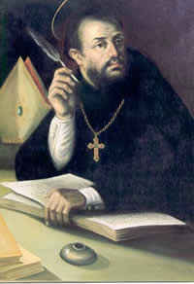
919a. We comprehend all the wisdom of that maxim, but the difficulty is precisely in knowing ourselves. By what means can we do so?
The Spirits’ Book by Allan Kardec
Do what I used to do when I was living on the earth: at the end of each day I examined my conscience, reviewed what I had done and asked myself whether or not I had failed to fulfill some duty and whether or not anyone had reason to complain about me. It was thus that I arrived at knowing myself and in seeing what there was in me that needed to be reformed.
St. Augustine of Hippo

Slide 6
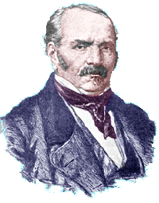
If we interrogate our conscience more frequently, we would see how often we fail without noticing it by not having scrutinized the nature and motive for our deeds.
The interrogative form requires categorical, yes-no answers that leave no room for alternatives. They are personal assertions and from the sum of those answers, we can compute the sum of the good and the evil that exists in us.
(Allan Kardec - The Spirits’ Book, item 919. a)

Slide 7
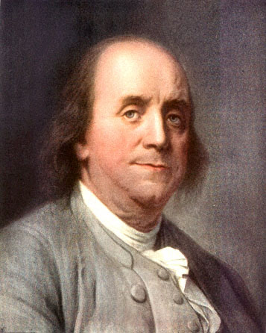
HOW CAN WE KNOW OURSELVES BETTER?
Sincerity, one of Benjamin Franklin’s 13 virtues, can help us in the process of self-knowledge.
Sincerity upon analyzing ourselves is a must for it is not by trying to deceive ourselves or by being condescending with our mistakes that we acquire self-knowledge and thus are able to work on the areas that need improvement.

Slide 8
HOW CAN WE KNOW OURSELVES BETTER?
The maxim Know Thyself looks good on paper.
But those who have tried it know that one of the greatest hurdles is being able to see oneself objectively and sincerely.
We all have built-in biases about who and what we are, and these biases can color our self-images. It is very difficult to see ourselves as others see us.
We often cannot be objective about our emotional selves because we have built up defenses that hinder accurate self-evaluations.

Slide 9
HOW CAN WE KNOW OURSELVES BETTER?
Our "insights' about ourselves usually contain a number of convenient blind spots. The self-actualized individual, who can speak freely and honestly of her or his faults and abilities, is rare.
The self-actualized individual, who can speak freely and honestly of his or her faults and abilities is rare.
Knowing one’s self is actually a lifelong journey and a journey that should be embarked upon with total trust in the personal observations and personal experiences we have experienced so far.

Slide 10
It seems to be to our advantage to discover what is under our mental hoods. But how can we do so, when so much of our mental lives is unavailable for introspection?
First, we can try to be objective observers of our own behavior.
We can try to see ourselves through the eyes of other people, or at least consider the possibility that they have picked up on something about us that we have missed.
We can try to learn about ourselves by reading and assimilating findings from psychological sciences. Most of us already pay attention to medical findings that inform us about our bodies (e.g., that smoking is harmful), and it is but a small stretch of the imagination to realize we can learn about our psychological selves in the same way.

Slide 11
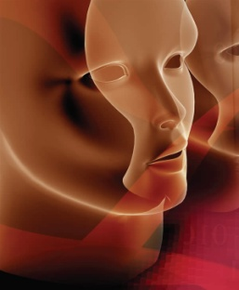
ASPECTS OF self-knowledge: self-enhancement and self-verification
Self-enhancement is when a person focuses on positive central traits over negative ones.
Self-verification, on the other hand, refers to preferring accurate information about the self, whether positive or negative.
Essentially, it seems that people self-enhance more than they self-verify. For instance, we prefer accurate information about positive traits of ours over negative ones. http://likealake.bloghttp://likealake.blogspot.com/2009/02/selfenhancement.htmlspot.com/2009/02/self-enhancement.html

Slide 12
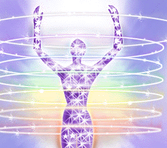
Self-Knowledge and Inner Change
In order to start processing the changes we need to see in our lives it’s essential that we find ways to increase the amount of self-knowledge we have.
If we look inside we can see our inner world of thoughts, feelings and emotions, and as we see them we understand them.
Additionally, we are able to recognize what lead us to feel sad, happy and even spiritual. Using this assessment technique we can begin to program our inner transformation.

Slide 13
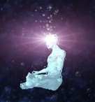
Self-Knowledge and Inner Change
Thus, we can work on what needs to be changed in our actions, our lives, and in the way we relate to others.
We are able to unlock our inner secrets and embark on an incredible journey of self-transformation.
But, it is crucial to remove certain concepts that are rooted in ourselves that put us down, such as: I will never get better; I will never get what I want, or I will never be happy.
Whatever we work on improves. Most often, we find what we’re looking for.
But we need to recognize it when we find it. Those who believe they'll never find it, often miss hat is right from under their noses.

Slide 14
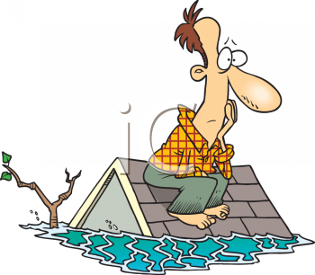
Self-Knowledge and Inner Change
A man is sitting on the roof of his house as the whole village is flooded, including his house. The water level is still rising.
A man comes on a boat and asks him to get in, but he says he is waiting for God to rescue him. A little later, a helicopter circles around and drops a rope and a chair for him to get on board but the man says he wants only God to rescue him.
"The man drowns, goes to heaven and asks God, Where were you when I needed you? God answers, I sent you a boat and a helicopter. Where were you?

Slide 15
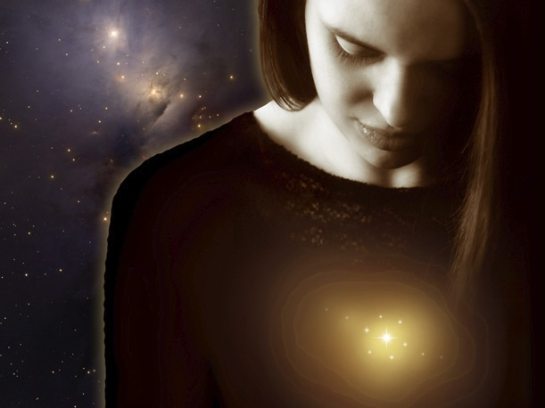
Self-Knowledge and Inner Change
If there is a will, you will find the way to get there or as close to it as possible. If there is a will to change, you can most certainly change. If you lack the will to change, nobody can show you how.
Remember, it is easier to change ourselves than someone else, but we must be willing to change.

Slide 16
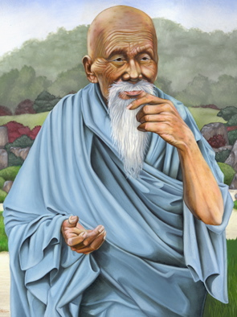
Knowing others is intelligence; knowing yourself is true wisdom. Mastering others is strength;
mastering yourself is true power. Tao Te Ching
He who knows others is wise; He who know himself is enlightened.
Tao Te Ching
Lao Tzu
Chinese Philosopher

Slide 17
United States Spiritist Council
Visit our website for
more information:
www.spiritist.us

