Slide 1
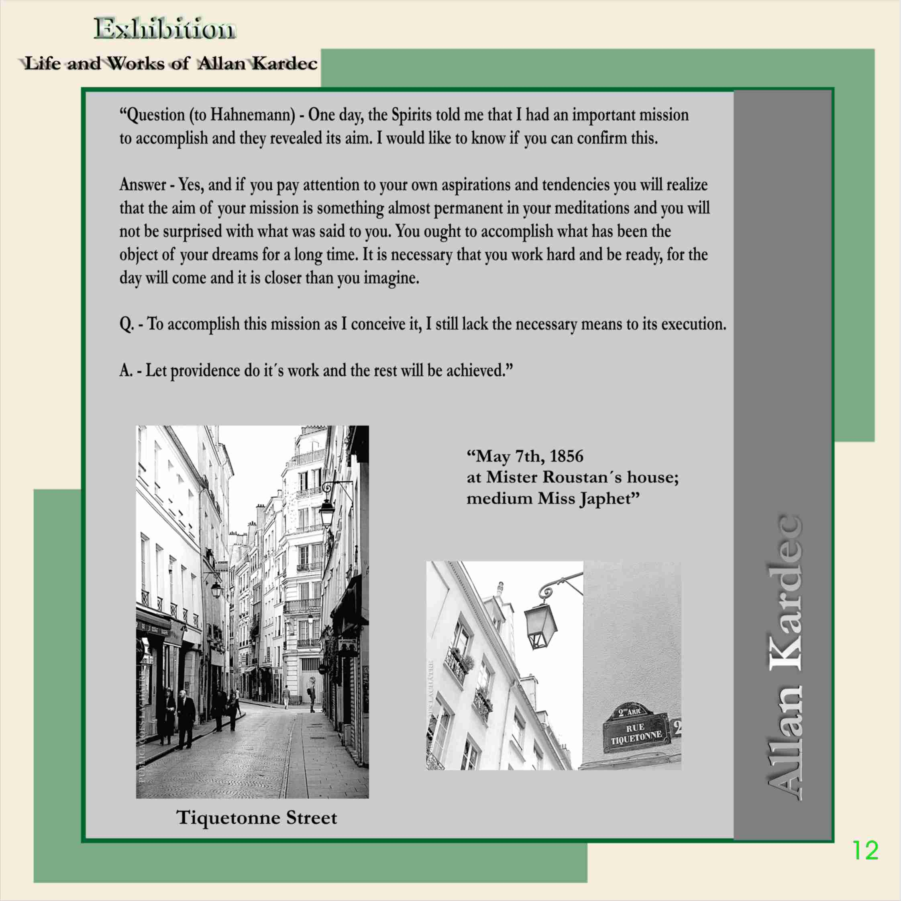
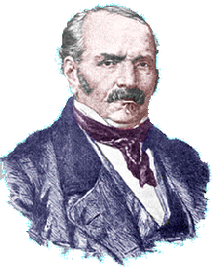
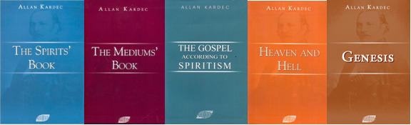
THE HISTORY OF SPIRITISM
Part - 2
2009 © United States Spiritist Council
Notes:
<number>
In a brief historical journey regarding the European Spiritist Movement, Dr Luis explained that Portugal, Spain, France, England, Belgium, Russia and Sweden, amongst other European countries, had an appreciable number of adepts at the beginning of the twentieth century. But the two Great Wars greatly affected the foundations of European Spiritism and that, for the rest, in Portugal and Spain the dictatorships of Salazar and Franco almost extinguished what was still remaining in those countries and some Spiritists were even shot by orders of Franco.

Slide 2
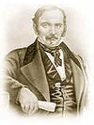
It was at this house that Prof. Rivail first receives information concerning his mission.
Notes:
<number>
1856 ﾐ 07 MAI) ﾐ Em Paris, na Franca, Allan Kardec recebe mensagem do Espirito Hahnemann, na residencia do Sr. Roustan, tendo como medium a Srta. Haphet, confirmando sua missao de codificar a nova doutrina.

Slide 3

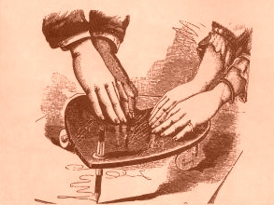
Psychography
At first, Kardec used a new mechanism called a basket-spinning top; it was a basket with a pencil in the center. This tool was used to receive the answers from the spirits about the reasons for the communications and the new teachings.
Julie and Caroline Baudin, two adolescents of 14 and 16 years of age respectively, were the mediums Kardec used more often in the beginning.
Notes:
<number>
In a brief historical journey regarding the European Spiritist Movement, Dr Luis explained that Portugal, Spain, France, England, Belgium, Russia and Sweden, amongst other European countries, had an appreciable number of adepts at the beginning of the twentieth century. But the two Great Wars greatly affected the foundations of European Spiritism and that, for the rest, in Portugal and Spain the dictatorships of Salazar and Franco almost extinguished what was still remaining in those countries and some Spiritists were even shot by orders of Franco.

Slide 4

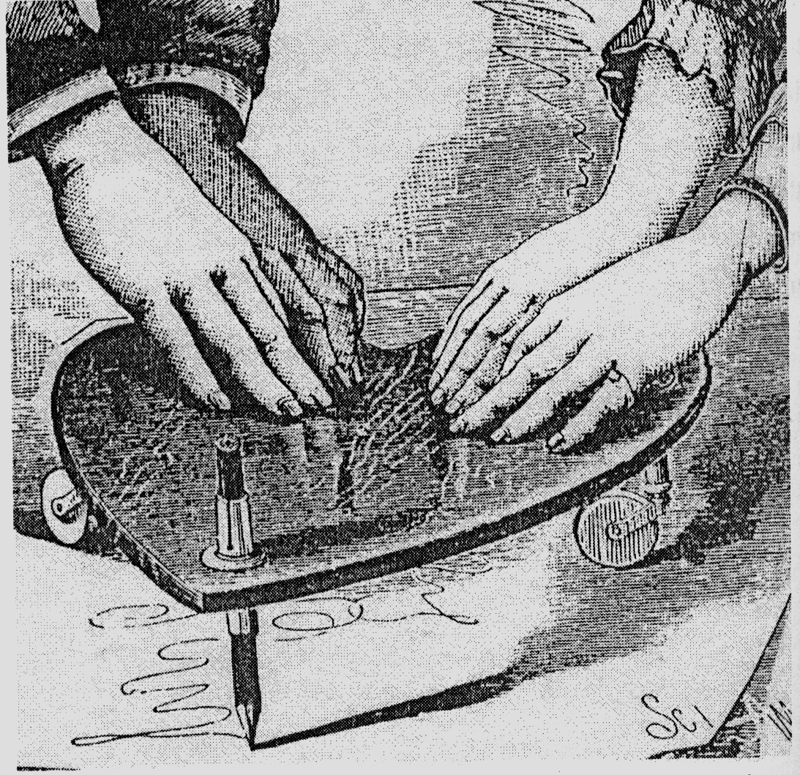
Indirect Direct
BASKETS OR PLANCHETTES (OUIJA) HAND
In time, the basket-spinning top became less useful and the mediums’ hands took its place - a phenomenon known as psychography.
“(...) THE BASKET ITSELF DOES NOT BECOME INTELLIGENT BUT ONLY SERVES AS AN INSTRUMENT FOR AN INTELLIGENCE ...” § The Mediums’ Book 157
Notes:
<number>
In a brief historical journey regarding the European Spiritist Movement, Dr Luis explained that Portugal, Spain, France, England, Belgium, Russia and Sweden, amongst other European countries, had an appreciable number of adepts at the beginning of the twentieth century. But the two Great Wars greatly affected the foundations of European Spiritism and that, for the rest, in Portugal and Spain the dictatorships of Salazar and Franco almost extinguished what was still remaining in those countries and some Spiritists were even shot by orders of Franco.

Slide 5
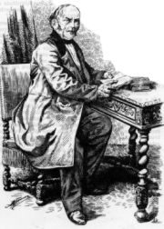
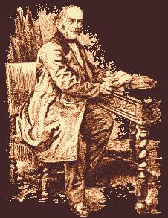
They asked Rivail to analyze and to organize over 50 notebooks of communications received by the mediums.
Carlotti Friedrich
Tiedeman - Professor of Zoology and Anatomy at the Heidelberg
Rene Taillandier - Rivail’s student and member of the Science Academy
Victorien Sardou - Dramaturge Pictographic Medium
Camille Flammarion –
Scientist/ Astrophysicist
Notes:
<number>
He drew up a series of progressive questions in relation to the various problems of human life and the universe in which we find ourselves, and submitted them to his unseen communicators, receiving their answers to the same through the instrumentality of the two young mediums. His conversations with the invisible intelligences completely revolutionized his ideas and convictions. He published them as Le Livre des Esprits (The Spirits' Book), called by many today "the Bible of Spiritualism"
0. Entregaram a Kardec 50 cadernos de comunicações recebidas em 5 anos, pois conheciam bastante o seu poder de síntese e de ordenação.
0. As sessões então passaram a ter um objetivo determinado e Kardec, propunha aos Espíritos uma série de perguntas já preparadas e metódicamente dispostas. As perguntas versavam sobre Filosofia, Psicologia e natureza do mundo invisível.

Slide 6
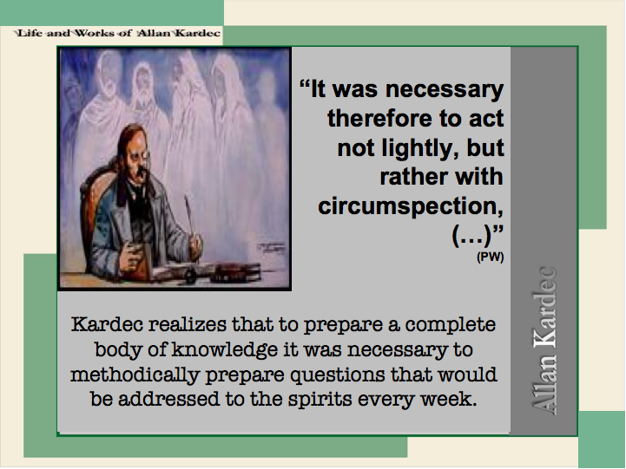
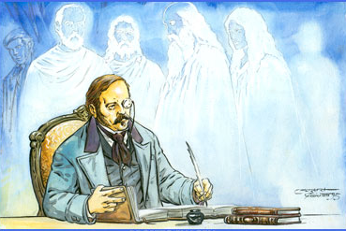
Notes:
<number>

Slide 7

“(...) “receiving communications from almost a thousand serious Spiritist Centers” (GAS, Intro.)
Contacts described in Kardec's printed works:
  37 countries:
  Europe (18),
  America (8),
  Africa (5),
  Asia (6)
  268 cities
  (Fernandes, 2004)
Notes:
<number>
A conselho dos próprios Espíritos, outros médiuns, mais de 10, foram utilizados para confirmação das orientações espirituais.

Slide 8
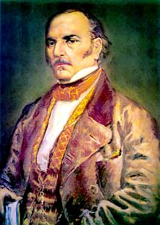
Universal Control of the Spiritist Principles
They are spread from pole to pole
They are brought through many different mediums
It does not depend on only one person
There is no nationality
It does not stem from any known religion
No social class
They are transmitted gradually by the enlightened Spirits.
From The Gospel According to Spiritism
Notes:
<number>
In a brief historical journey regarding the European Spiritist Movement, Dr Luis explained that Portugal, Spain, France, England, Belgium, Russia and Sweden, amongst other European countries, had an appreciable number of adepts at the beginning of the twentieth century. But the two Great Wars greatly affected the foundations of European Spiritism and that, for the rest, in Portugal and Spain the dictatorships of Salazar and Franco almost extinguished what was still remaining in those countries and some Spiritists were even shot by orders of Franco.

Slide 9

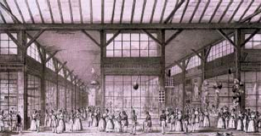
“By comparing and matching all the answers, which were coordinated, classified and many times revised in the silence of meditation, it was then that I compiled the first edition of The Spirits’ Book.”
Notes:
<number>

Slide 10

Interesting Facts
No one wanted to invest in the publication of The Spirits’ Book.
First Edition = 1,200 copies
Kardec published it with his own resources.
The success of the publication was immediate and unexpected.
It became a best-seller in its category.
La Table, le Livre et les Esprits
page 30
Marion Aubree and
François Laplantine
The Spirits’ Book was reprinted 15 times while Kardec was alive.”
Notes:
<number>

Slide 11
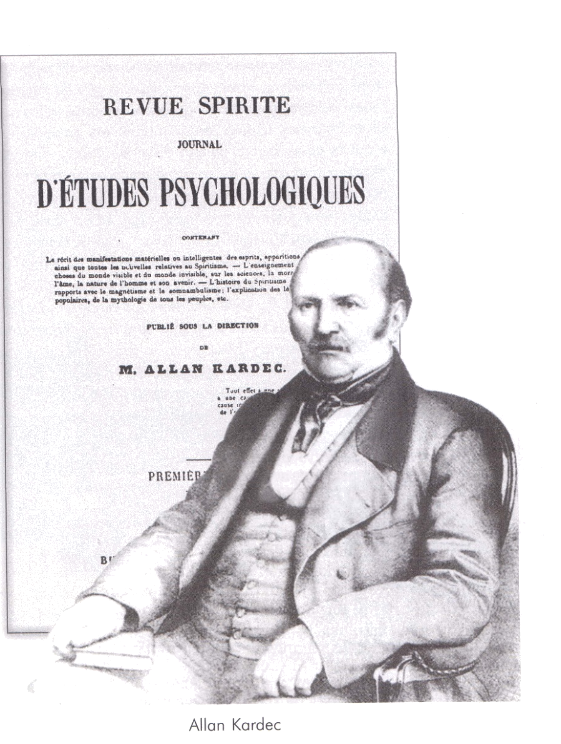

The Parisian Society for Spiritist Studies and The Spiritist Magazine
In the year of 1858, right after the publication of The Spirits Book, Allan Kardec founded The Parisian Society for Spiritist Studies [Société Parisienne des Études Spirites] and publishes the first issue of the The Spiritist Magazine [La Revue Spirite], a Journal for Psychological Studies.
Allan Kardec was the Editor in Chief of the Spiritist Review until his death on March 31, 1869. Thus, the twelve volumes of the Spiritist Magazine is an integral part of the CODIFICATION and play a great role in it.
Notes:
<number>
In a brief historical journey regarding the European Spiritist Movement, Dr Luis explained that Portugal, Spain, France, England, Belgium, Russia and Sweden, amongst other European countries, had an appreciable number of adepts at the beginning of the twentieth century. But the two Great Wars greatly affected the foundations of European Spiritism and that, for the rest, in Portugal and Spain the dictatorships of Salazar and Franco almost extinguished what was still remaining in those countries and some Spiritists were even shot by orders of Franco.

Slide 12
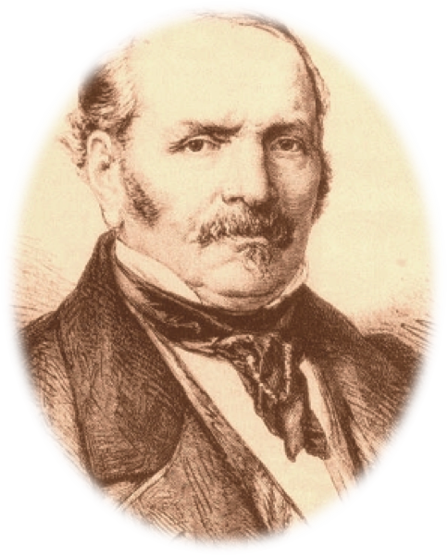
Allan Kardec
From his first contact with the spirits in 1855, Kardec spent 14 years organizing Spiritism, which he would finish on March 31, 1869, the day he passed away due to an aneurism.
Notes:
<number>
In a brief historical journey regarding the European Spiritist Movement, Dr Luis explained that Portugal, Spain, France, England, Belgium, Russia and Sweden, amongst other European countries, had an appreciable number of adepts at the beginning of the twentieth century. But the two Great Wars greatly affected the foundations of European Spiritism and that, for the rest, in Portugal and Spain the dictatorships of Salazar and Franco almost extinguished what was still remaining in those countries and some Spiritists were even shot by orders of Franco.

Slide 13
Summary of the Basic Books of Spiritism
Notes:
<number>

Slide 14

The Spirits’ Book
Published on 4/18/1857, it is the main book of Spiritism. It can be considered the doctrine’s backbone because it supports all other doctrinal books. It is divided in four parts:
  The First Cause
  The Spirit World
  Ethical Laws
  Hopes and Solace
It contains 1,019 questions that Kardec asked the superior spirits who were responsible for bringing Spiritism to humanity.
“What is God?”
“Where do we come from?”
“Where are we going?”
“What are we doing on earth?”
These are some of the questions answered by Spirit of Truth’s group.
Notes:
<number>

Slide 15

The Mediums’ Book
Published on 1/15/1861. It contains the benefits and dangers of mediumship, i.e., it is about the channel that connects incarnated people to the spiritual world.
It shows that although all human beings have this ability, there are those who have it in a broader sense.
Kardec and the superior spirits discuss how this subtle faculty allows a person to contact the spirits without being harmed by malicious entities and losing control of mediumship.
Notes:
<number>

Slide 16

The Gospel According to Spiritism
Published on 4/15/1864, this book can be understood as the moral part of the Spiritist Doctrine. In this book Kardec and superior spirits comment in an easily understood language, upon the main passages of Jesus’ life.
They explain his parables and show the grandiosity of the Master’s teachings and also give important advice about our daily conducts as we face life’s difficulties and doubts.
Notes:
<number>

Slide 17

Heaven and Hell
Kardec published this book on 8/1/1865. Through invocation of spirits from all social classes, beliefs, and levels of development he describes their arrival in, and experience of, life in the spirit world after death.
Former royalty, farmers, religious people, assassins, ignorant and intellectual people, these are but a few of those who came back to tell about what they encountered in the world of spirits after the terrestrial journey, and how they envisioned their future lives.
Notes:
<number>

Slide 18

Genesis
In this book published on 1/6/1868, Kardec explains the Biblical Genesis, and how the
Universe was formed, demonstrating its rationality when compared to scientific knowledge, without the allegories of the time when it was written.
Miracles are explained by the laws of nature as products of alterations in the energy that surround us.
Finally, Kardec causes religion and science to stand side by side, thereby strengthening the faith of those who believe in God.
Notes:
<number>

Slide 19

Notes:
<number>

Slide 20

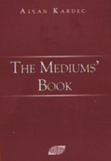
1857 – The Spirits’ Book
1858 - ‘La Revue Spirite’ Journal of Psychological Studies
1861 – The Medium’s Book
1864 - The Gospel According to Spiritism
1865 – Heaven and Hell
1868 – Genesis
1890 – Posthumous Work
1868
Notes:
<number>

Slide 21
Questions
List the books that compose the Spiritist Codification by name and year of publication.
The Gospel Explained by Spiritism; The Medium’s Book; Heaven and Hell; The Spirits’ Book; Genesis – 1861; 1868; 1857; 1864; 1865
Notes:
<number>

Slide 22
Major objective of Spiritism
“Spiritism’s aim is to help humankind improve their moral and intellectual progression.”
The Spirits’ Book, question 799
Notes:
<number>
In a brief historical journey regarding the European Spiritist Movement, Dr Luis explained that Portugal, Spain, France, England, Belgium, Russia and Sweden, amongst other European countries, had an appreciable number of adepts at the beginning of the twentieth century. But the two Great Wars greatly affected the foundations of European Spiritism and that, for the rest, in Portugal and Spain the dictatorships of Salazar and Franco almost extinguished what was still remaining in those countries and some Spiritists were even shot by orders of Franco.

Slide 23
Books written by Allan Kardec
Le Livre des Esprits, 1ère édition - 18/04/1857);
Revue Spirite: 01/04/1858);
Instruction Pratique sur les Manifestations Spirites, édition unique - 1858;
Revue Spirite: 01/01/1859);
Qu'est-ce que le Spiritisme – from 08/1859 to 02/1861
Revue Spirite: 01/1860
Lettre sur le Spiritisme - 09/1860
Revue Spirite: année 1861
Le Livre des Médiums - 15/01/1861
Revue Spirite: 01/01/1862;
Le Spiritisme a sa plus simple expression - 15/01/1862
Réponse à l'adresse des Spirites Lyonnais à l'occasion de la nouvelle année (02/1862);
Voyage Spirite en 1862 - (12/1862
Revue Spirite: année 1863
Revue Spirite: année 1864
Imitation de L'Évangile selon le Spiritisme - 06/04/1864
Résumé de la Loi des Phénomènes Spirites - 04/1864
Auto-da-fé de Barcelone, reprografia [conjunto de técnicas que permitem reproduzir um documento] editada por Kardec (12/1864)
Revue Spirite: année 1865
Le Ciel et l'Enfer ou La Justice Divine selon le Spiritisme - 01/08/1865
Revue Spirite: année 1866 –
Recueil de priéres spirites (Coleção de Preces Espíritas) - 1866
Revue Spirite: année 1867 –
Étude sur la Poésie Médianimique (Estudo sobre a Poesia Medianímica - 01/1867
Revue Spirite: année 1868
La Genèse, les Miracles et les Prédictions selon le Spiritisme - 06/01/1868
Caractère de la Révelation Spirite - 02/1868
Revue Spirite: année 1869
Catalogue Raisonné des Ouvrages pouvant servir à fonder une Bibliothèque Spirite - 03/1869
Oeuvres Posthumes - 1890
Notes:
<number>

