Slide 1




Notes:
<number>

Slide 2


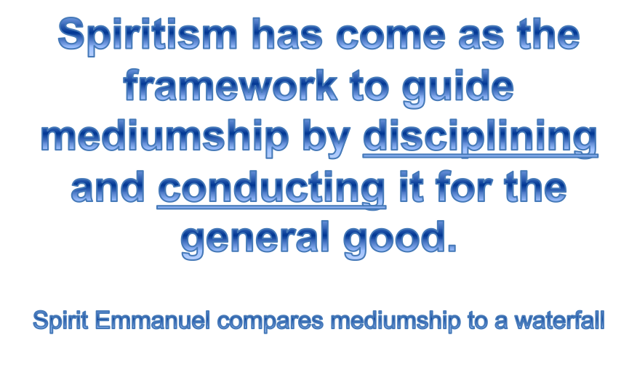

Slide 3

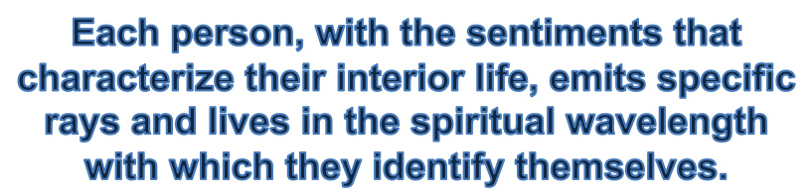


Slide 4
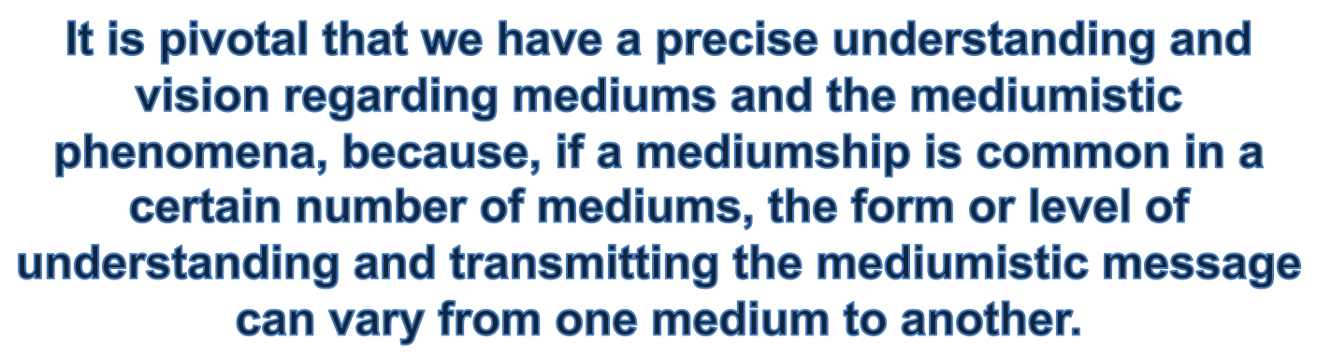







Slide 5

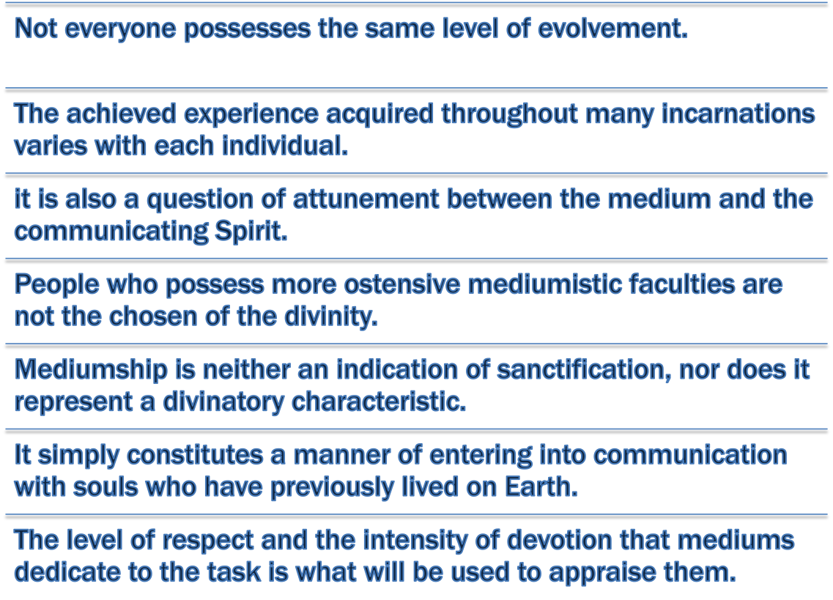
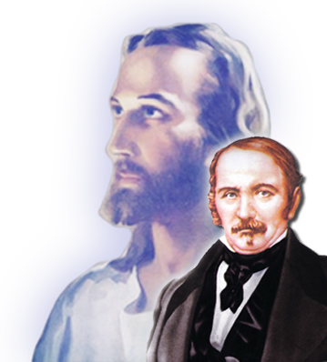

Slide 6



Slide 7



Slide 8
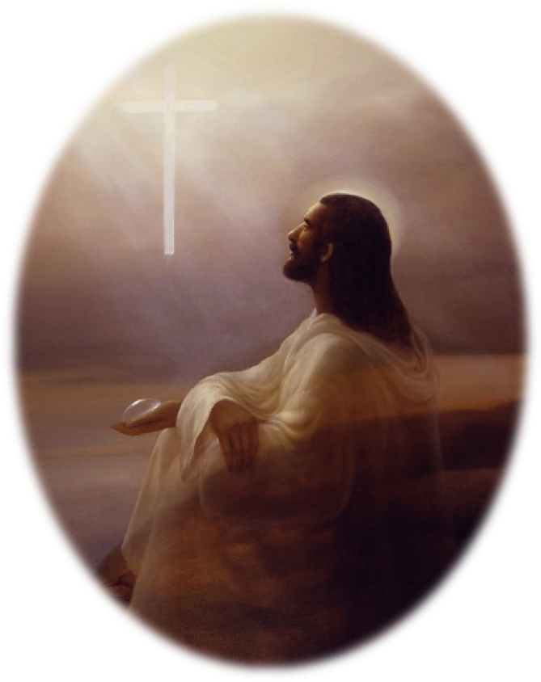
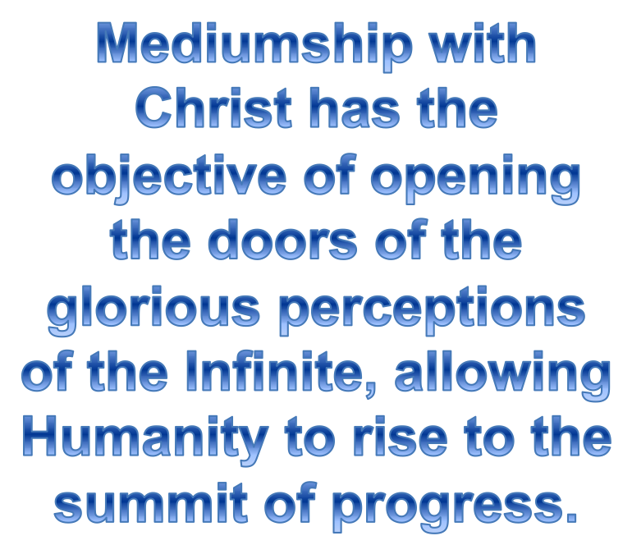
In the Domain of Mediumship by André Luiz/Francisco C. Xavier.

Slide 9
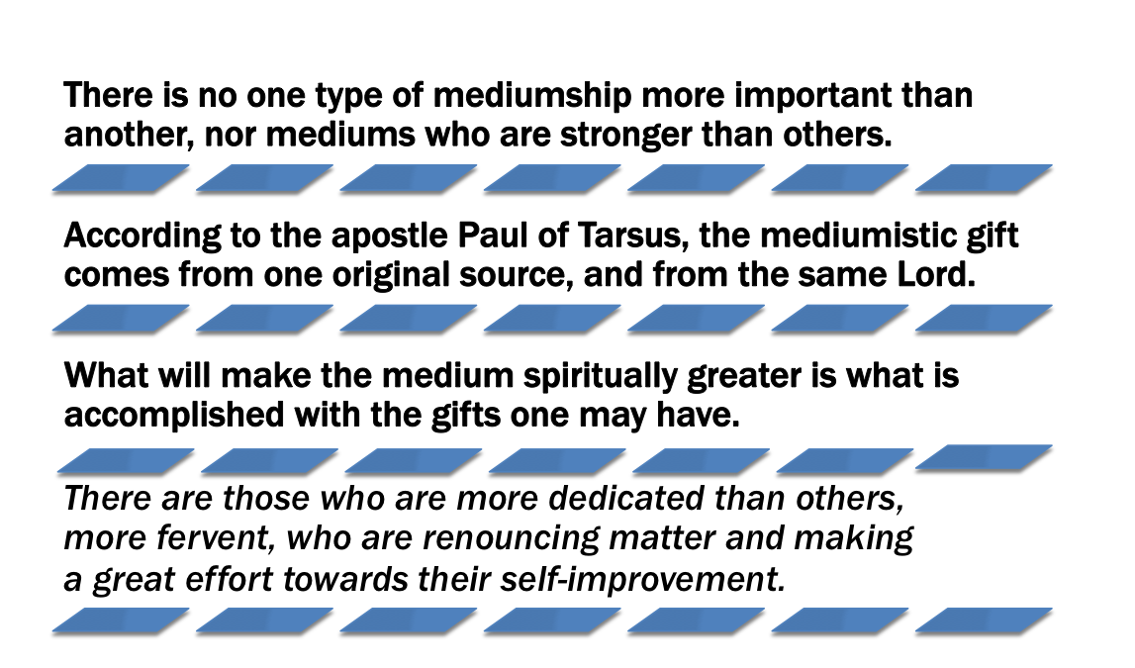


Illustration kindly provided by the “Image Project” (Projeto Imagem)
http://www.projetoimagem.com.br/
Guidelines for Safety by Divaldo Pereira Franco & Raul Teixeira

Slide 10
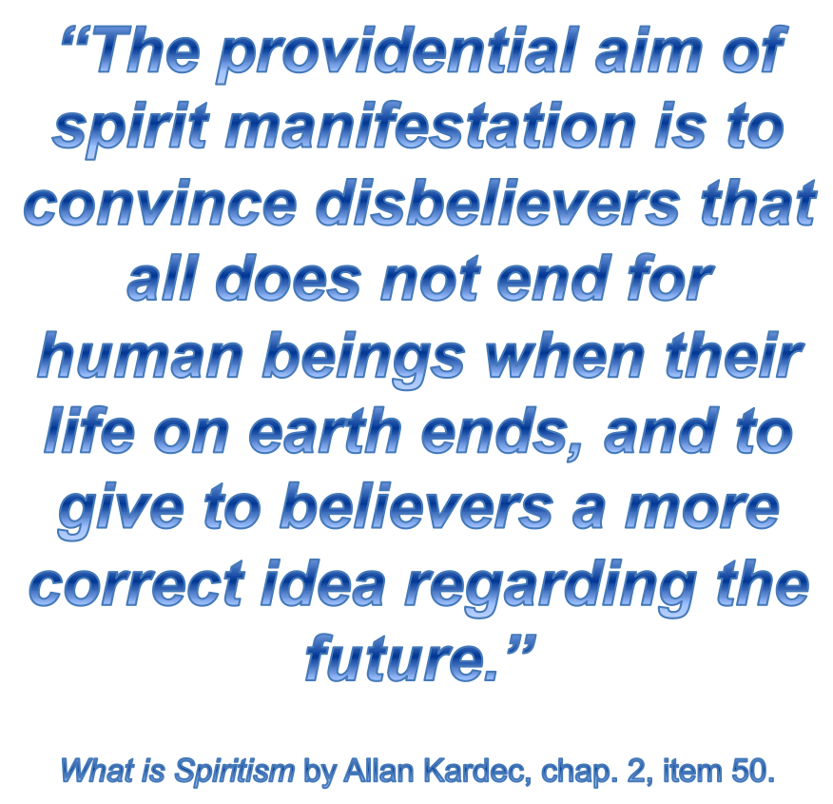


Slide 11

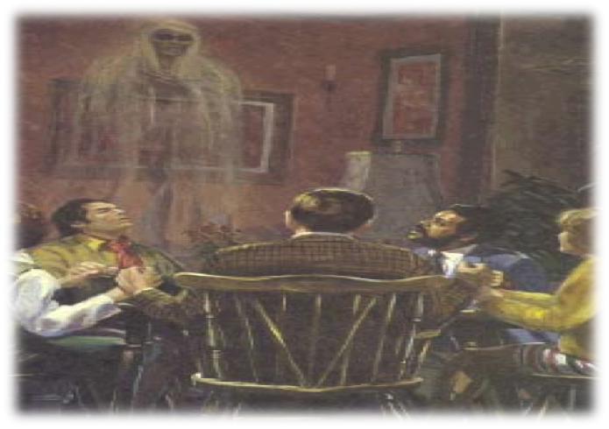


Illustration kindly provided by the “Image Project” (Projeto Imagem)
http://www.projetoimagem.com.br/

Slide 12
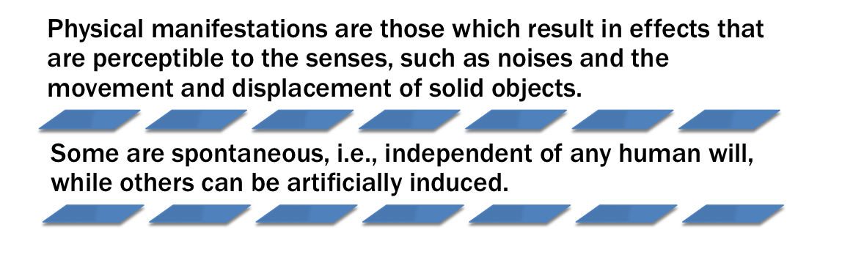

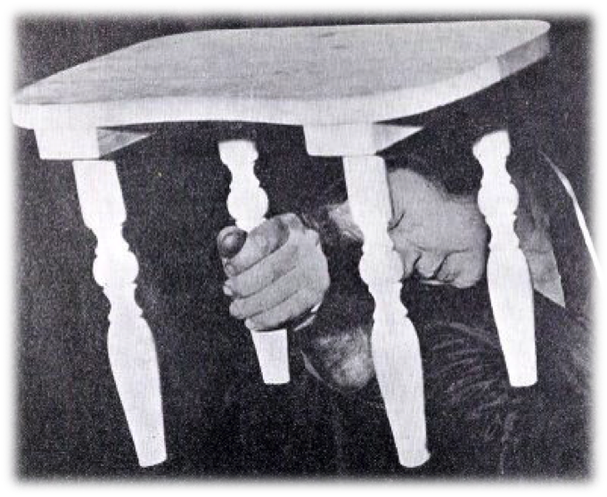
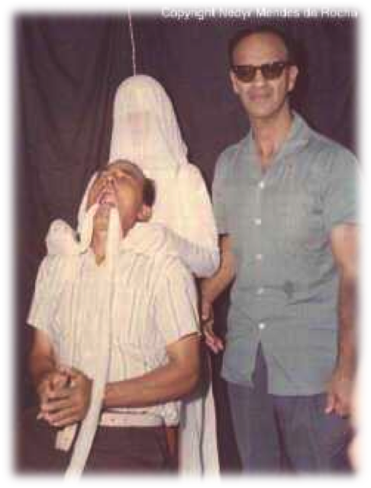
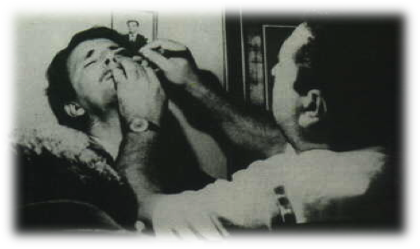

Photograph of a materialized hand and the entranced Mina ‘Margery’ Crandon during a seance.

Slide 13

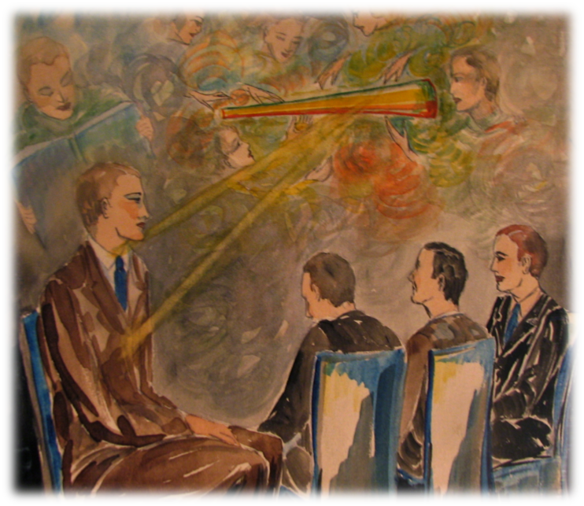
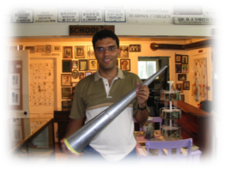
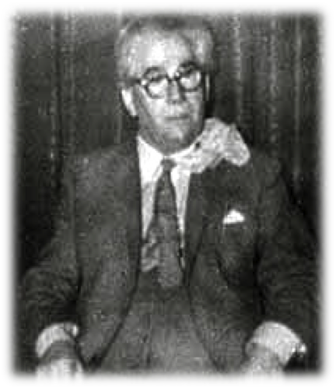
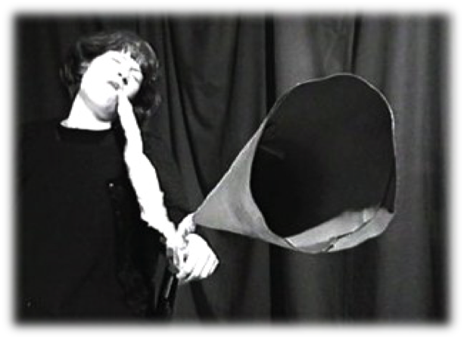
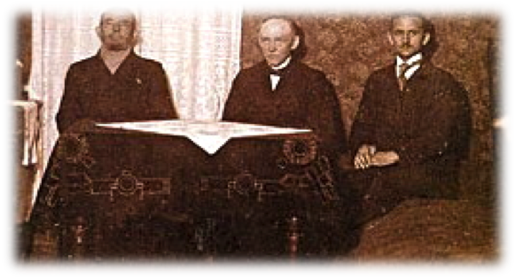
Ectoplasmic larynx on the body of the medium Leslie Flint)
Illustration kindly provided by the “Image Project” (Projeto Imagem)
http://www.projetoimagem.com.br/
Medium Kathleen Goligher produces ectoplasm around a trumpet that will be used to form an etheric amplifier.
Ectoplasmic larynx on the body of the medium Leslie Flint)
GEORGE VALIANTINE
The great medium of pneumatophony

Slide 14
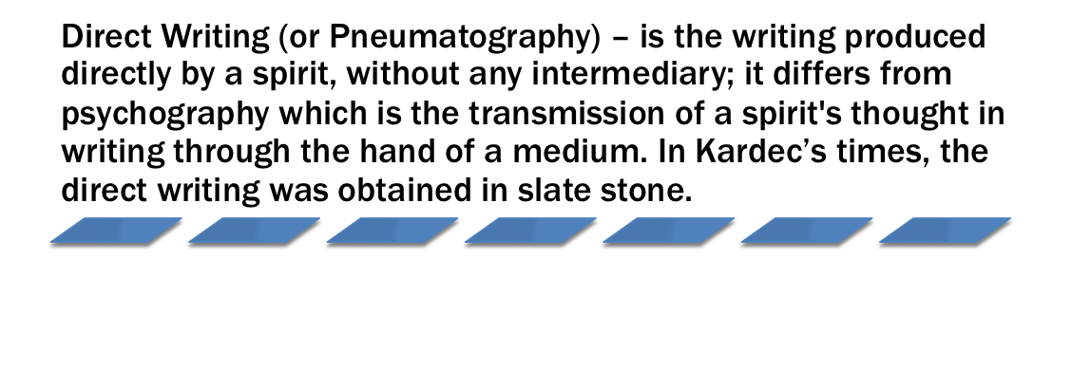
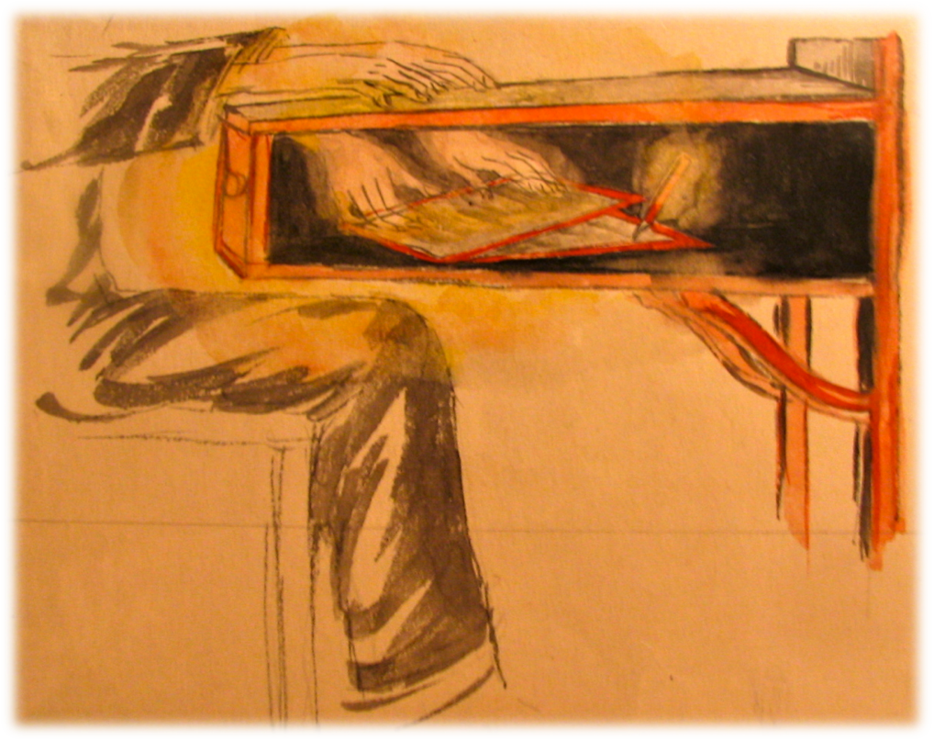
Illustration kindly provided by the “Image Project” (Projeto Imagem)
http://www.projetoimagem.com.br/

Slide 15
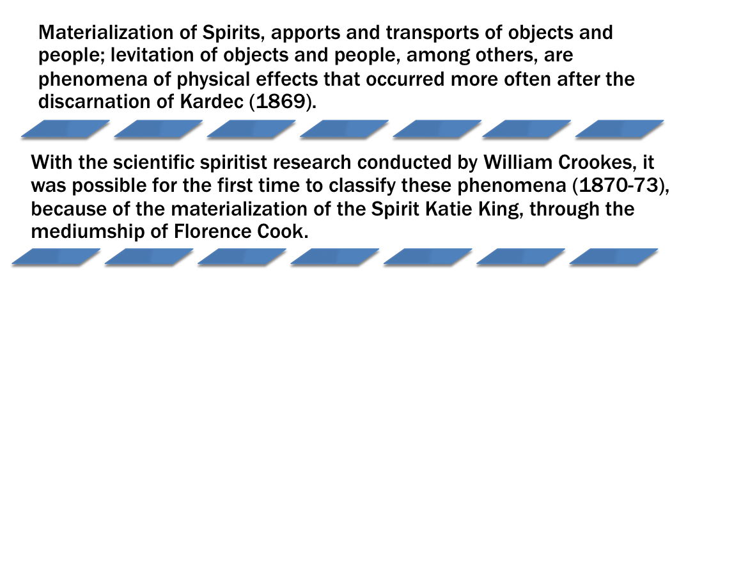
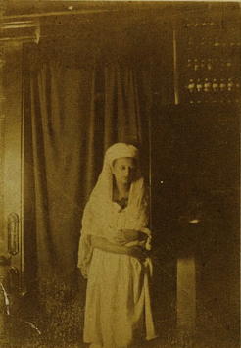
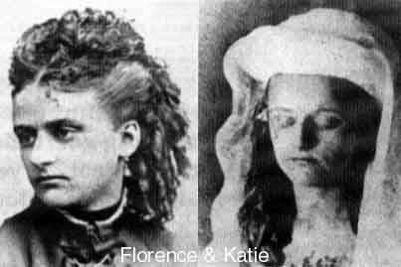
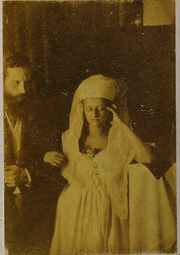
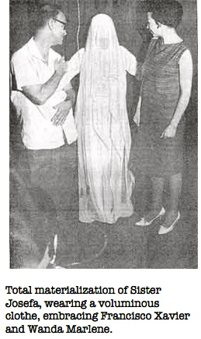

Slide 16

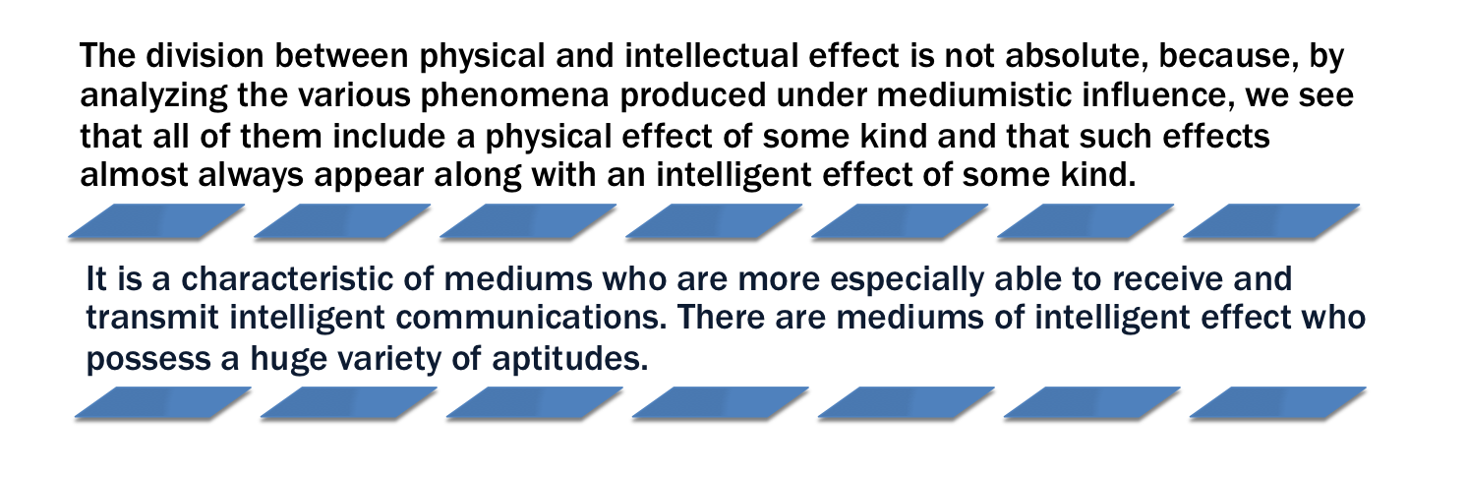
Illustration kindly provided by the “Image Project” (Projeto Imagem)
http://www.projetoimagem.com.br/

Slide 17
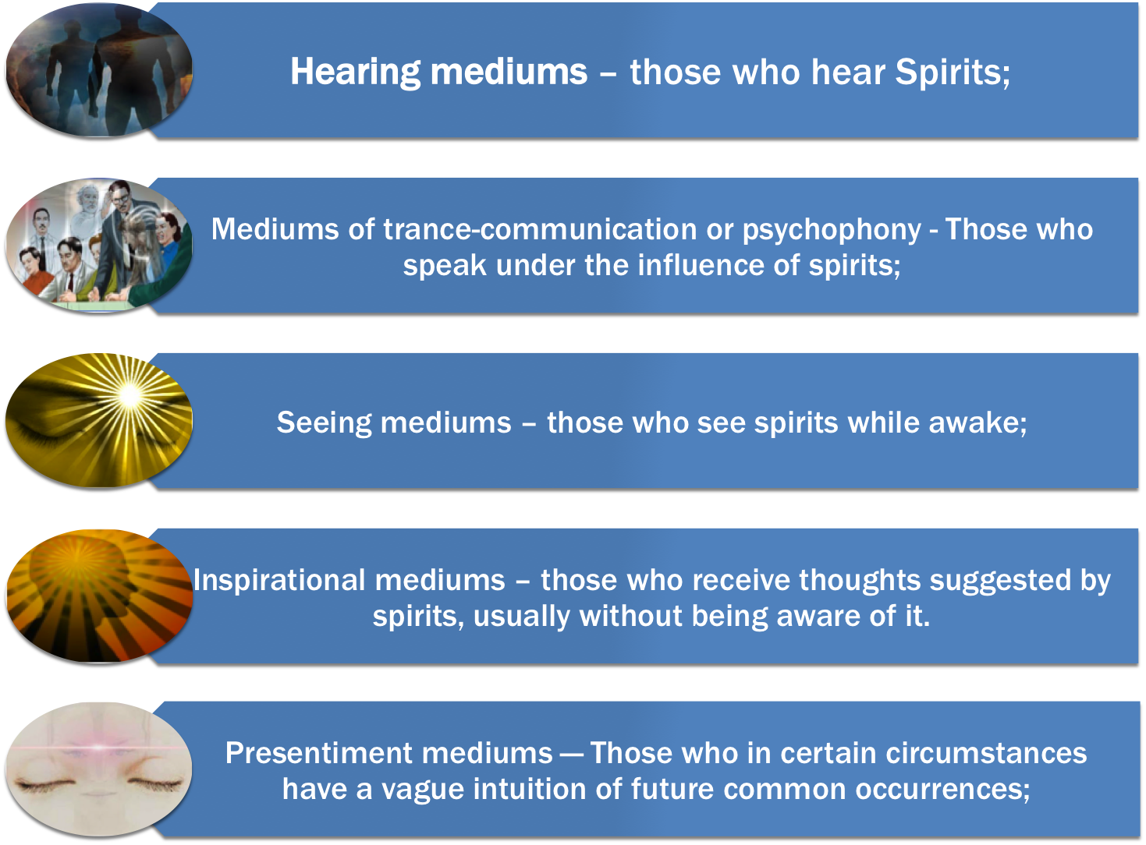
Notes:
<number>
Life is a constant coming and going from one sphere to the other. Wherever there is inhabited land on our planet, there must consequently be a steady stream of those return­ing to the spiritual world, just as there is of those coming in to reincarnate. Traditional religions, bent on their intentions to frighten into conversion or to hold power through fear, often full of rituals and mysticism, have done little to clarify the situation called “death”. Rather they have only taught delusions, which have left the vast majority of the earth population totally unprepared for this normal and natural event. The orthodox teachings of heaven or eternal damnation in hell, of sleeping till the final judg­ment day, have done nothing to help human anxiety; nor has it done anything to prepare people for what they may actually expect on their return to their spiritual homeland.

Slide 18


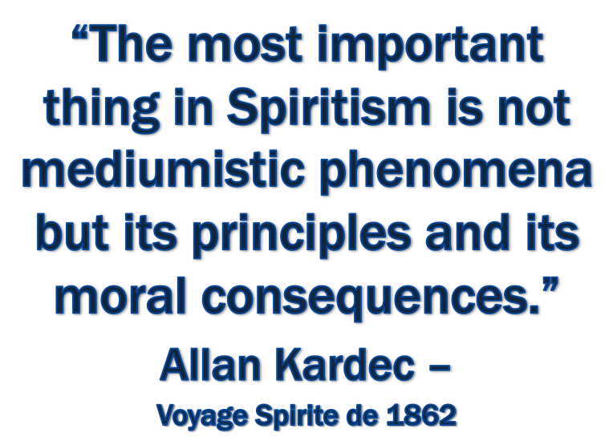
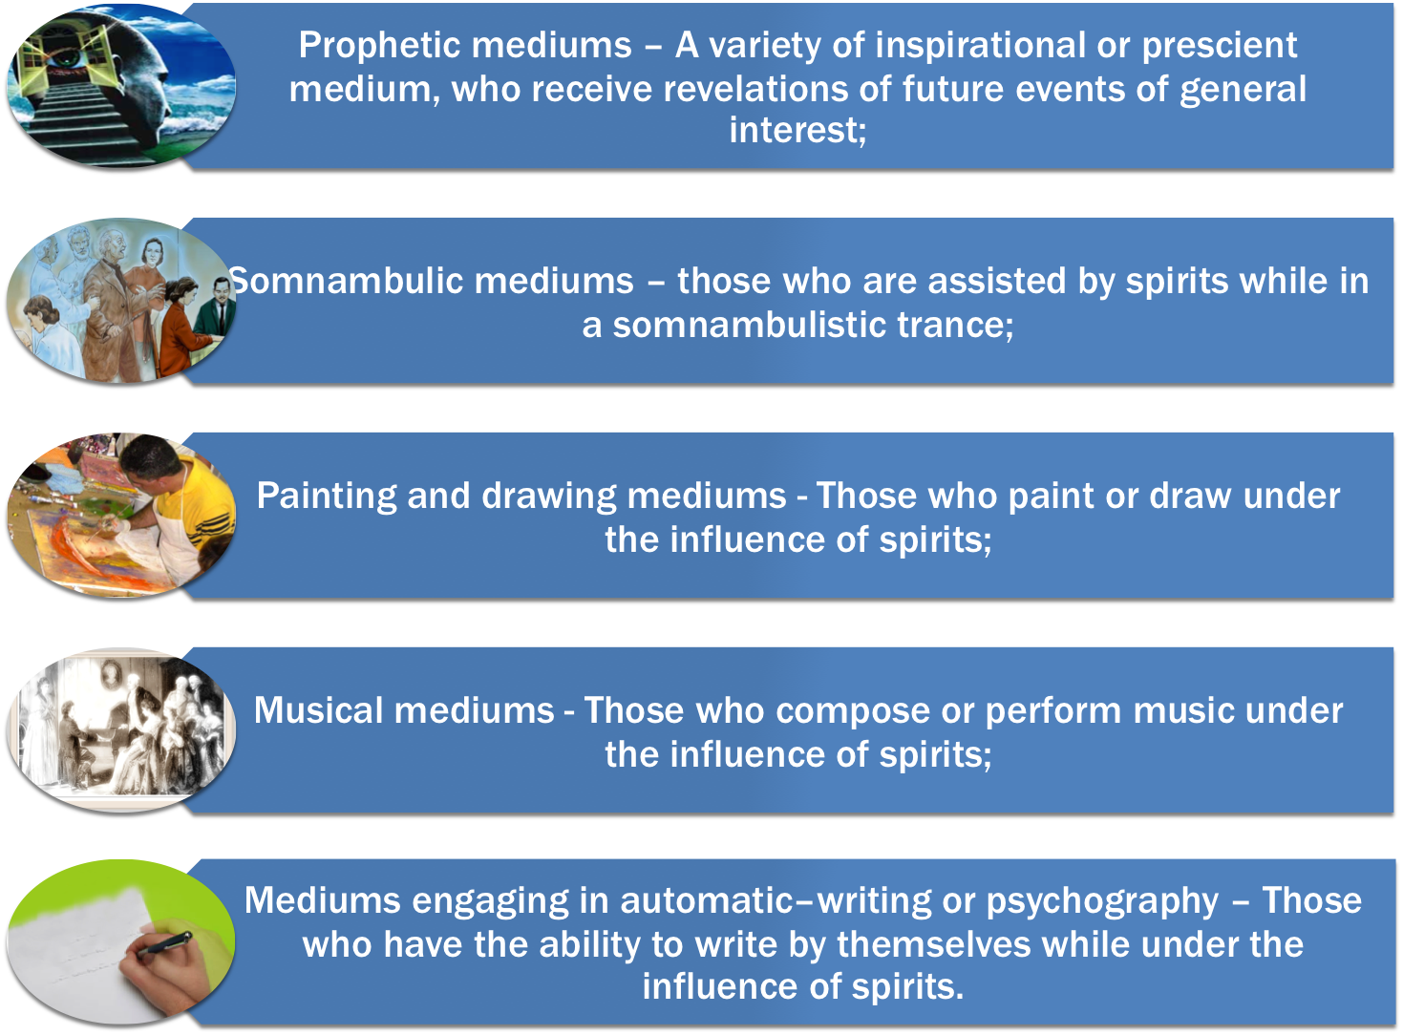
Notes:
<number>

Slide 19

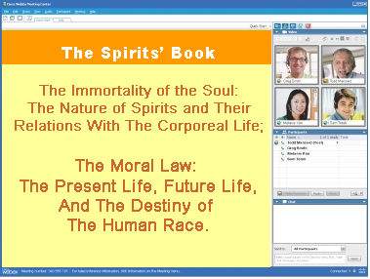


UNITED STATES SPIRITIST COUNCIL
Visit our website for
more information:
www.Spiritist.us

