Slide 1
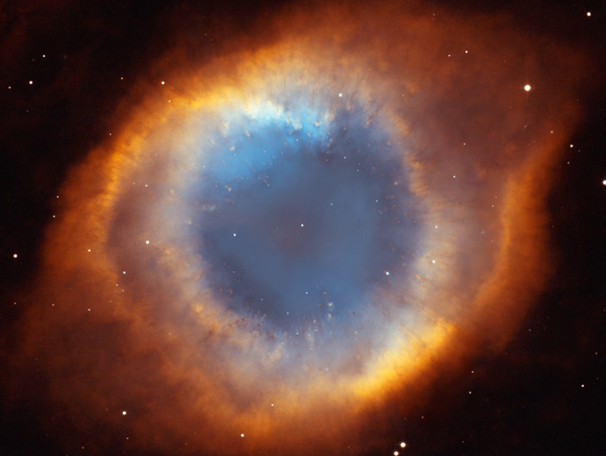

INTRODUCTION TO SPIRITISM
LESSON 4
Fundamentals of Spiritism
God - The First Cause
2010 © United States Spiritist Council
Notes:
<number>

Slide 2
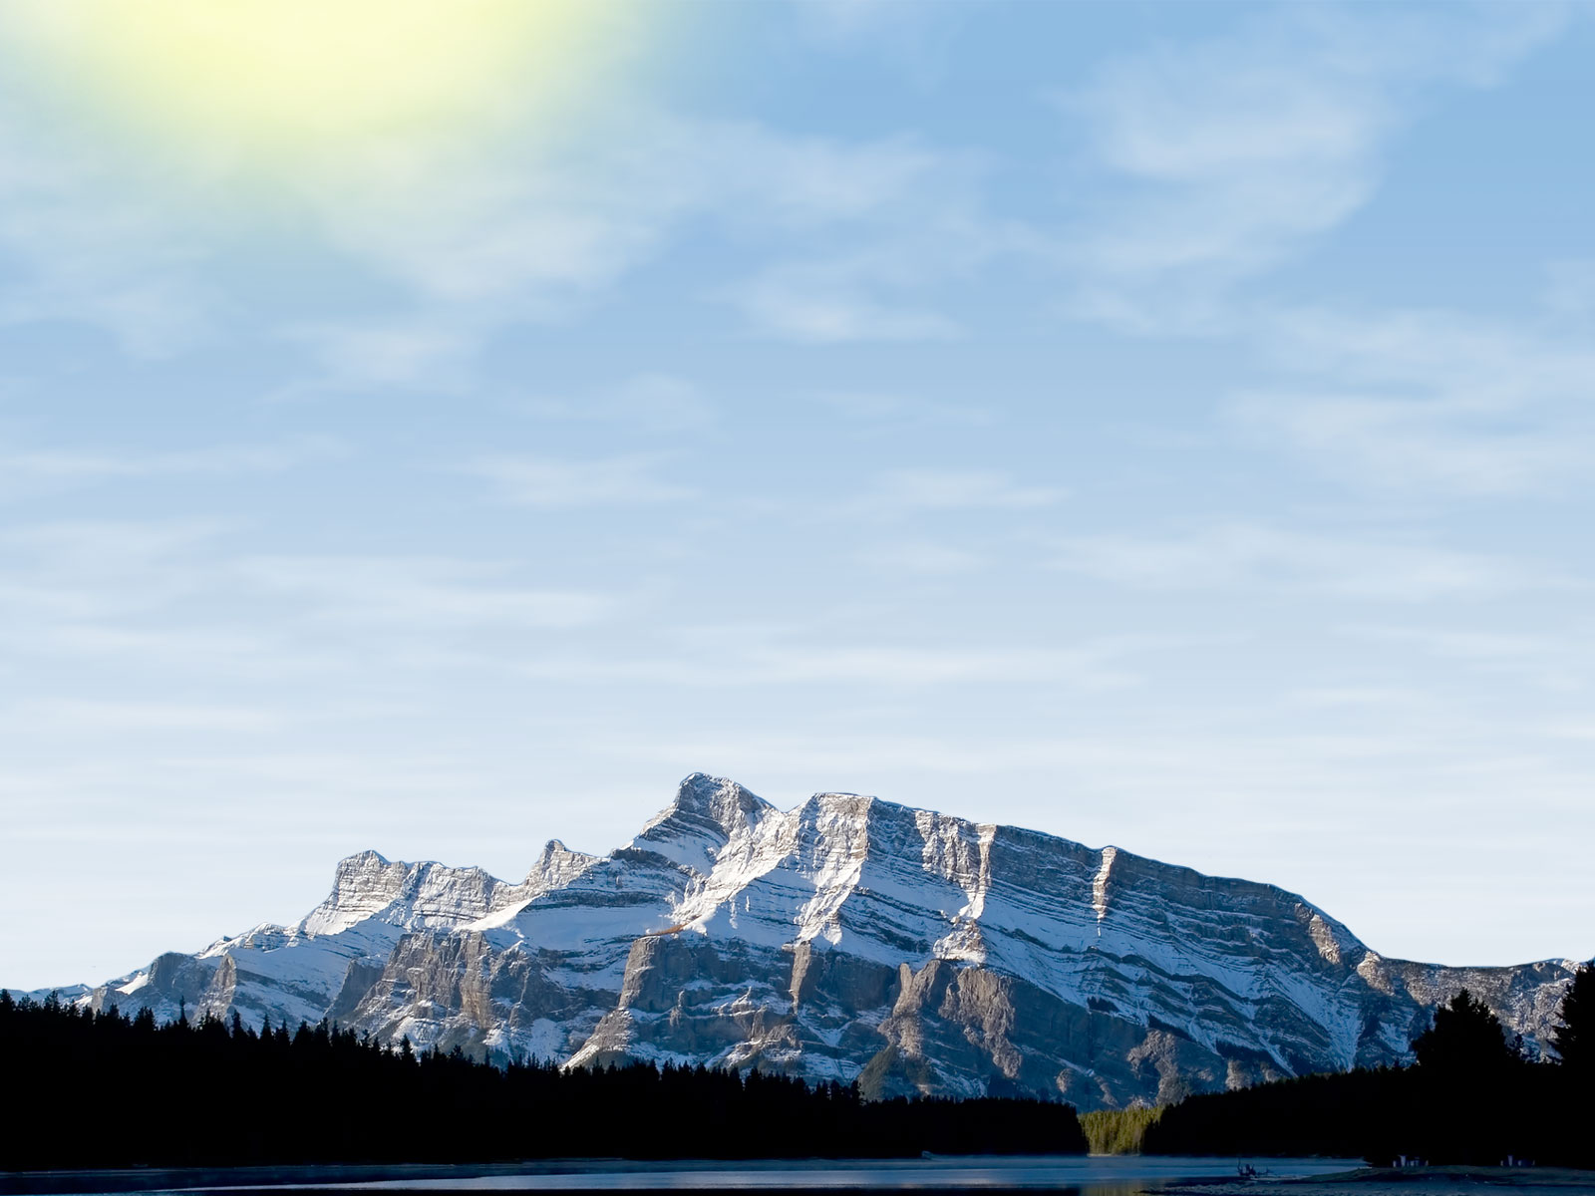
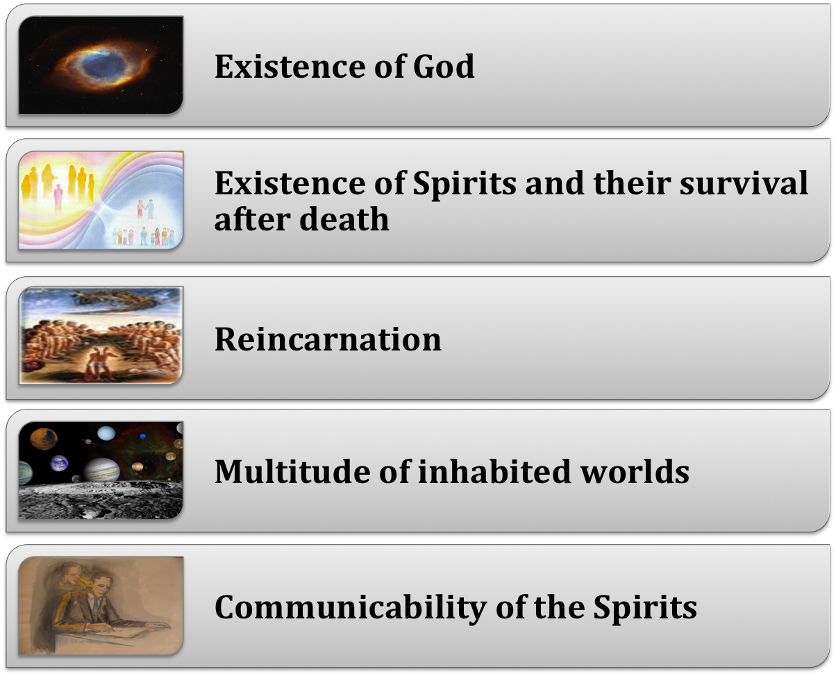
Fundamentals of Spiritism
Notes:
<number>

Slide 3
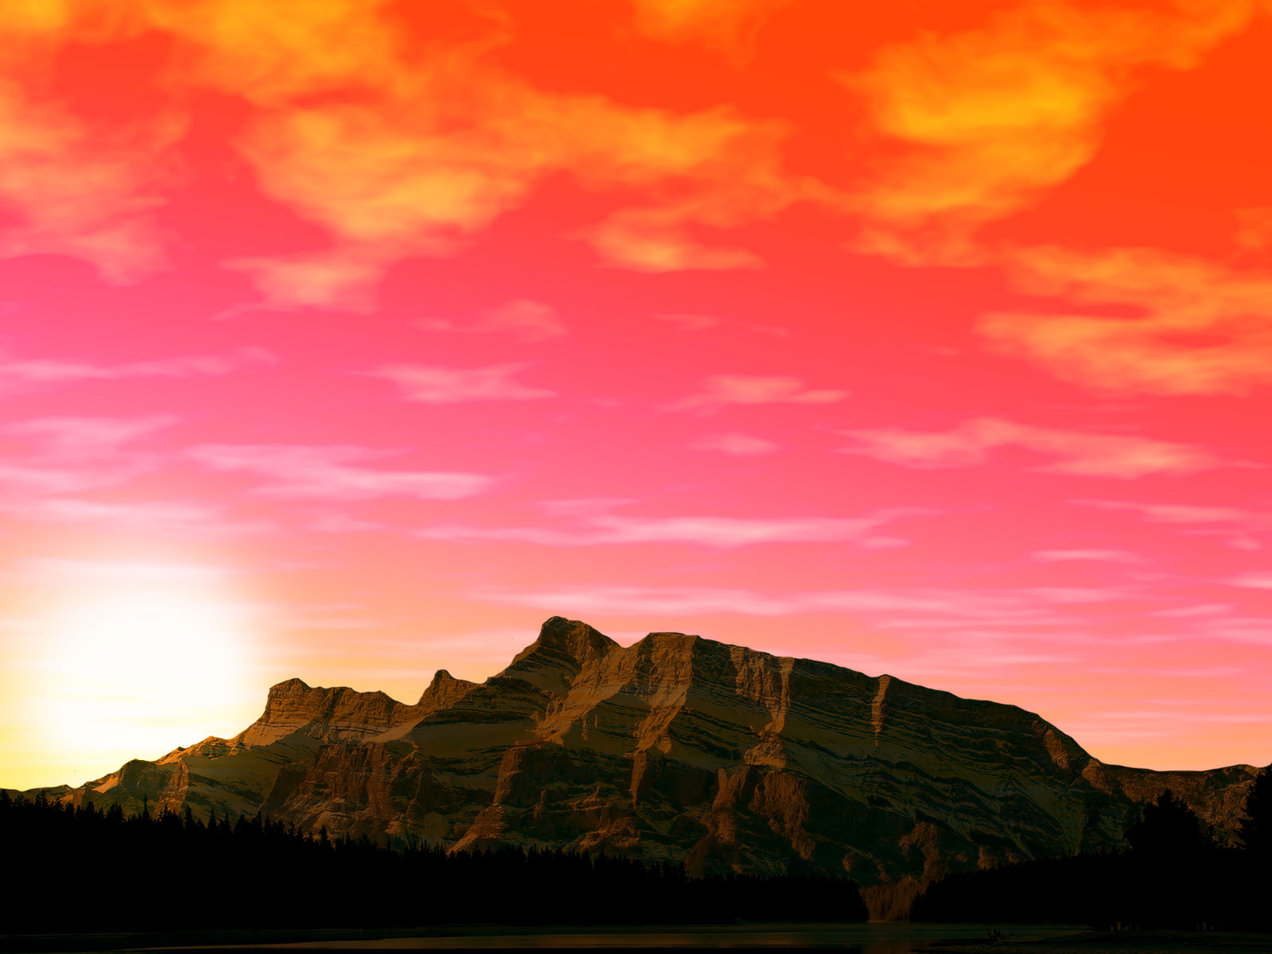
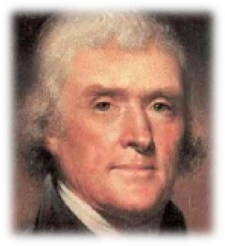
United States Declaration of Independence
Throughout the era of humankindwe see people encountering, accepting or renouncing the conception of God.
We hold these truths to be self-evident, that all men are created equal, that they are endowed by their Creator with certain unalienable Rights, that among these are Life, Liberty and the pursuit of Happiness.
Notes:
<number>

Slide 4
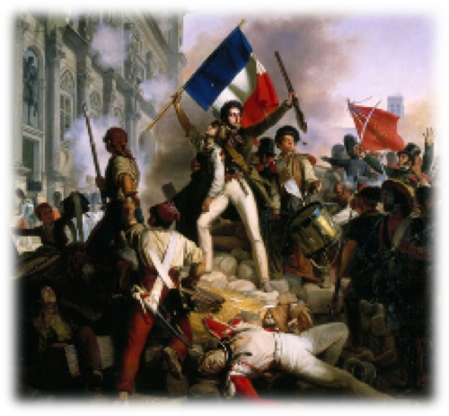
Declaration of the Rights of Man - 1789
Approved by the National Assembly of France, August 26, 1789
In this document basic human rights were stated as coming from the state government rather than coming from God as traditional Catholic France has always believed.
“France should renounce God.”
Pierre Gaspar Schoumetre in 1793, at the Notre Dame Cathedral, in Paris
In 1802, Napoleon Bonaparte restored the idea of God in France.
Notes:
<number>

Slide 5
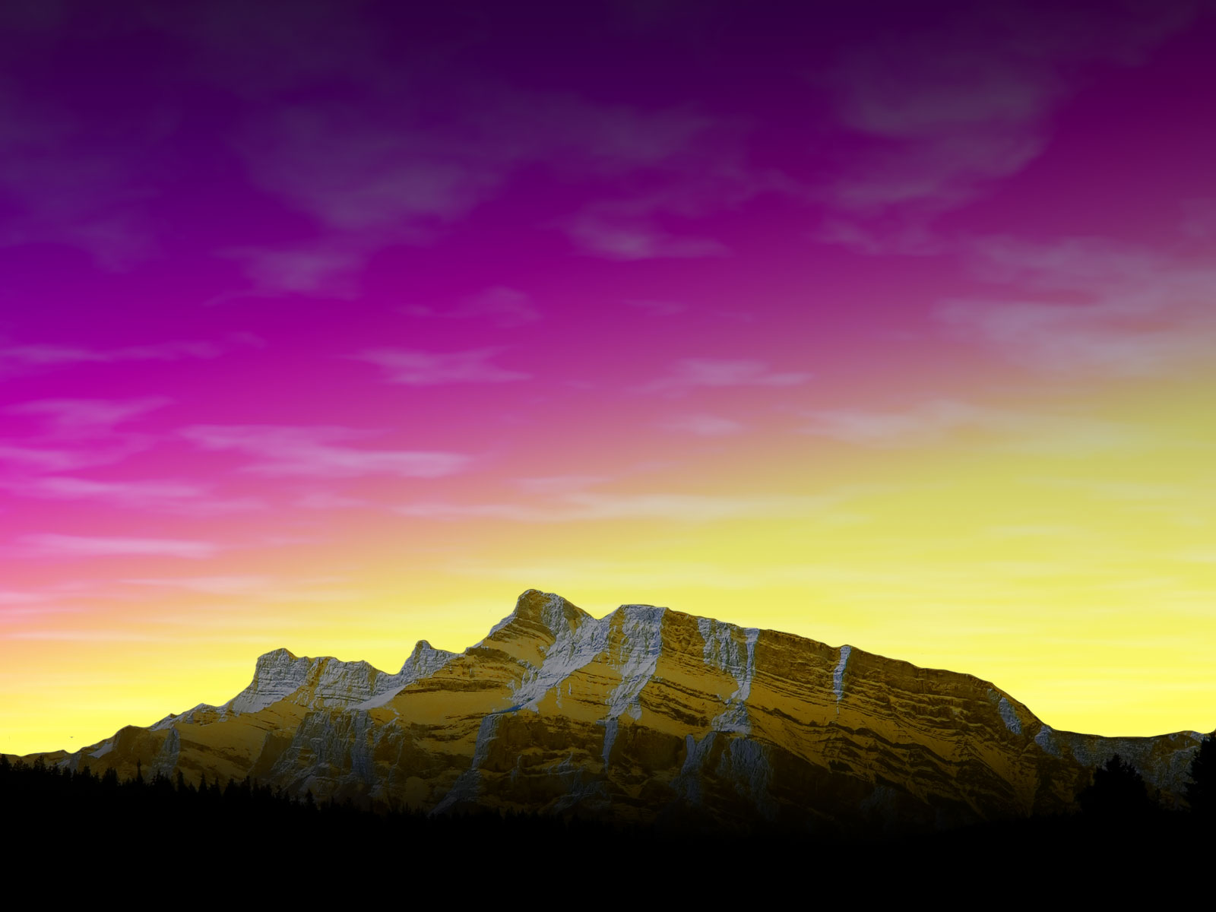
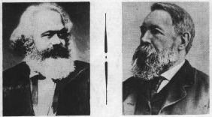
Manifesto
of the Communist Party 1848
It outlines the theory of the class struggle, and of the revolutionary role of the proletariat. Stating the historical materialism, they definitely renounced God, once again in humankind history.
  Karl Marx and Frederick Engels
Notes:
<number>

Slide 6
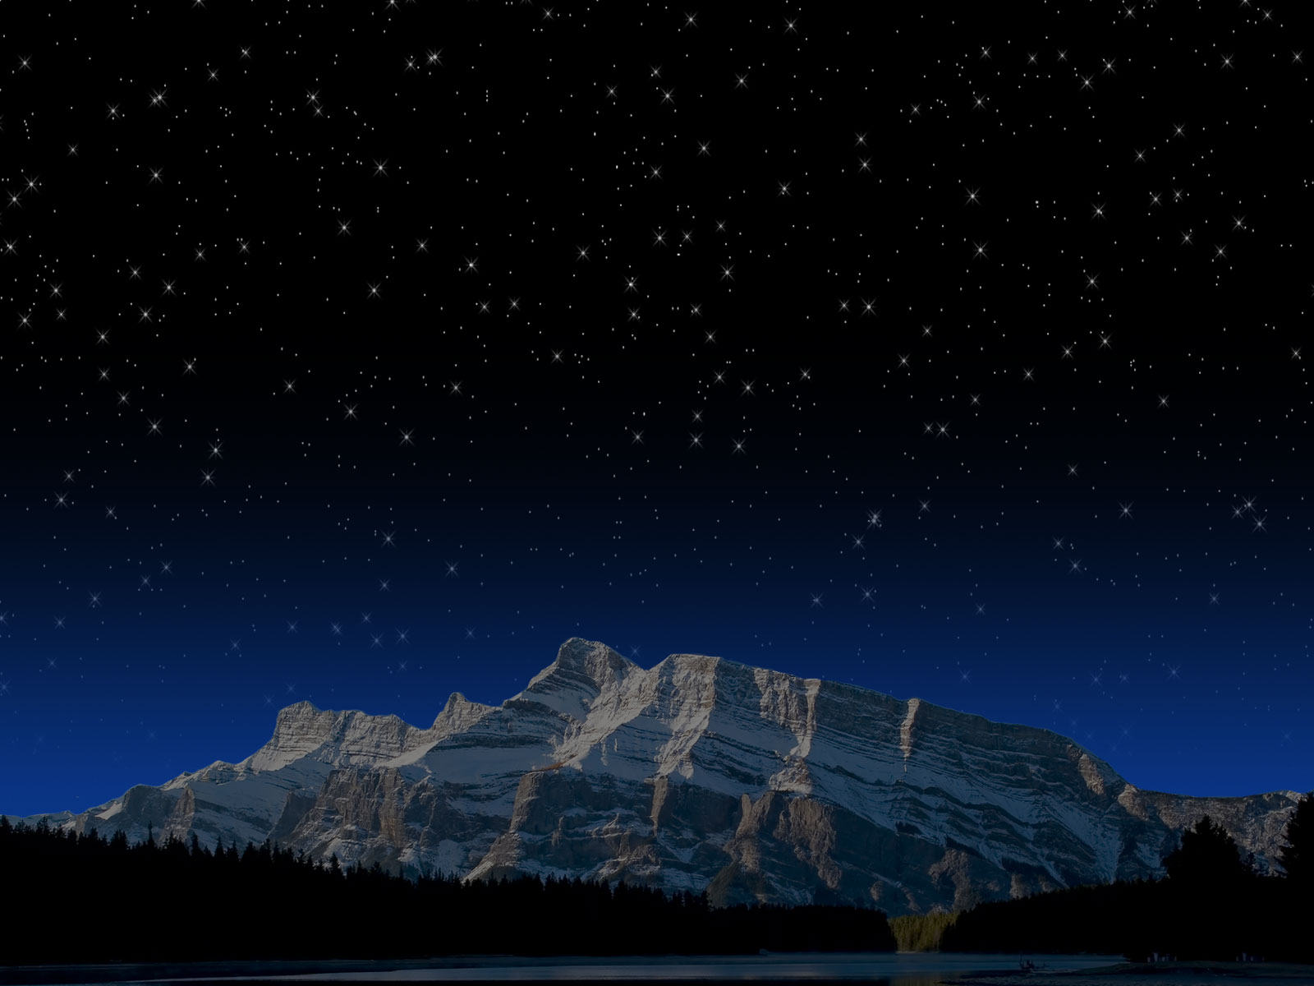
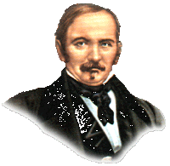
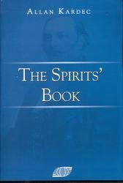

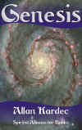
Spiritism - The Spirits’ Book
In 1857, Prof. Rivail, in France, the great pedagogue, disciple of Johann Pestalozzi, published a book that would definitely place God as the basis of everything.
Notes:
<number>

Slide 7
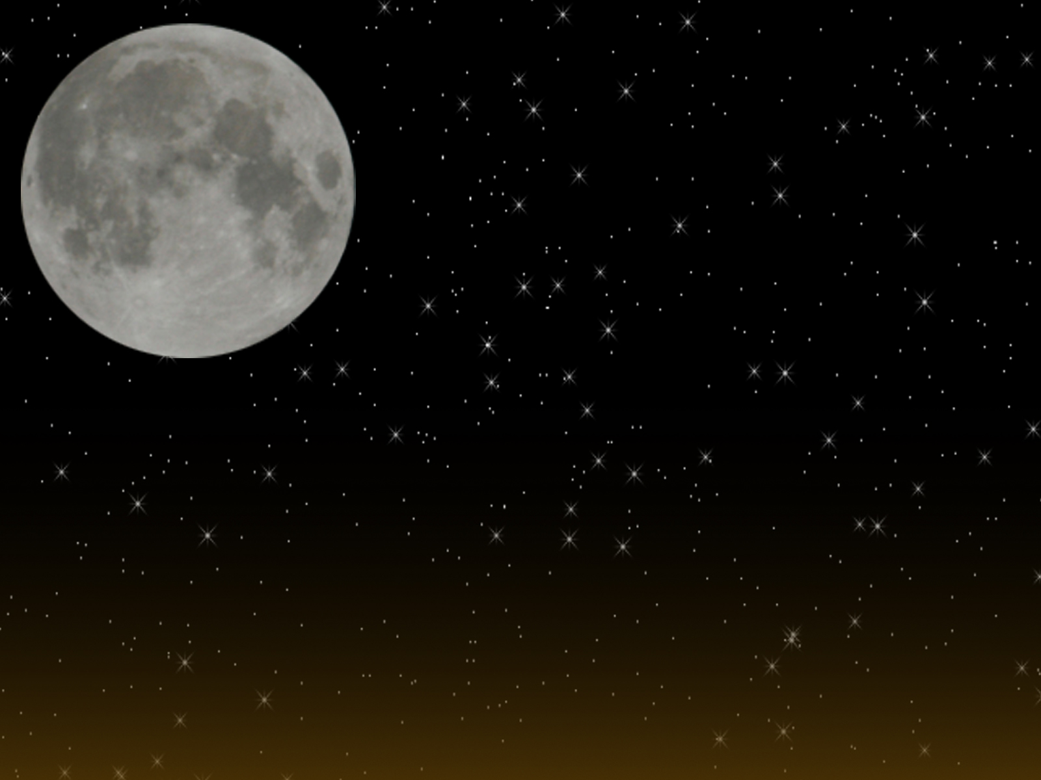
1. What is God?
Here are some questions and answers reproduced from the Spirit’s Book:
  What is God?
    God is the Supreme Intelligence, the First Cause of all things.
  How should we define Infinity?
    As that which has no beginning and no end.
  Can we say that God is infinite?
    In this case, your definition is incomplete. Unfortunately, human language is incapable of expressing ideas that transcend human intelligence.
      In perfections God is certainly infinite. But God is also more than infinity, and we make an error in logic when we equate the two. A quality possessed by a being cannot, after all, be considered identical to the being itself. Furthermore, “Infinity” is an abstraction. To define something unknown, like God, by reference to something equally unknown, is, once again, to make an error in logic.
“The Good” (Germanic Source) GOD
Notes:
<number>
But what is God, then? Is God the Laws of the Universe?
Is he the Creator? How did the Universe started? What is the Universe origins?
God is the supreme intelligence because, if there is order in the Universe, there is necessarily a responsible intelligence behind it. The effect is a result of a cause, therefore, the intelligent effect has an intelligent cause.
To attempt to define God is almost impossible. However, in attempting to understand and to accept the divinity, the individual creates attributes to God, but, one still cannot truly understand God nor to appreciate God in its essence and intimate nature, as explained by the spirits to Kardec (“The Spirits’ Book”, Q. 10).

Slide 8
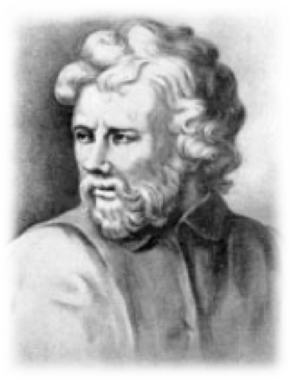
Who or what is God?
  “If I could say who or what God is, I would be God or God would not be God.”
  Epictetus (55-135), the great Stoic philosopher
Notes:
<number>
"No man is free who is not master of himself."

Slide 9
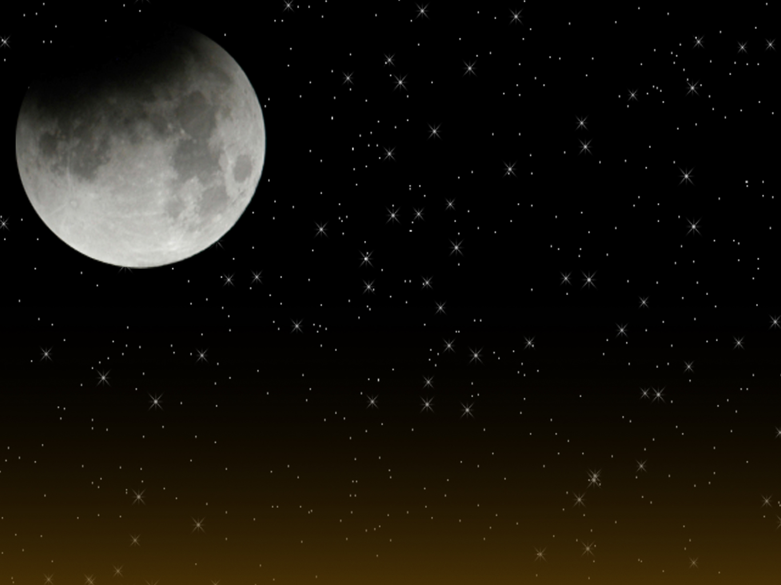
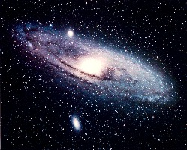

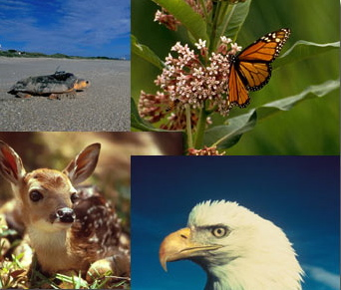
Proof’s of God’s Existence:
“An axiom in science states: There is no effect without a cause. Look for the cause of whatever is not the work of human beings then reasoning itself will answer your question.”
The Spirit’s Book, q. 4
Notes:
<number>

Slide 10
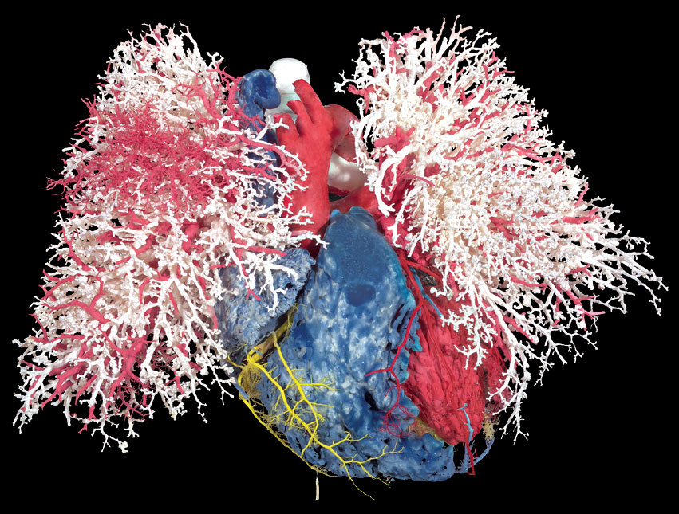
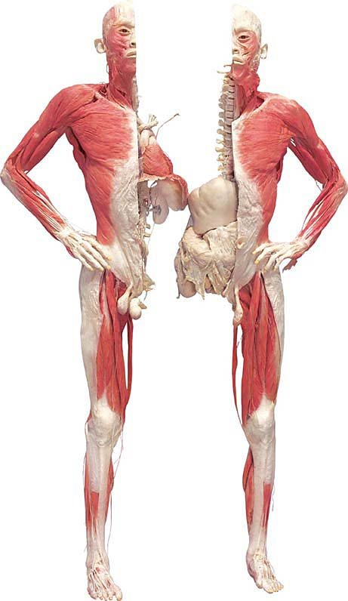
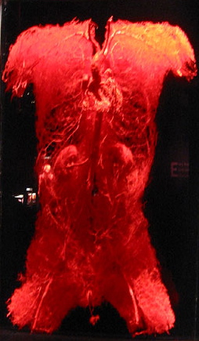
Proof’s of God’s Existence:
Bodies - the exhibition
Blood Vessels, Heart
Notes:
<number>

Slide 11
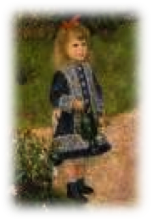
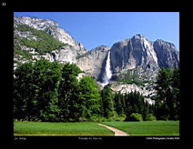
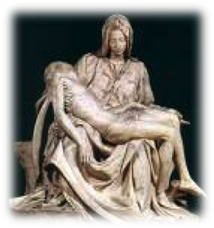
Proof’s of God’s Existence:
Proverb: “The workman is known by his work”
The harmony that regulates the workings of the universe is only consistent with the existence of an Intelligent cause.
Notes:
<number>
The existence of the clock attests to the existence of the watchmaker; the ingeniousness of the mechanism attests to the intelligence and the knowledge of the watchmaker. When the clock gives you, the precise time, the information that you need, has it occurred to you to say: That is a very intelligent clock.

Slide 12
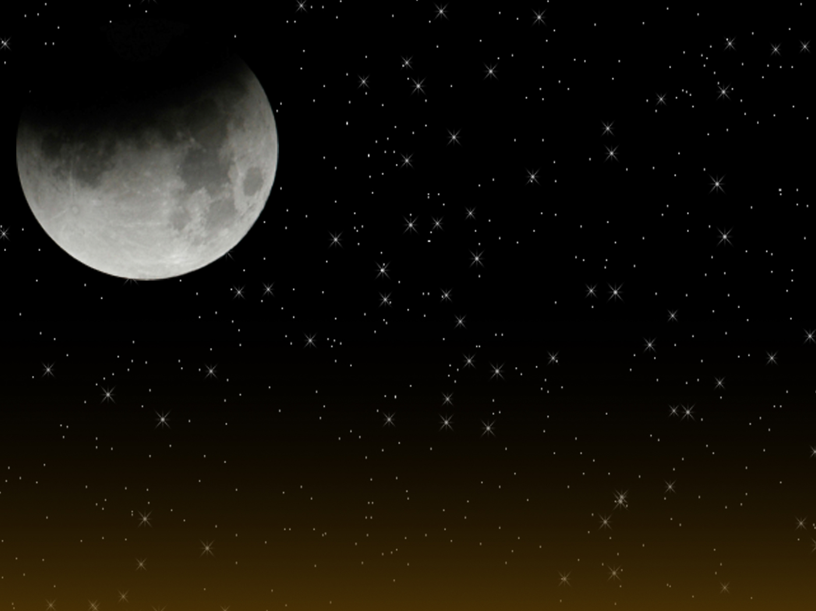
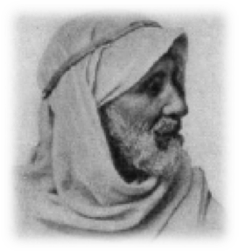
Someone asked a poor and ignorant Bedouin, who prayed incessantly to God, how could he believe in Him?
  “By His works”, he said. And he explained:
  “Don't you recognize the origin of a jewel by the jeweler's trade mark? Don't you recognize the writer of a letter, from the handwriting on the envelope? Can’t you affirm that a camel and not a dog passed by the highway, simply by looking at the trace left behind by the animal? Thus, also, I know that God exists by His works.”
  “How? Explain it better.”
  It is very easy. The stars, in the sky, are not the work of human beings. Human beings could not have placed them there. Therefore, they can only be the work of God and therefore, God exists.”
Notes:
<number>

Slide 13
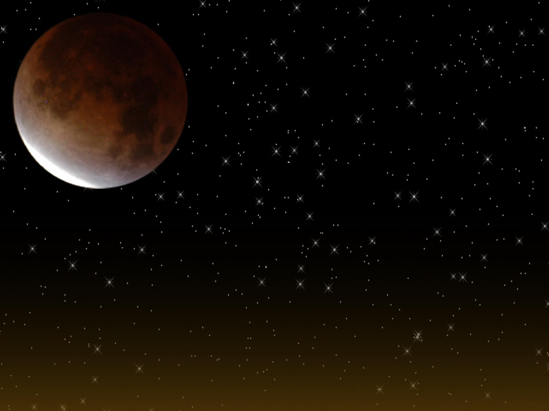
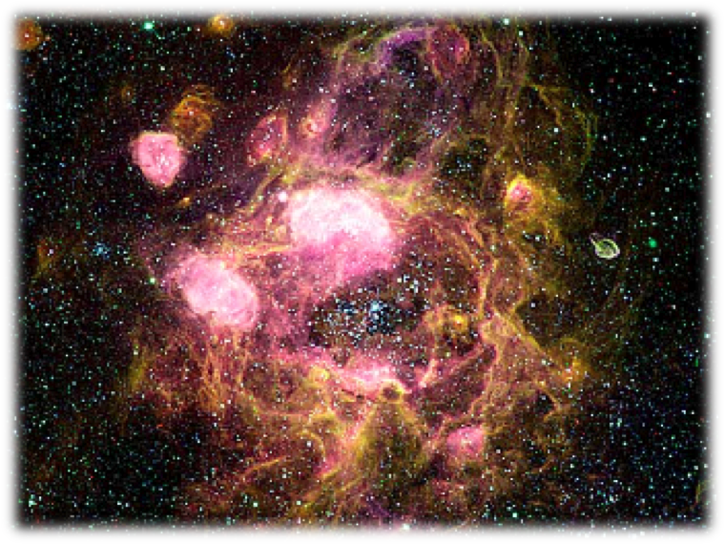
Using Science to prove God’s existence?
The way Kardec approached his studies showed a constant parallelism between Spiritism and Science, in the domain of Astrophysics and Cosmology.
They are unique sciences, where there can only be observations and no experiments.
Notes:
<number>

Slide 14
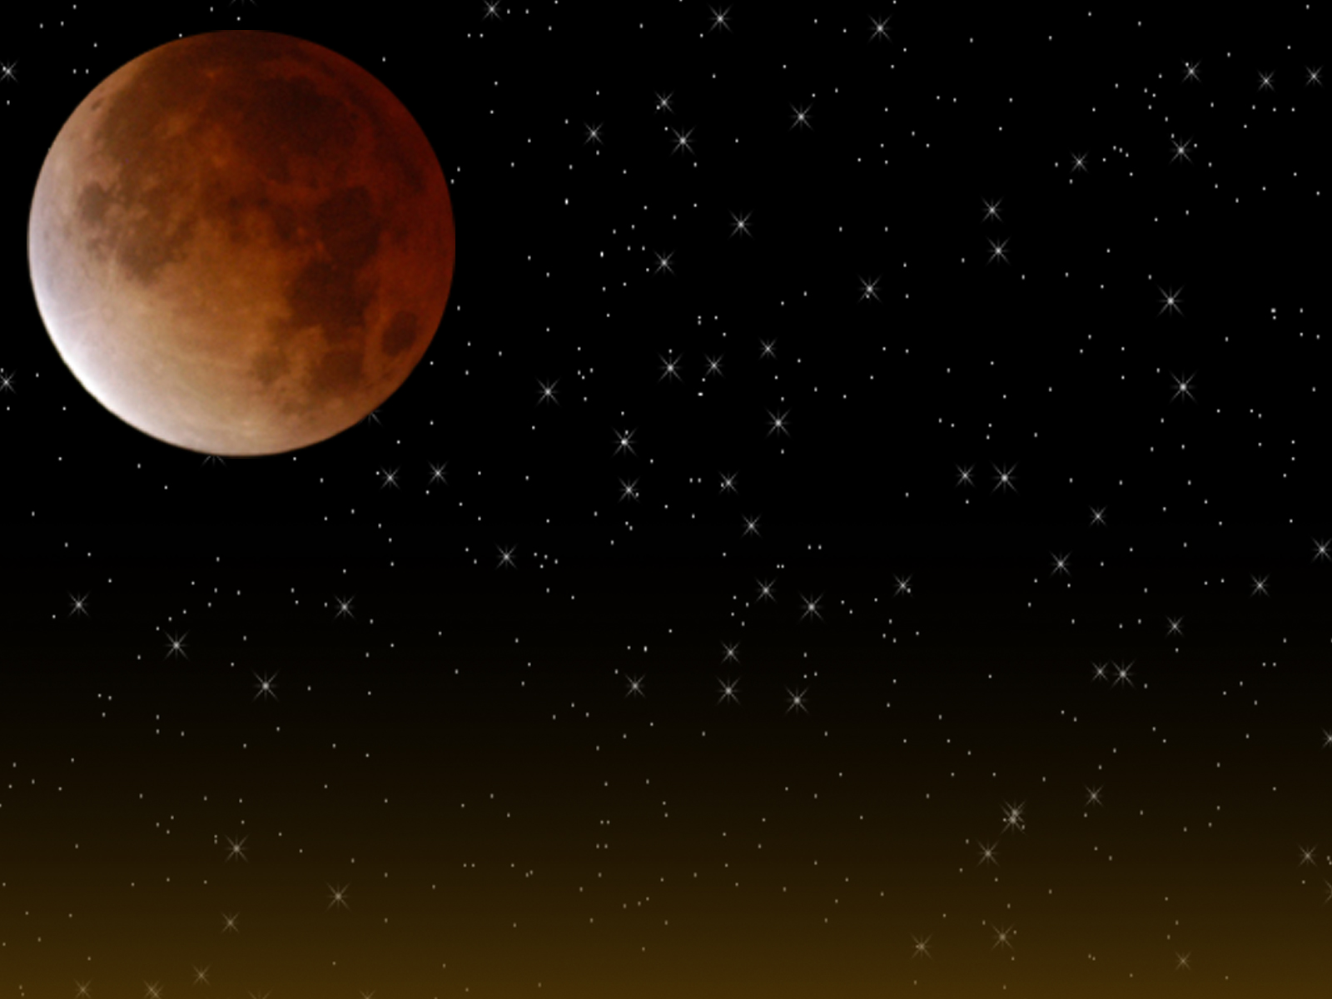
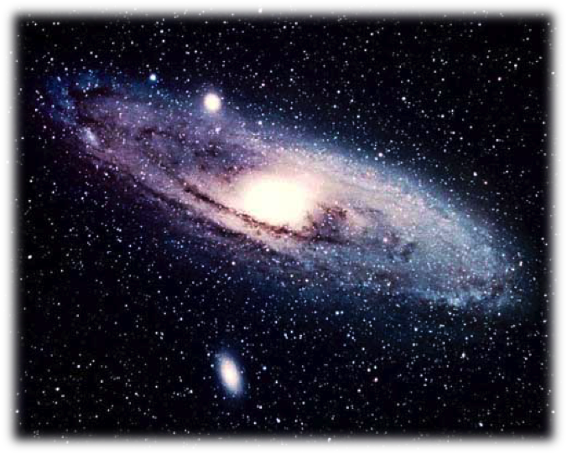
It is not necessary to observe black holes, stars in the confines of the dark universe or dark matter to know that they exist. In a similar way, it is not necessary to visualize Spirits and sense their influence to know that they exist.
It is not possible to obtain a sample of the fabric of the universe, or to pull off a piece from the Sun, to place it on a slide and to put it under a microscope
- The same way that Professor Allan Kardec created a method for a better understanding of the spiritual reality that involves us all.
Notes:
<number>

Slide 15
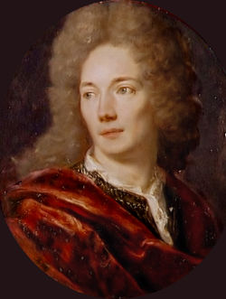
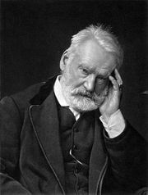
“The impossibility as far as I myself can see to disprove the existence of God, proves to me that God does exist.”
Jean de La Bruyere
1645 -1696), was a French essayist and moralist.
“God had to exist, otherwise, how could we exist?”
“God manifests himself to us in the first degree through the life of the universe, and in the second degree through the thought of man.”
Victor Hugo
1802-1885
Notes:
<number>
I'm religiously opposed to religion. Victor Hugo Religions do a useful thing: they narrow God to the limits of man. Philosophy replies by doing a necessary thing: it elevates man to the plane of God. Victor Hugo To love another person is to see the face of God. Victor Hugo God manifests himself to us in the first degree through the life of the universe, and in the second degree through the thought of man. The second manifestation is not less holy than the first. The first is named Nature, the second is named Art.

Slide 16
Where to find God?
NATURE CONSCIENCE
Conscience is God present in man. Victor Hugo
‘Here and Hereafter’ by Leon Denis
Notes:
<number>

Slide 17
Attributes of God
In order to sense God better, we give God certain attributes:
God is infinite and eternal
God is unchangeable
God is immaterial
God is unique (no other gods)
God is all-powerful
God is just and good
Notes:
<number>

Slide 18
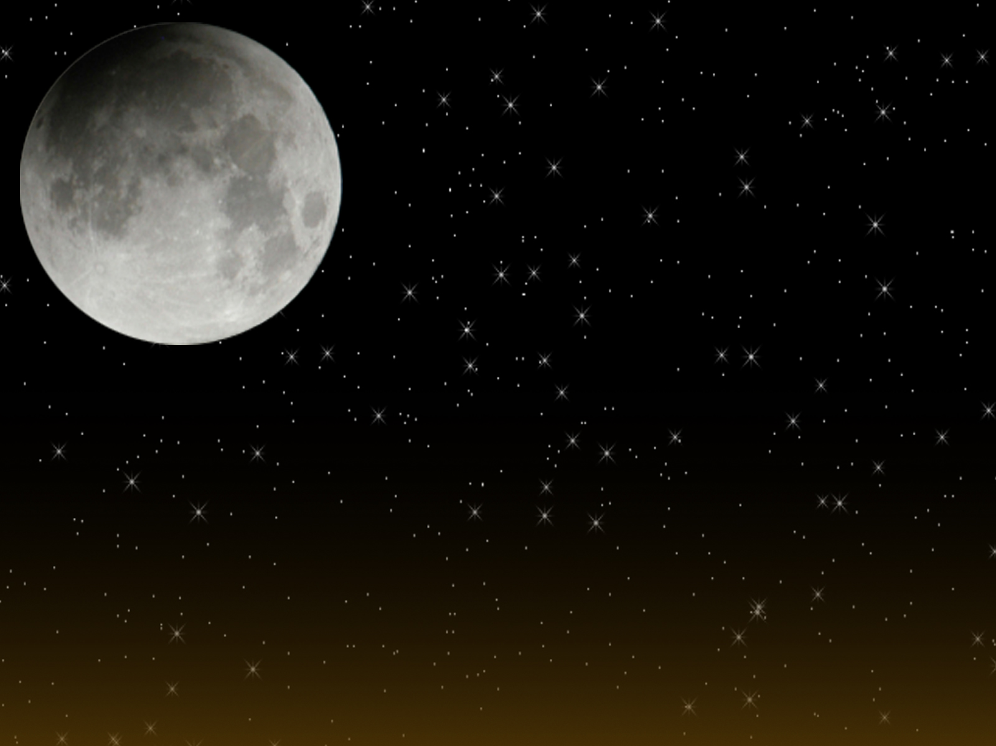
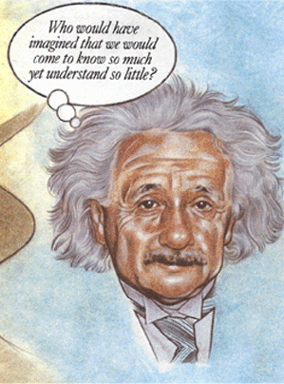
EINSTEIN AND GOD
“(…) Every one who is seriously involved in the pursuit of science becomes convinced that a spirit is manifested in the laws of the Universe -- a spirit vastly superior to that of man, and one in the face of which we with our modest powers must feel humble.”
Albert Einstein - The Human Side, Selected and Edited by Helen Dukas and Banesh Hoffman, Princeton University Press, 1979.
Notes:
<number>
“I have tried to respond to your question as simply as I could. Here is my answer.
Scientific research is based on the idea that everything that takes place is determined by laws of nature,
and therefore this holds for the actions of people. For this reason, a research scientist will hardly be inclined
to believe that events could be influenced by a prayer, i.e. by a wish addressed to a supernatural Being.”
“However, it must be admitted that our actual knowledge of these laws is only imperfect and fragmentary, so that, actually, the belief in the existence of basic all-embracing laws in Nature also rests on a sort of faith. All the same this faith has been largely justified so far by the success of scientific research. In this way the pursuit of science leads to a religious feeling of a special sort, which is indeed quite different from the religiosity of someone more naive.”

Slide 19
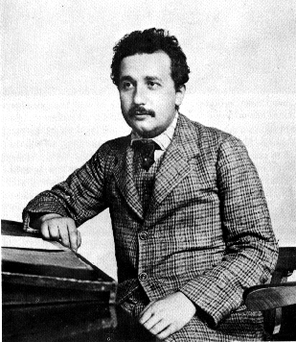
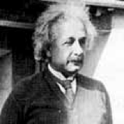
EINSTEIN AND GOD
I believe in Spinoza's God who reveals himself in the orderly harmony of what exists, not in a God who concerns himself with the fates and actions of human beings.
(Albert Einstein)
(Albert Einstein, responding to Rabbi Herbert Goldstein who had sent Einstein a cablegram bluntly demanding "Do you believe in God?" Quoted from Victor J. Stenger, Has Science Found God? 2001, chapter 3.)
Notes:
<number>
I do not believe in a personal God and I have never denied this but have expressed it clearly. If something is in me which can be called religious then it is the unbounded admiration for the structure of the world so far as our science can reveal it. (Albert Einstein, 1954)

Slide 20
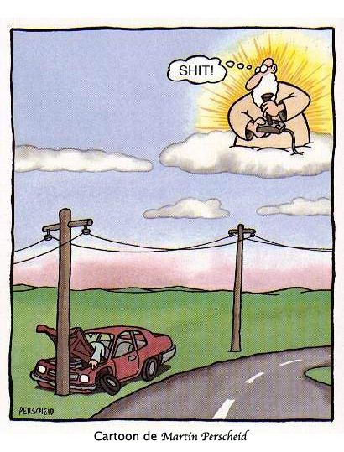
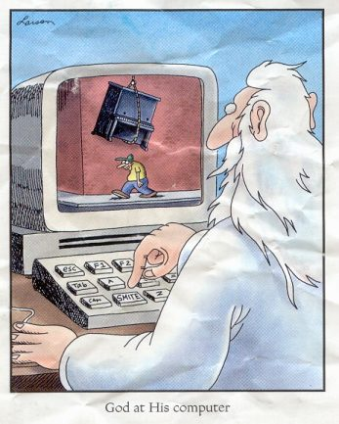
God doesn’t smite or spare you from being smitten
Oops
Notes:
<number>

Slide 21
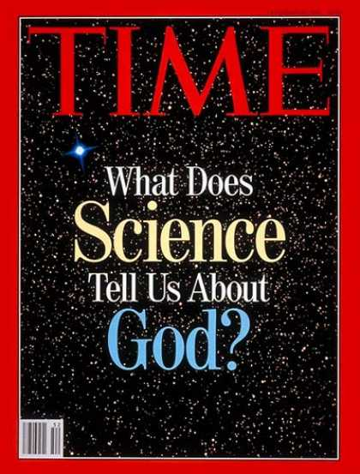
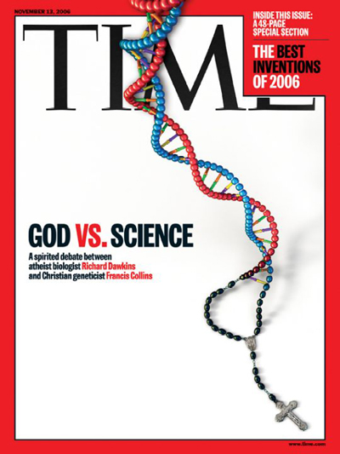
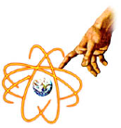

Slide 22

No Pantheism
God is not the result of all forces and intelligences of the universe!
Question 15
Notes:
<number>

Slide 23
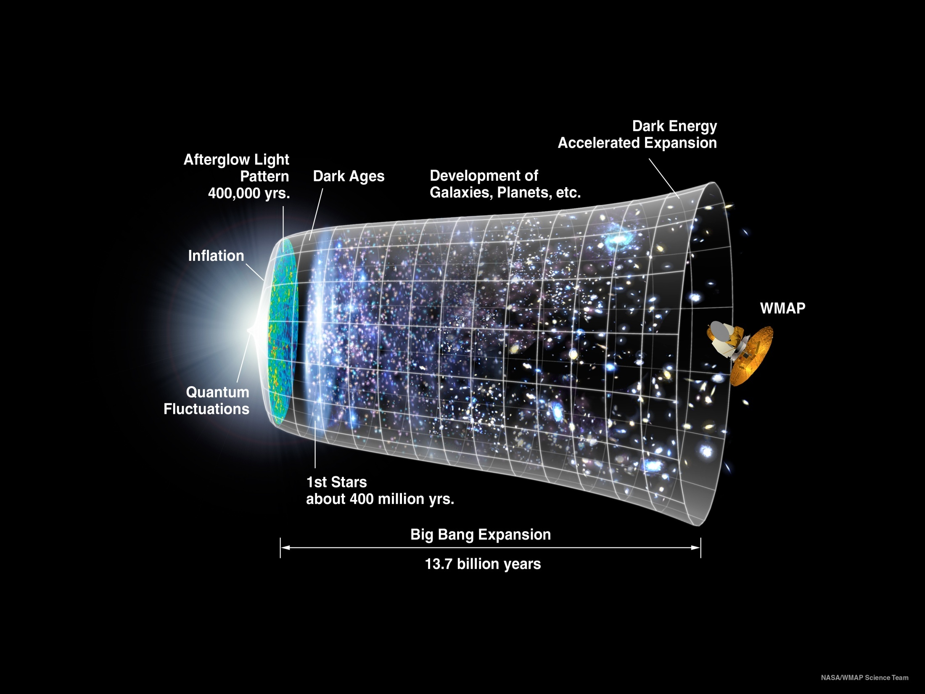
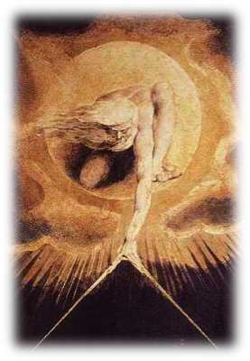
God is the Cause
Notes:
<number>
Most scientists believe that a long time ago, the Universe we live in was incredibly small, dense and hot. Many different observations support this view and it now appears that the Universe underwent a very dramatic event right at the beginning, known as the Big Bang.
Different estimates put the Big Bang some 13 to 17 thousand million (13 - 17 billion) years ago. Since then the Universe has expanded, cooled down and has become much less dense.
The Big Bang is primarily believed because without it they'd have to admit that God created everything.ﾊIf ... "God" created the universe then, logically, nothing in life is more important than finding out just who that God is and why we were created.ﾊ But many persons would prefer to hide from this inconvenient reality.ﾊ Therefore the Big Bang theory (though defying true science, i.e. that "every action has an equal and opposite reaction") is believed and promulgated, but it isﾊ inherently unscientific in nature.ﾊ A Little Bang happening all by itself in a small box (to the left) has a greater chance of probability than a Big Bang containing (theoretically) all the matter in the known universe.

Slide 24
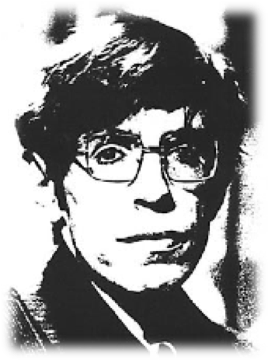
"The odds against a universe like ours emerging out of something like the Big Bang are enormous...
I think clearly there are religious implications whenever you start to discuss the origins of the universe."
Stephen W. Hawking
Notes:
<number>

Slide 25
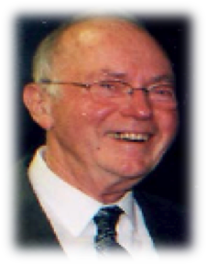
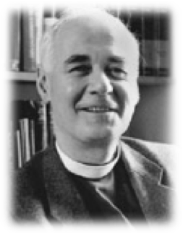
Science finds God
Charles Townes (Nobel Prize in Physics, 1964): “...somehow intelligence must have been involved in the laws of the universe.”
John Polkinghorne (physicist): “When you realize that the laws of nature must be finely tuned to produce the universe we see, we have to admit the idea that the universe did not just happen, but that there must be a purpose behind it”
Notes:
<number>

Slide 26
QUIZ
1. What is God?
a. The result of all forces and intelligences of the universe.
b. The Supreme Intelligence of the Universe; the first cause of all things.
2. What is the origin of the word God?
a. The “good”, from a Germanic source.
b. “Wisdom”, from Latin.
3. Which proverb corroborates on God’s existence?
a. "God is a busy worker but loves to be helped."
b. “The workman is known by his work.”
4. What are some of God’s attributes?
a. Unchangeable, Unique, Material and Eternal.
b. Just, Infinite, All-Powerful and Eternal.
5. Where can we find God?
a. In our conscience and in Nature.
b. Only in religious places.
Notes:
<number>

Slide 27
Notes:
<number>

Slide 28
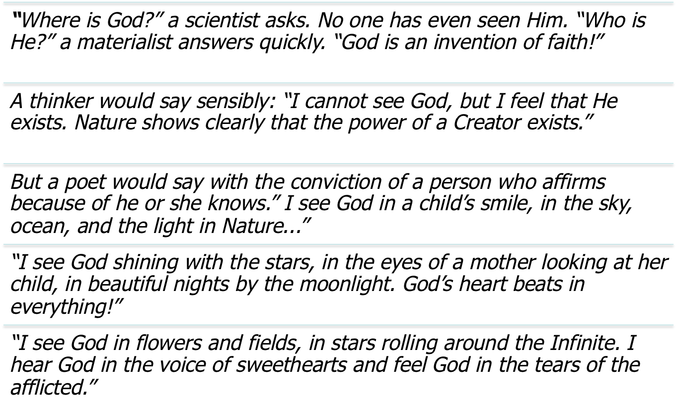
Where is God
Notes:
<number>

Slide 29
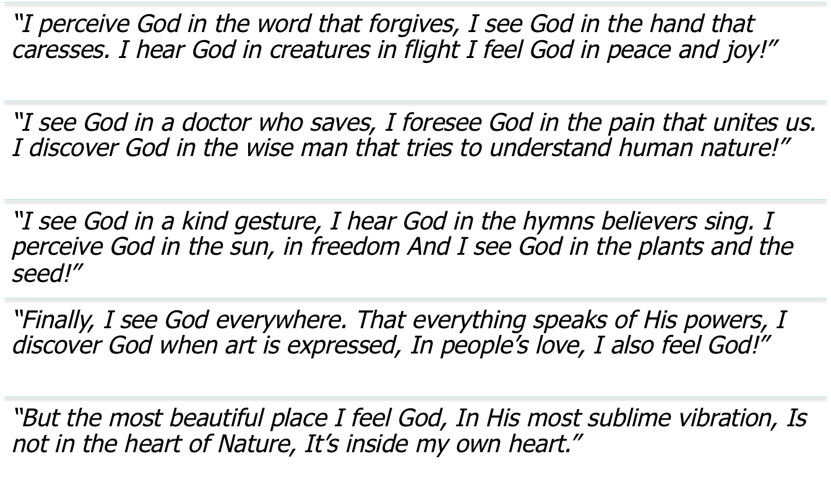
Where is God
Notes:
<number>

