Slide 1






Notes:
<number>

Slide 2



Anyone is entitled to be considered a "medium" if he or she is psychically sensitive and capable of receiving and responding to spirit control or influence.
Since mediumship is a natural faculty it appears at the appropriate time, which was previously determined in the individual’s reincarnation plan.

Slide 3



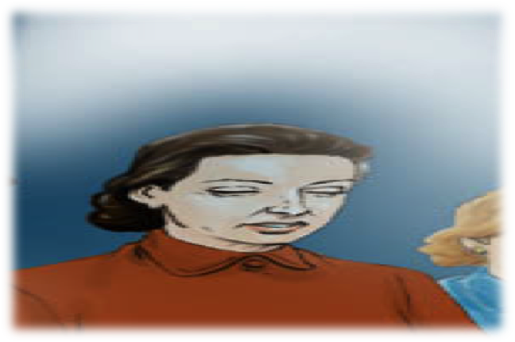


Illustrations kindly provided by the “Image Project” (Projeto Imagem)
http://www.projetoimagem.com.br/
Spontaneous – it will not generate great discomforts, whether physical or emotional, to the beginning medium;
Trial – the mediums will experience emotional unbalances that will reflect in their physical bodies. Spiritual disturbances could occur.
Mediumship is without a doubt a powerful instrument, but it can also be transformed into a lamentable source of disturbance, according to the spiritual and moral level of those possessing such resource.

Slide 4

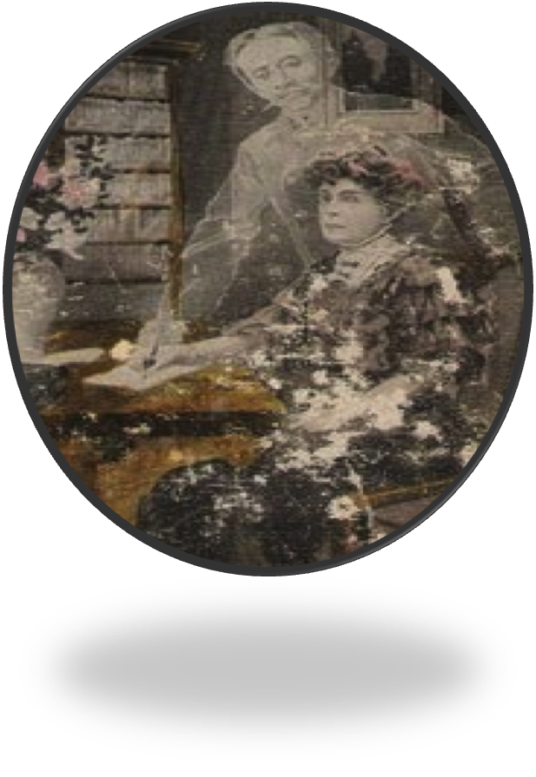
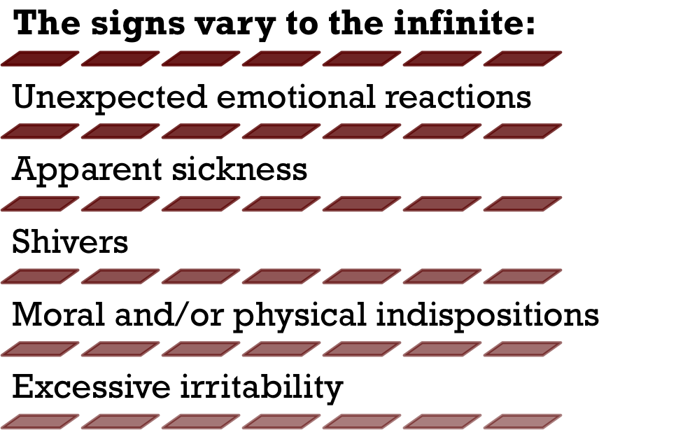
The appearance of mediumship does not depend on place, age, social condition or gender. It can appear during childhood, adolescence, youth, at a mature age or in the elderly. It can manifest itself in the Spiritist Center, at home, at any religious temple, or even in a person with strongly materialistic inclinations.
Notes:
<number>

Slide 5
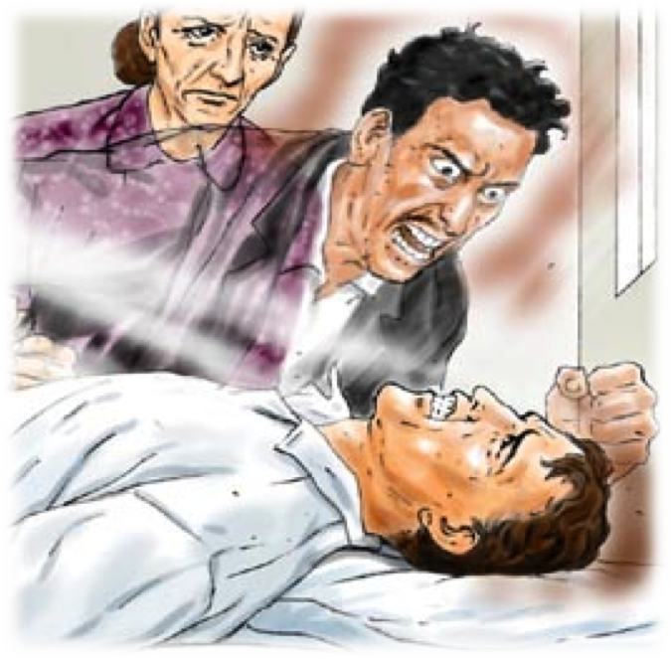

It is not mediumship that is responsible for these bodily disturbances, but the fluidic action from the Spirits that favors, or does not favor, the occurrence of dystonias, in accordance with the quality of its presentation.
Illustration kindly provided by the “Image Project” (Projeto Imagem)
http://www.projetoimagem.com.br/
FRANCO, Divaldo Pereira. Ser Médium. Mediums and Mediumship. By the Spirit Vianna de Carvalho.

Slide 6
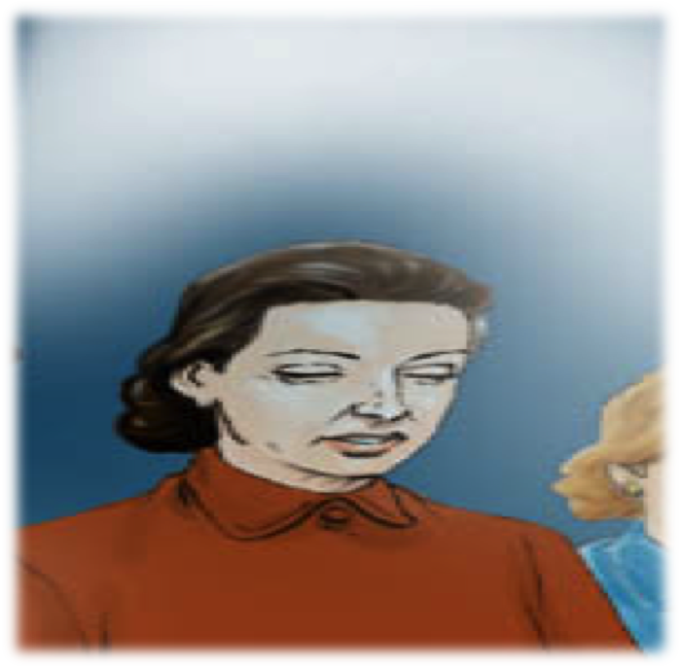

When the spiritual action is of an elevated level, an aura of peace and well-being envelopes the mediators, assisting them in preserving the energy that nourishes and supports them during their physical existence.
FRANCO, Divaldo Pereira. Ser Médium. Mediums and Mediumship. By the Spirit Vianna de Carvalho.

Slide 7
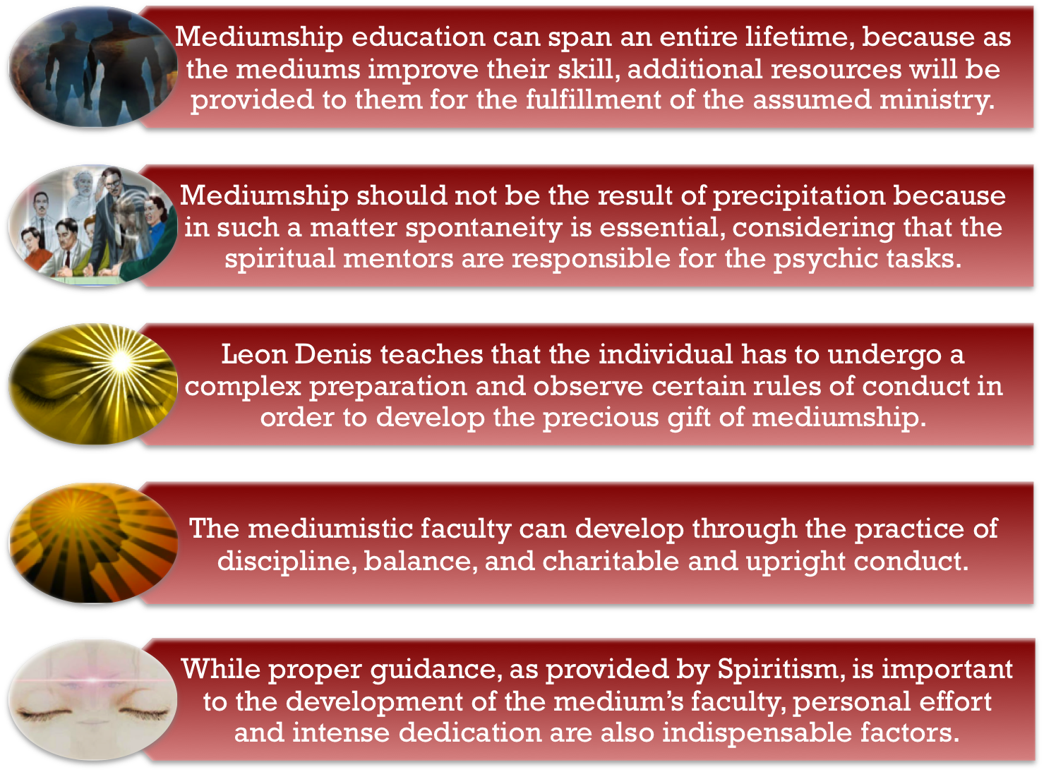
Notes:
<number>
Life is a constant coming and going from one sphere to the other. Wherever there is inhabited land on our planet, there must consequently be a steady stream of those return­ing to the spiritual world, just as there is of those coming in to reincarnate. Traditional religions, bent on their intentions to frighten into conversion or to hold power through fear, often full of rituals and mysticism, have done little to clarify the situation called “death”. Rather they have only taught delusions, which have left the vast majority of the earth population totally unprepared for this normal and natural event. The orthodox teachings of heaven or eternal damnation in hell, of sleeping till the final judg­ment day, have done nothing to help human anxiety; nor has it done anything to prepare people for what they may actually expect on their return to their spiritual homeland.

Slide 8


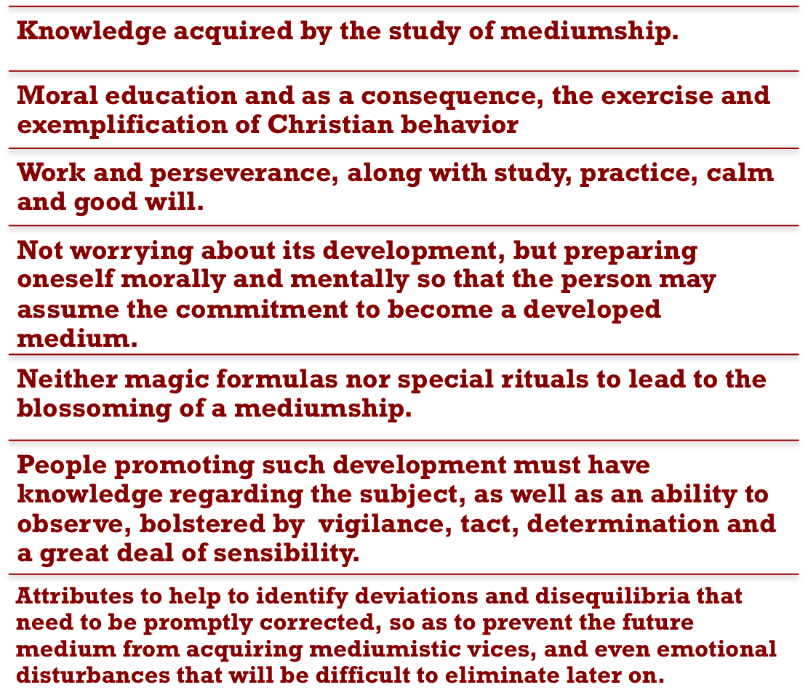

Slide 9


Oftentimes the individual is not always conveniently assisted as soon as his or her mediumship appears; either due to ignorance regarding the subject, which is in fact, most common, or due to the disinterest or indifference of relatives and friends.
The truth is that at the beginning of its evolvement, the medium faces many conflicts and illnesses. Oftentimes, they have no knowledge about Spiritism and mediumship, and have never approached a Spiritist Center.
It is only after much suffering that they finally approach Spiritism. These newcomers arrive at the Spiritist Center completely disoriented, still under the religious preconceptions that they had been taught for so long.

Slide 10

They display incredulity, and insist that their problems be resolved overnight!
They declare that they do not believe in the influence or effects caused by Spirits, affirming they do not wish to be mediums.

Slide 11

Some display extraordinary enthusiasm, due to the impact received from the spiritual revelations that have suddenly been disclosed to them
They require further understanding and assistance from the more experienced mediums, so that they do not become lost or confused by the communications of mischievous entities.

Slide 12

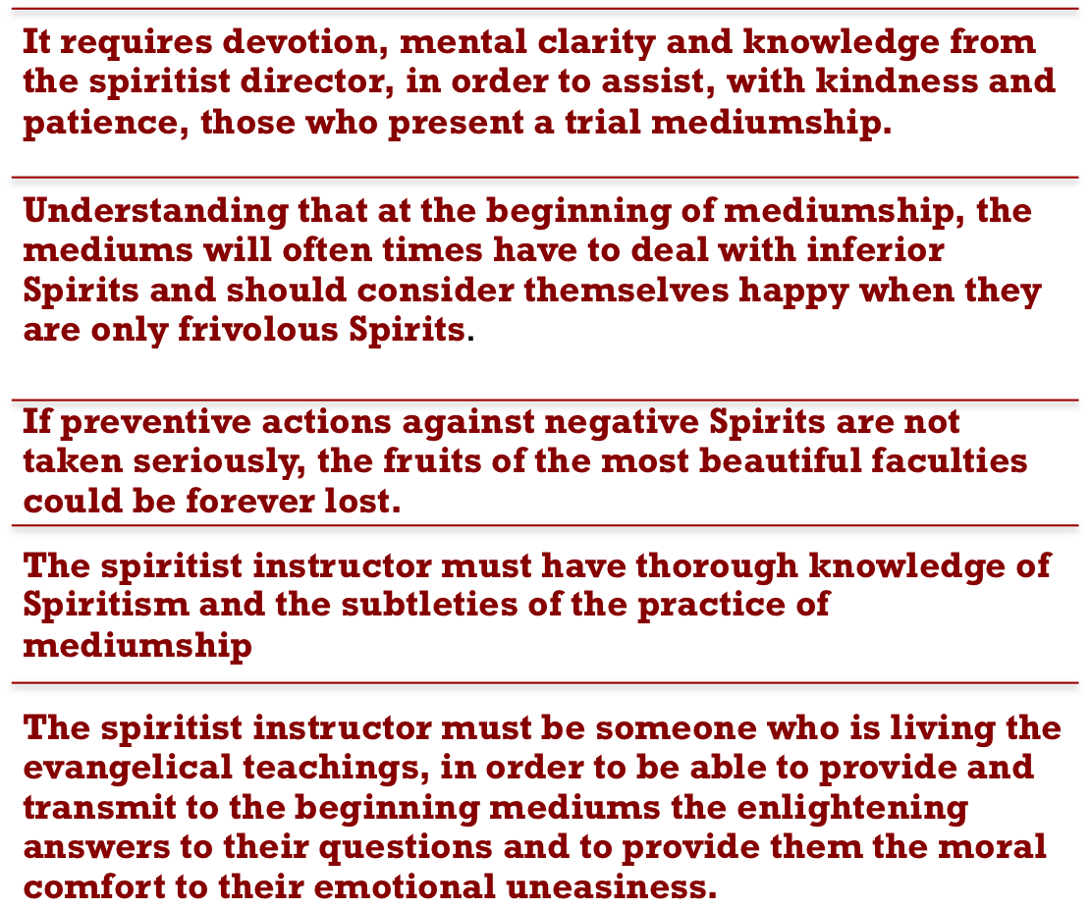

Slide 13
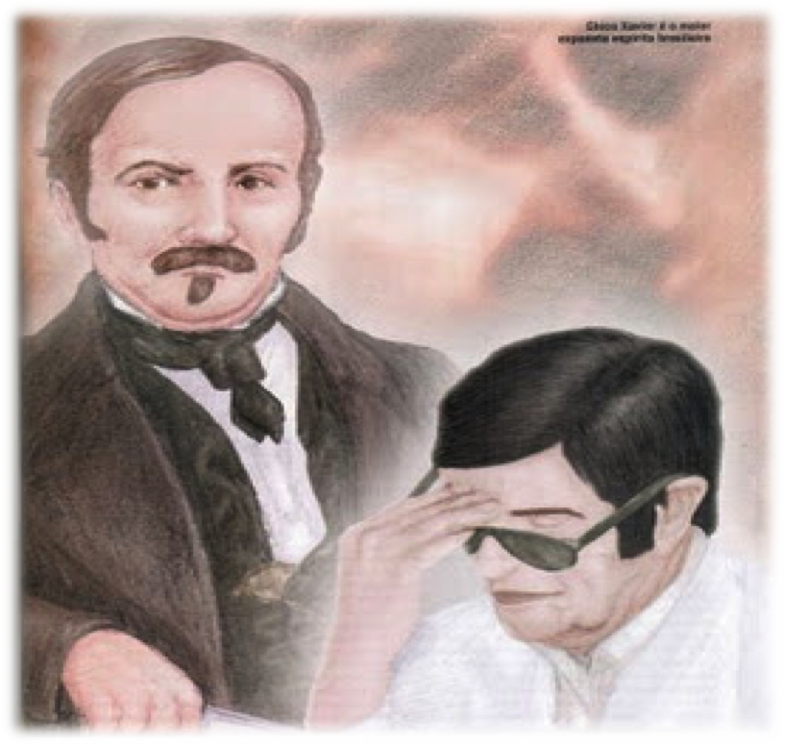
The unfoldment of mediumship, in essence, must be inner improvement, because only the medium’s improvement will enable the Spirit to manifest in a better way.
Chico Xavier In Goiania, question 23

Slide 14









Educate yourselves,
Fight your addictions,
Including the mental ones,
Learn to be good,
Read uplifting books every day,
Seek God through prayer
(Chico Xavier Songs of the Heart-Cânticos do Coração, Volume II)

Slide 15

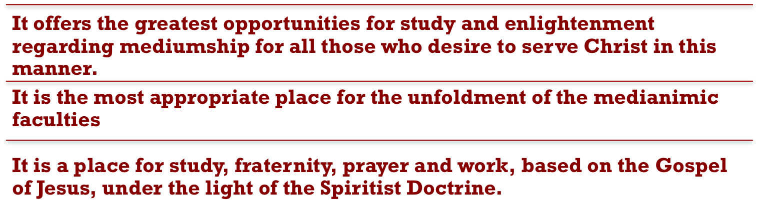

Slide 16

Spiritual benefactors that help the mediums
Protective Spirit or guardian angel – those who follow each individual through the course of his or her life, and to aid him or her to progress.
Relatives of the medium - with whom they have longer or shorter ties, in order to be useful to them within the limits of their possibilities.
Sympathetic Spirits - are those who are drawn to each individual through personal affection, and by a similarity of attraction to goodness or to evil.
In the physical plane, the task of guiding the mediums is assigned to the instructors of the mediumship courses and to the directors of the mediumship meetings.

Slide 17

In the past this responsibility was based on initiative, that is, the instructor imparted his or her teachings in accordance with the disciple’s receptivity and strength.
Today we don’t need a guru to guide a disciple through the successive stages that lead to the ideal level.
Spiritism has demystified the old occultism, and has rendered its basic knowledge accessible to the ordinary person.
We should not forget that fostering mediumistic development still requires the supervision, the attention and the personal guidance of someone who has high moral values and the doctrinaire conditions to promote it.
Oneself should not attempt mediumship development, nor should it be attempted without the support of books that are essential for the understanding of its basic concepts.

Slide 18

It is possible for a medium trainee to slowly develop his or her faculties if placed in a harmonious and well-assisted group, wherein well-disciplined mediums are already fully active.
Under no circumstance should mediumistic development be attempted through the aid of organizations that promise fast and amazing results in just a few lessons, or if based on suspicious books. .
it is imprudent to push for development if the person does not have any inclination to study the subject in the books that comprise the Codification of Kardec, or the complimentary works of his followers.
The individual who is determined to put mediumship ability into practice, once it has appeared, must bear in mind the significance of this faculty.

Slide 19









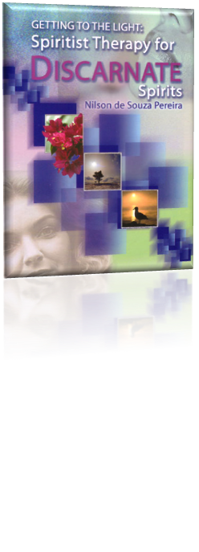

The education or unfoldment of mediumship is the work of a lifetime and, in fact, starts prior to reincarnation, continuing throughout incarnated life, and beyond.

Slide 20


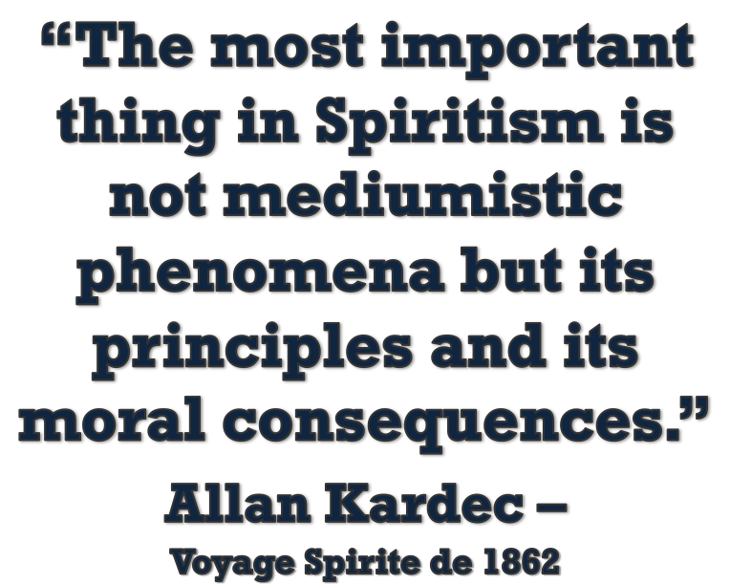
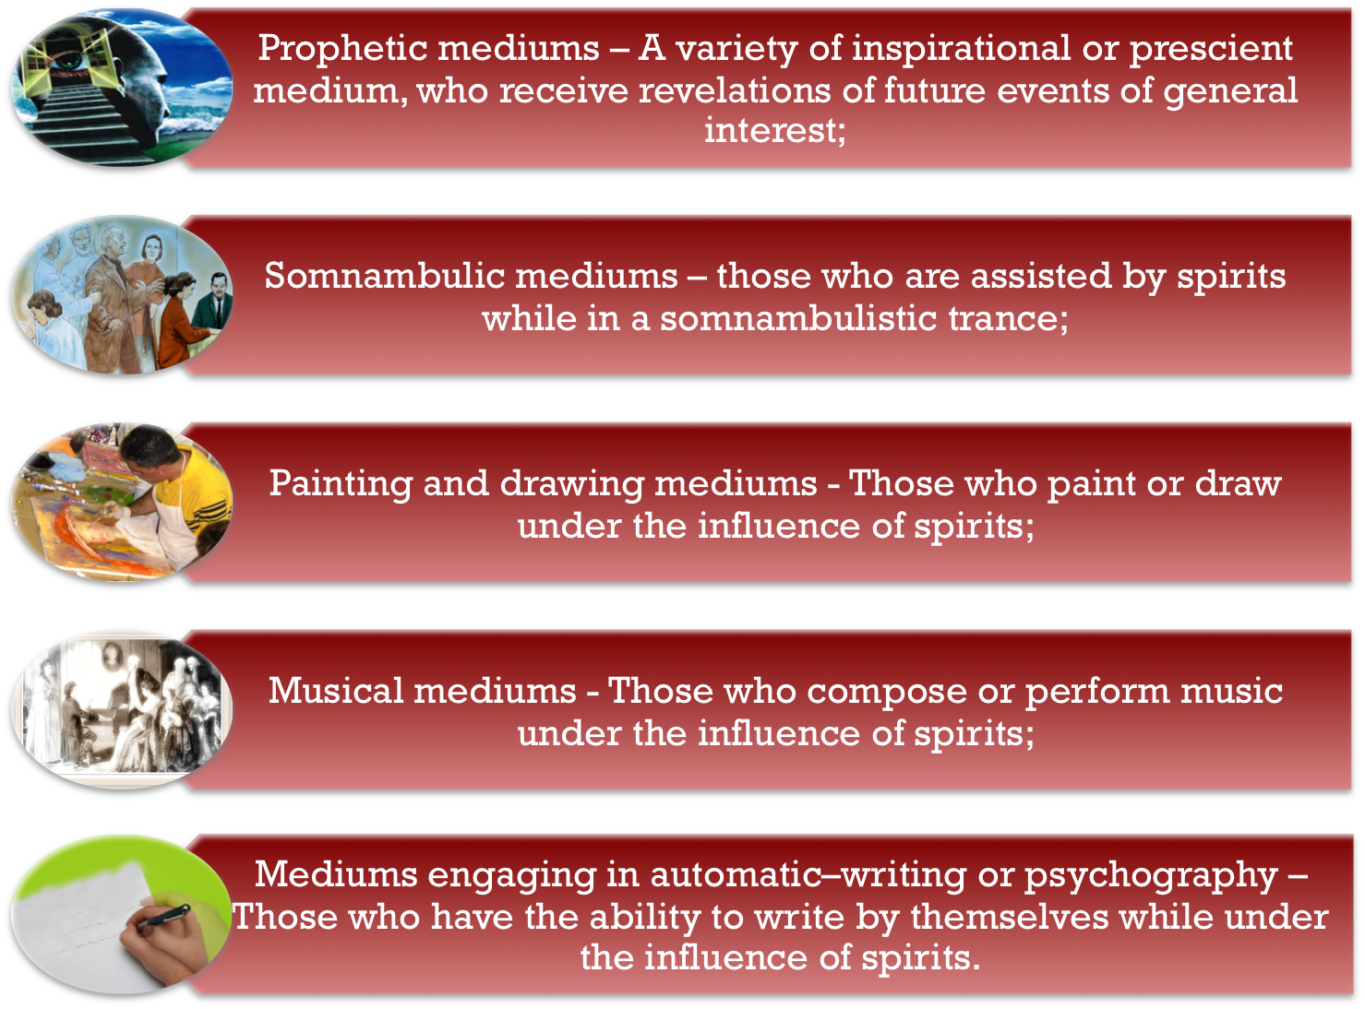
Notes:
<number>

Slide 21
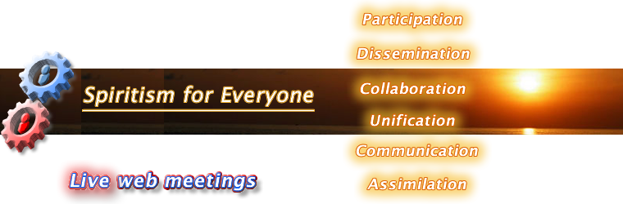
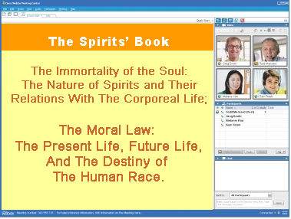


United States Spiritist Council
Visit our website for
more information:
www.Spiritist.us

