Slide 1
Inner Transformation
Lesson 5
FRUGALITY and TEMPERANCE
2011 © United States Spiritist Council

Slide 2
Definition
Righteousness is an important theological concept in Judaism and Christianity.
It is an attribute which implies that a person's actions are justified, andcan be interpreted to meanthat the person has been "judged" or "reckoned" as leading a life that is pleasing to God. (wikipedia)
It also means to be in complete accordance with what is just, honorable, and Godly.
Righteousness is comprised of those things that are upright, virtuous, noble, morally right, and ethical.

Slide 3
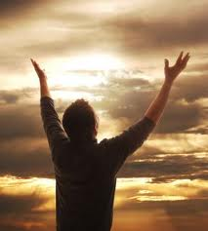
Righteousness
He who pursues righteousness and love finds life, prosperity and honor.
(Proverbs 21:21)
Bible
Quotations
For the Lord is righteous; He loves righteousness; And the upright will behold His face". (Psalms 11:7)
All men's souls are immortal, but the souls of the righteous are immortal and divine.
Socrates

Slide 4
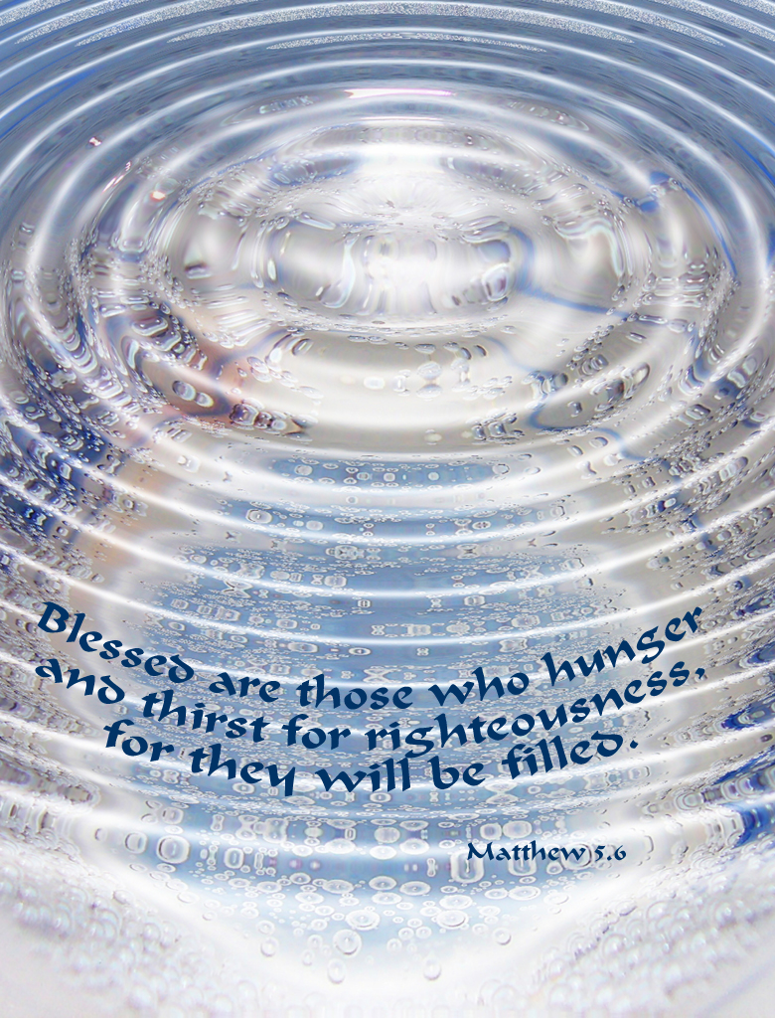

Slide 5
The idea of hunger and thirst speaks of a deep longing and strong desire that aches desperately to be satisfied.
Stephanie Miles
There are no words that would serve better than hunger and thirst to express this strong desire to obtain the righteousness that we ought to feel. No needs are so keen; none so imperiously demand supply, as these.

Slide 6
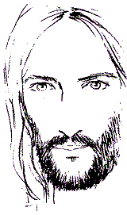
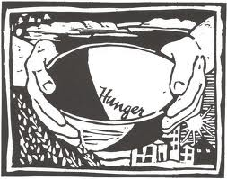
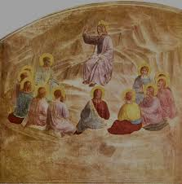
In using the imagery of hunger and thirst,Jesus communicates howimportant righteousness is to our lives.
Jesus extends his blessing to those who desire righteousness as a profoundly urgent priority in their lives, recognizing its vital importance.

Slide 7
Righteousness
Righteousness is as necessary to our spiritual lives as food and water are to our physical lives.
Without food and water, the body suffers and may die.
Without righteousness, the soul feels empty and unhappy.
When the uneasy sensation of hunger takes place in the stomach, we know we must find food or perish.
When the soul is awakened to a sense of its own desires, and begins to hunger and thirst after righteousness, which is its proper food, it will neither rest nor find peace until it is satiated.

Slide 8
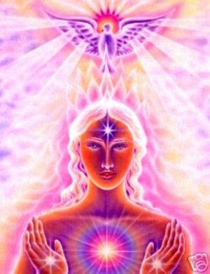
Blessed are those who hunger and thirst for righteousness
Newborn babies intrinsically know that food will satisfy their hunger. They do not think twice about the validity of their physical needs, nor do they neglect their need to eat. They simply cry out for what they know is good.
The same is true for those who seek spiritual evolvement; there should be no question of the necessity of spiritual food. Nor should one neglect the need for fulfillment. Instead, God desires for spiritual seekers to cry, as babies cry, to Him and allow Him to generously provide for their needs.

Slide 9
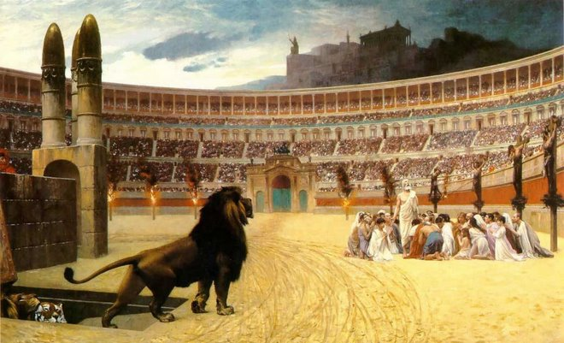
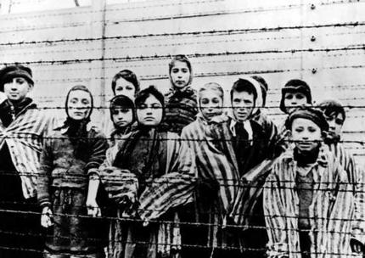
Blessed are those who are persecuted because of righteousness, for theirs is the kingdom of heaven.
Persecution is the systematic mistreatment of an individual or group by another group.
The most familiar forms are religious persecution, ethnic persecution, and political persecution, though there is naturally some overlap between these terms.
The inflicting of suffering, harassment, isolation, imprisonment, fear, pain and exclusion. Wikipedia

Slide 10
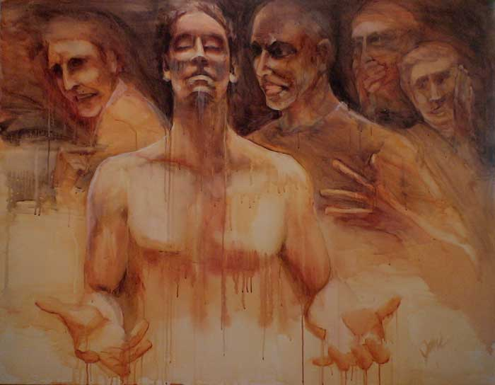
Blessed are those who are persecuted because of righteousness, for theirs is the kingdom of heaven.
Nowadays, persecution frequently comes in verbal form, usually by way of unkind mockery and reproachful language.
In today's society the act of revealing that you are somehow religious or spiritual may bring on smirks and laughs, rude and disgusting comments, alienation, and even retaliation.
Persecuted, ©JaniFreimann 2008
The four background figures to represent the spirits of Cynicism, Anger, Mocking, and Gossip.

Slide 11
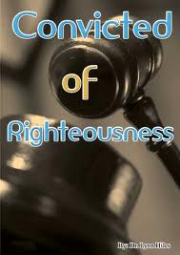
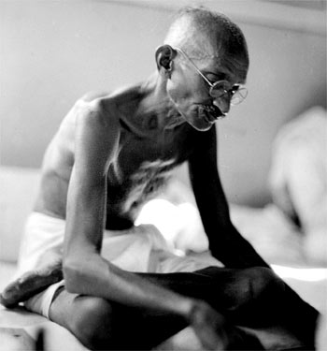
Blessed are those who are persecuted because of righteousness, for theirs is the kingdom of heaven.
But the important thing to do is to follow Jesus’ advice and to persist on doing good and being righteous, because only through this persistence will we achieve spiritual improvement.
Oneshould never bow down to error and should always live by the moral and ethical values that we learn from human laws, remembering, above all, those that we learn from God’s laws, thus demonstrating our constant awareness that we dwell in eternity.
I object to violence because when it appears to do good, the good is only temporary; the evil it does is permanent.Mahatma Gandhi

Slide 12
The Righteous Person
Jesus embodies righteousness and righteous people will try to follow Jesus’ footsteps during their lives.
For righteous people, all their daily actions, everything that they think about, every decision that they make, everything that they read and look at, will be done in the same way that Jesus would have done them.

Slide 13
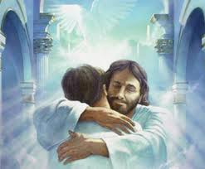
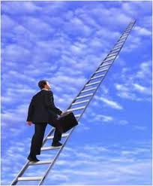
The Righteous Person
It is interesting to notice that this beatitude does not say, ‘Blessed are the righteous’. Rather it says ‘blessed are those who hunger and thirst after righteousness for they shall be filled’.
It seems that there is implied in this blessing an understanding that we are being challenged to commit ourselves to a process, a journey, an ongoing reaching out for the righteousness of God.

Slide 14
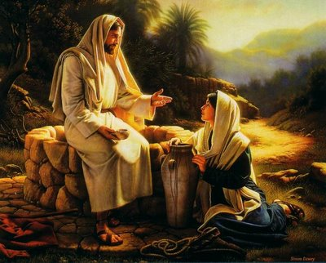
True religion is real living; living with all one's soul, with all one's goodness and righteousness. Albert Einstein
Well of Life
“Whoever drinks the water I give him will never thirst. Indeed, the water I give him will become in him a spring of water welling up to eternal life.” (John 4:14)
“I am the bread of life.”
(John 6:48)
Notes:
7When a Samaritan woman came to draw water, Jesus said to her, "Will you give me a drink?" 8(His disciples had gone into the town to buy food.) 9The Samaritan woman said to him, "You are a Jew and I am a Samaritan woman. How can you ask me for a drink?" (For Jews do not associate with Samaritans.[a]) 10Jesus answered her, "If you knew the gift of God and who it is that asks you for a drink, you would have asked him and he would have given you living water." 11"Sir," the woman said, "you have nothing to draw with and the well is deep. Where can you get this living water? 12Are you greater than our father Jacob, who gave us the well and drank from it himself, as did also his sons and his flocks and herds?" 13Jesus answered, "Everyone who drinks this water will be thirsty again, 14but whoever drinks the water I give him will never thirst. Indeed, the water I give him will become in him a spring of water welling up to eternal life." 15The woman said to him, "Sir, give me this water so that I won't get thirsty and have to keep coming here to draw water." 16He told her, "Go, call your husband and come back." 17"I have no husband," she replied. Jesus said to her, "You are right when you say you have no husband. 18The fact is, you have had five husbands, and the man you now have is not your husband. What you have just said is quite true." 19"Sir," the woman said, "I can see that you are a prophet. 20Our fathers worshiped on this mountain, but you Jews claim that the place where we must worship is in Jerusalem." 21Jesus declared, "Believe me, woman, a time is coming when you will worship the Father neither on this mountain nor in Jerusalem. 22You Samaritans worship what you do not know; we worship what we do know, for salvation is from the Jews. 23Yet a time is coming and has now come when the true worshipers will worship the Father in spirit and truth, for they are the kind of worshipers the Father seeks. 24God is spirit, and his worshipers must worship in spirit and in truth." 25The woman said, "I know that Messiah" (called Christ) "is coming. When he comes, he will explain everything to us." 26Then Jesus declared, "I who speak to you am he."

Slide 15
Caring for the body and the spirit

Slide 16
Body and Spirit
The body, may be regarded as a prisoner in the flesh. In order for this prisoner to live, move about and even conceive of the illusion of freedom, the body must be sound, of good disposition and vigorous.
It is the spirit that molds its envelope (body), and appropriates it to its new needs. It brings it toward perfection, develops and completes the organism by measure as it experiences the need of manifesting new qualities.
Genesis (Chap 11 § 11) – Allan Kardec

Slide 17
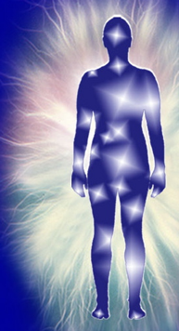
Caring for the body and the spirit
Spiritism helps us understand the importance of the relationship between body and soul, and tells us that they are both necessary for each other and must be cared for.
We should love our soul but care also for our body, the soul’s instrument.
Being heedless of the needs that are indicated by nature itself means to be heedless of the law of God.

Slide 18
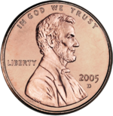
Frugality
Frugality: Make no expense but to do good to others or yourself; i.e., waste nothing.
Being frugal is to strive to Live Within Your Means. Don't squander your money on fun and frolicking, and don't waste the resources God gave us.

Slide 19
Temperance
Temperance: Eat not to dullness; drink not to elevation.
Being temperate is avoiding the extremes. Don't drink or eat to excess, or indulge in anything beyond what is healthy. Its also compromises and finding the middle ground. It’s Self-Restraint.

Slide 20
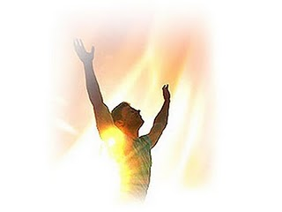
Caring for the body and the spirit
Those who desire to possess a clear conscience, a robust mentality and a well-balanced mind need to learn to be frugal and temperate.
One needs to avoid overindulgence in eating, which upsets body and mind. This is also valid for over-drinking, which entails the loss of all dignity and the over-stepping of all bounds; a frequent repetition of either inevitably leads to sickness and infirmity.
We need to grant to the body that which it requires in order to remain a useful servant, and nothing more; this is the wise person’s rule. To curtail the budget of its material needs, to subdue the senses and master the base appetites, is to shake off the yoke of the inferior forces, to prepare the spirit’s emancipation. To have few needs is likewise a form of wealth.
Here and Hereafter by Leon Denis

Slide 21
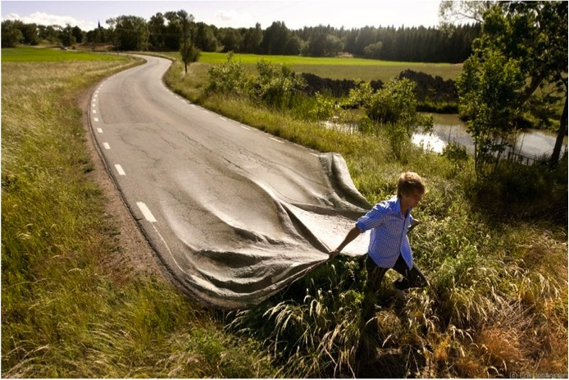
We are the artisans of our lives

Slide 22
Randall Bowman

Slide 25
United States Spiritist Council
Visit our website for
more information:
www.spiritist.us

