Slide 1
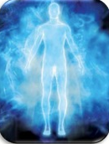
MEDIUMSHIP
Lesson 5
SPIRIT
MATTER
FLUID
2012 © United States Spiritist Council

Slide 2
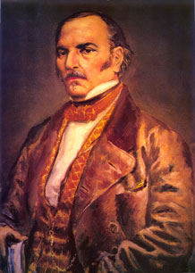
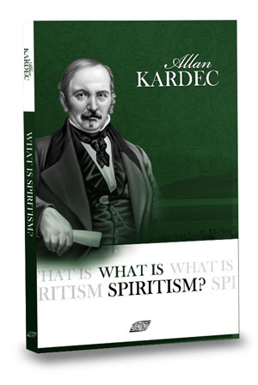
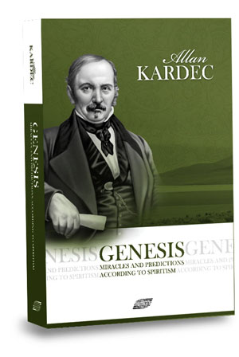
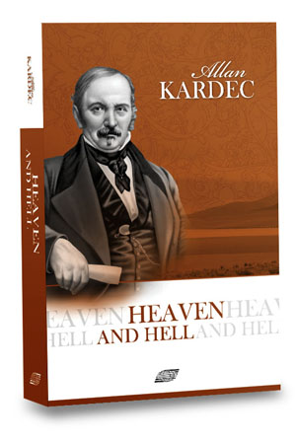
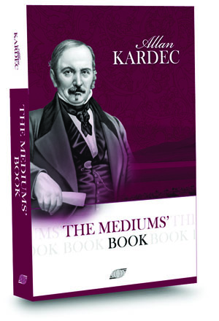
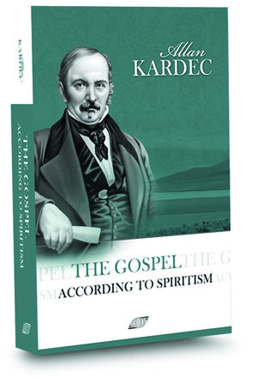
Allan Kardec presented the main elements of the Universe in two of the books of the Spiritist Codification, The Spirits’ Book and Genesis

Slide 3
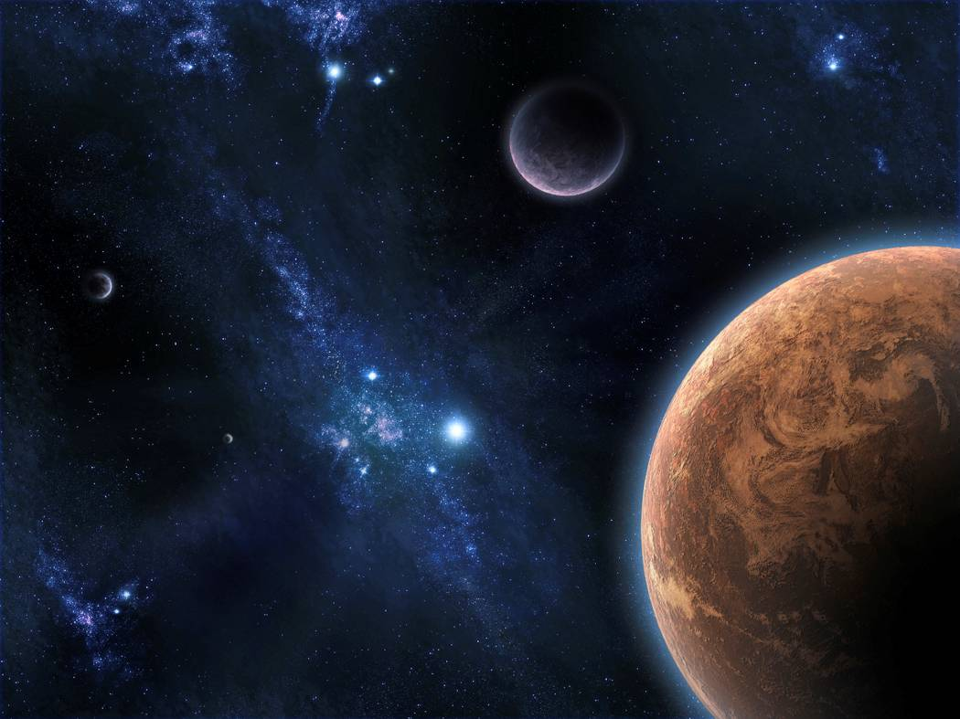
MOST BASIC ELEMENTS OF THE UNIVERSE
Cosmic Principle
Source: Allan Kardec - The Spirit’s Book, question 27

Slide 4
Allan Kardec - The Spirit’s Book, question 27
Cosmic Principle
These three elements comprise the principle of all that exists – they are the universal trinity.
But to the element of matter must be added the universal fluid, which plays an intermediary role between spirit and matter per se, since matter is too dense for spirit to act upon it directly.

Slide 5
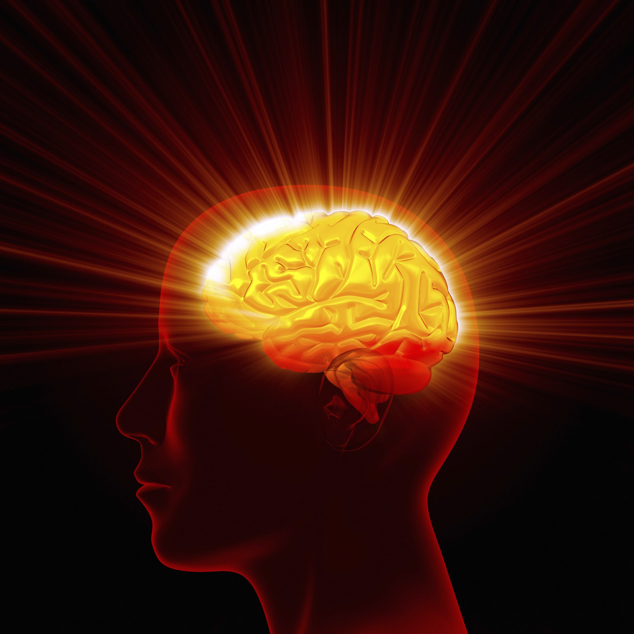
SPIRIT
The Spirit is the intelligent principle of the Universe, and Intelligence is one of spirit’s essential attributes.
Allan Kardec - The Spirit’s Book, questions 23 & 24

Slide 6
Spirits are not vague and indefinite beings
Spirits are incorporeal beings formed of quintessential matter, but matter existing in a state which has no analogue within the circle of your comprehension, and so ethereal that it could not be perceived by your senses.
Spirits are individualizations of the intelligent principle, just as bodies are individualizations of the material principle.

Slide 7
Structure

Slide 8
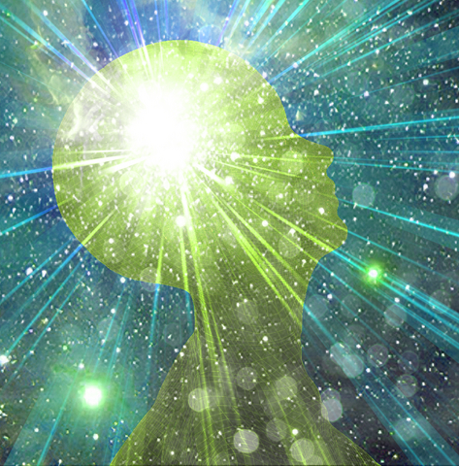
ATTRIBUTES OF THE SPIRIT
Immortality
Individuality
Intelligence, Thought & Reason
Conscience
Spirits are of different orders, according to their individual degree of self-purification.

Slide 9
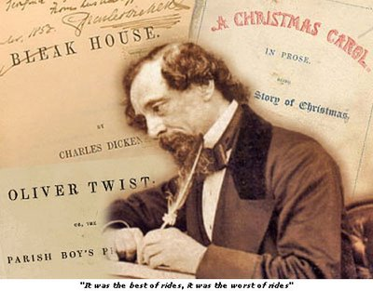
The whole difference between construction and creation is exactly this: that a thing constructed can only be loved after it is constructed; but a thing created is loved before it exists.
Charles Dickens

Slide 10
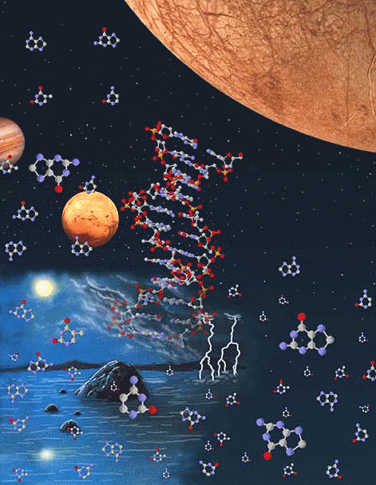
MATTER

Slide 12
The Spirits’ Book Question 30
Does matter consist of one or many elements?
“One single primitive element. The bodies that you regard as simple are not true elements, but rather transformations of the primitive matter.”

Slide 13
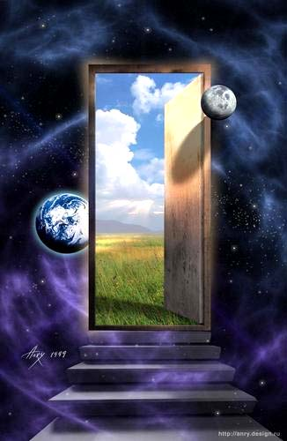
Spiritism explains to us that all creation has its origin in the universal cosmic fluid that we can understand as being the divine plasma, product of the Creator.
From the modifications occurred in the universal cosmic fluid, bodies, substances and others existent matters appear.

Slide 14
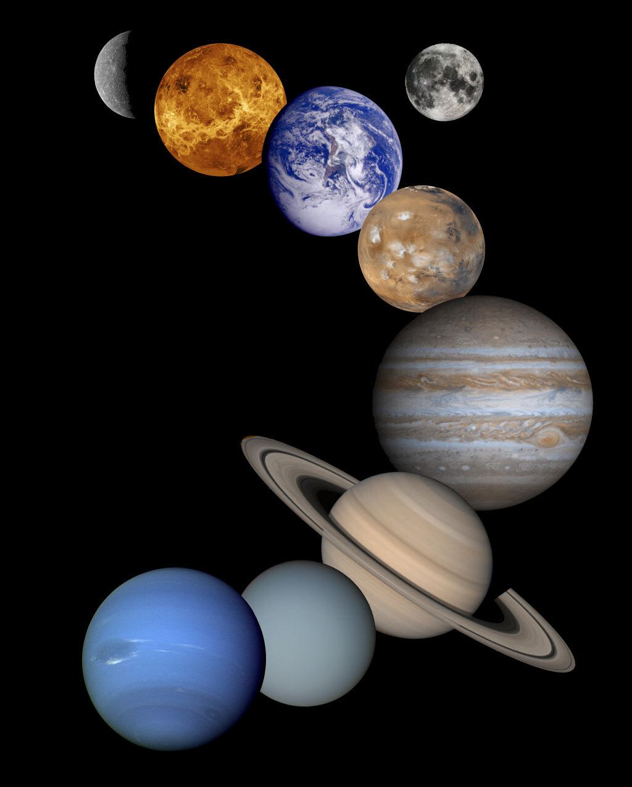
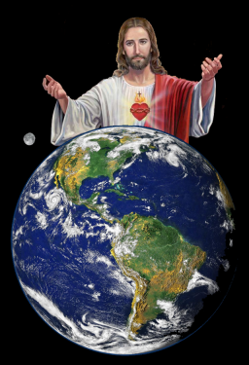
In this original substance, under the influx of the Supreme Lord, the Divine Intelligences united to Him operate in a process of indescribable communion .
They extract from this spiritual breathe the granaries of energy with which they construct the systems of the Immensity .
These Glorious Intelligences utilize the divine plasma converting it into cosmic habitations .
Created Spirit can form or co-create, but only God is the Creator of All the Eternity .

Slide 15
Under an analogous basis, the human Intelligences utilize the same cosmic fluid, for the Co-creation, in a lesser plan, assimilating the corpuscles of matter with the spiritual energy of their own,
thus forming the physic-psychosomatic vehicle in which they will reincarnate, or modeling the civilizations that represent in the world the Incarnate Humanity and the Discarnate Humanity.
Incarnate: 7 billion
Discarnate: 25 billion

Slide 16
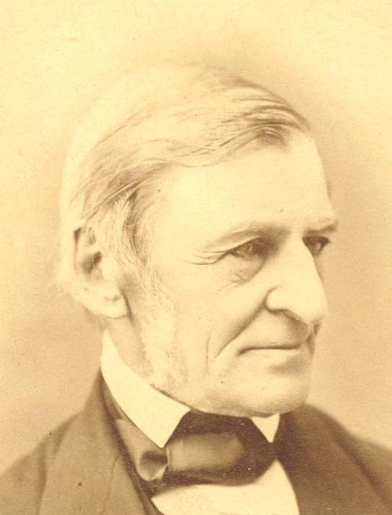
The creation of a thousand forests is in one acorn.
Ralph Waldo Emerson

Slide 17
FLUID
There is an ethereal fluid that fills space and penetrates bodies. This fluid is the ether, or primitive cosmic matter, the generator of the universe and beings.
Inherent to this ether are the forces that preside over the metamorphoses of matter — the immutable and necessary laws that govern the universe.
KARDEC, Allan. Matter. Genesis - Fluids. Chap. XIV - Item 10

Slide 18
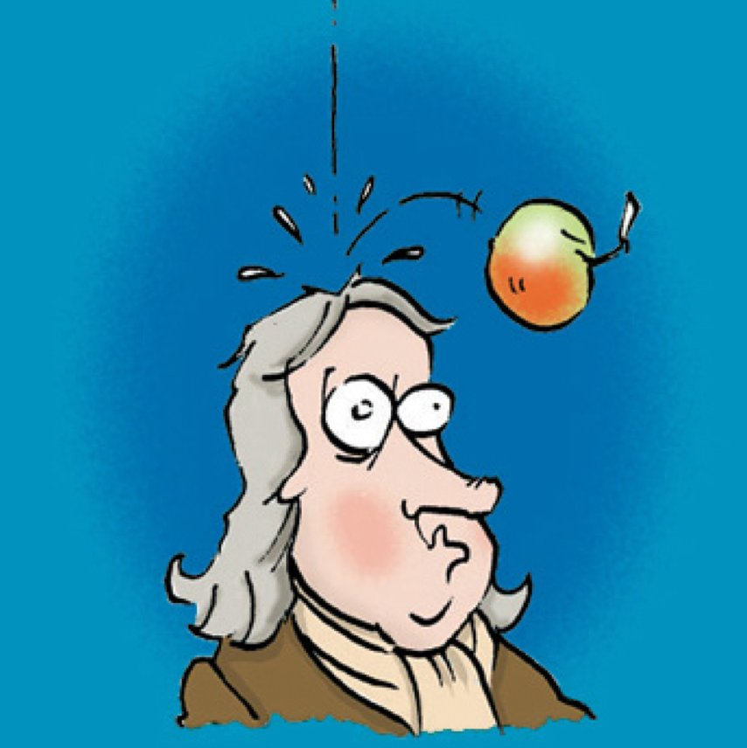
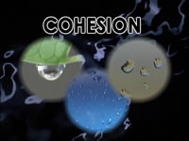
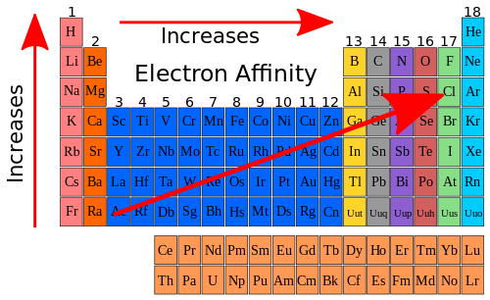
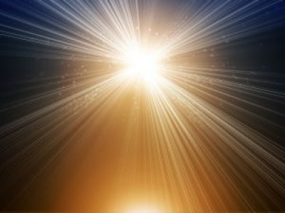
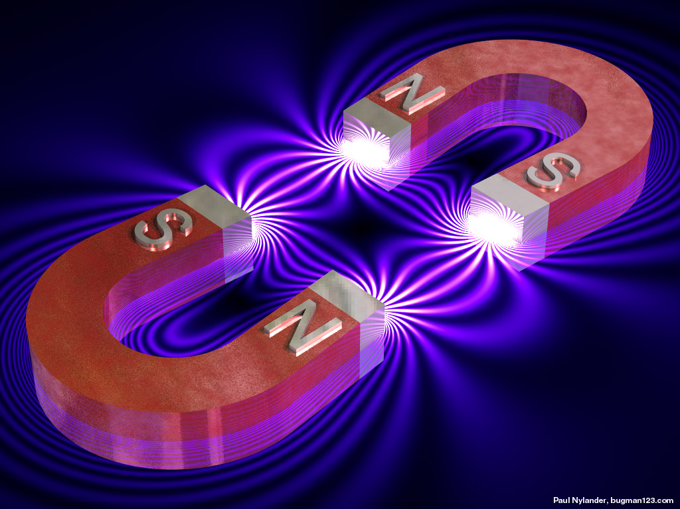
These multiple forces, indefinitely varied according to the combinations of matter, localized according to masses and diversified in their modes of action, depending on circumstances and conditions, are known on Earth as gravity, cohesion, affinity, attraction, magnetism, and active electricity.
Gravity
Cohesion
Affinity
All these forces are eternal and universal like the creation.
KARDEC, Allan. Matter. Genesis - Fluids. Chap. XIV - Item 10
Attraction
Magnetism
Electricity

Slide 19
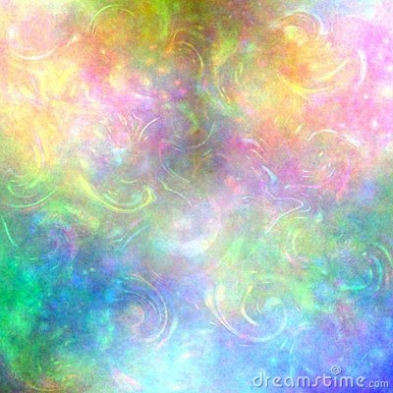
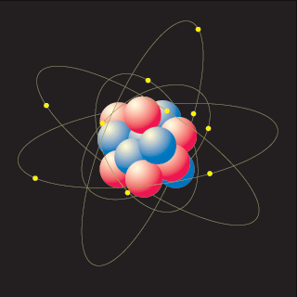
The universal elementary principle offers two distinct states:
Etherization
Materialization
That of etherization, or imponderability, (that cannot be weighed) which may be considered the normal primitive state;
That of materialization, or ponderability. The intermediary point is the transformation of the fluid into tangible matter.
However, even then there is still not a brusque transition, because our imponderable fluids may be regarded as a halfway phase between the two states.
KARDEC, Allan. Matter. Genesis - Fluids. Chap. XIV - Item 2

Slide 20
Each one of these two states necessarily gives place to special phenomena:
Etherization
Materialization
To etherization belong the phenomena of the invisible world (spiritual)
To materialization belong the phenomena of the visible world (fluids of ponderability)
However, Some called material phenomena are, within the jurisdiction of science per se; the others, qualified as spirit or psychic phenomena because they are most especially connected with the existence of spirits, fall within the attributions of Spiritism.
KARDEC, Allan. Matter. Genesis - Fluids. Chap. XIV - Item 2

Slide 21
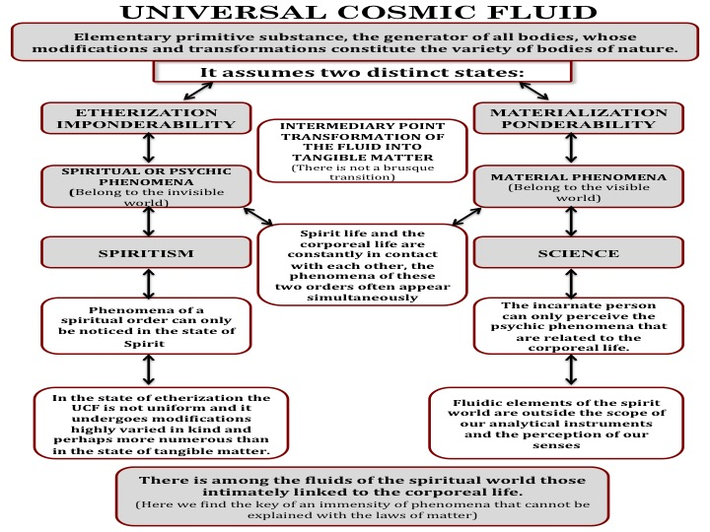

Slide 23
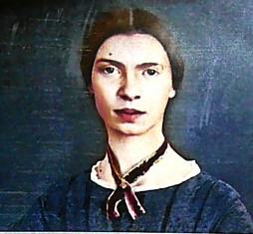
Love is anterior to life, posterior to death, initial of creation, and the exponent of breath.
Emily Dickinson

Slide 24
United States Spiritist Council
SATURDAYS @ 10:00 am to 11:00 AM EST
WEDNESDAYS @ 9:00 PM to 10:00 PM EST
Visit our website for
more information:
www.Spiritist.us

