Slide 1
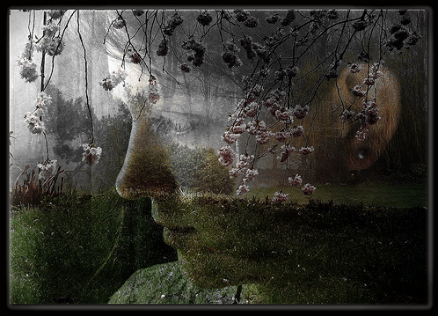
Forgiveness, MERCY and tolerance - moderation
Inner Transformation
Lesson 6
2011 © United States Spiritist Council

Slide 2
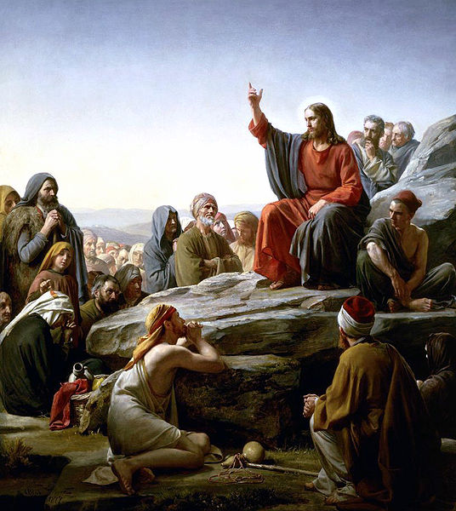
Blessed are the merciful, for they will be shown mercy. (Mt. 5:7)
Sermon On the Mount by w:Carl Heinrich Bloch, Danish painter, d. 1890.
Mercy is the compliment of meekness, because whoever is not merciful cannot be meek and peaceable. Mercy consists in forgetting and forgiving offenses. Forgetting offenses is proper for the advanced soul to forget offenses, and to be above the insults that might be directed towards it.

Slide 3
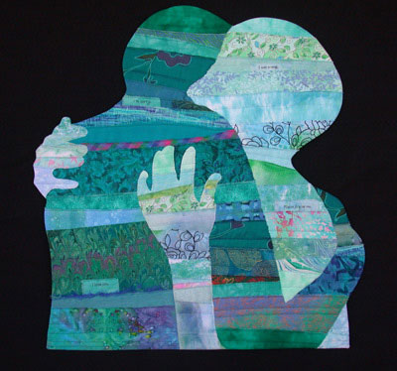
886. What is the true meaning of the word charity as Jesus understood it?
Benevolence towards everyone, indulgence towards the imperfections of others and forgiveness for offenses.”
The Spirits’ Book

Slide 4
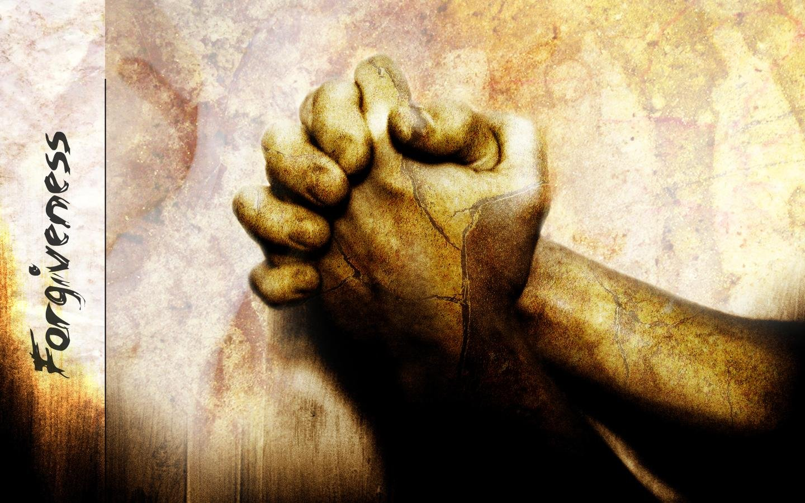
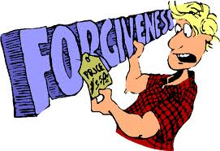
Forgiveness
How many times do we pay for one mistake?
The answer is thousands of times.
Humans are the only animals on earth who pay a thousand times for the same mistake.
Every time time we remember, we judge ourselves again, we are guilty again and we punish ourselves repeatedly.

Slide 5
Forgiveness
A wife or a husband may also remind us of our mistakes, so that we end up judging ourselves, punishing ourselves, and finding ourselves guilty yet again.
Is this fair?
Every time we remember the mistake, we blame them again and send them all the emotional poison we feel at the injustice, and then we make them pay again for the same mistake. Is that justice?"
Don Miguel Ruiz

Slide 6
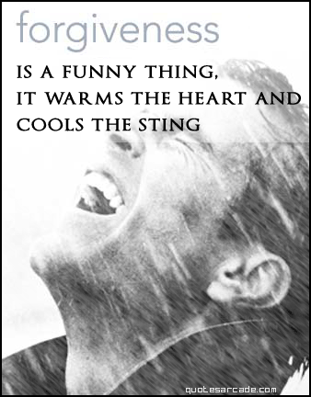
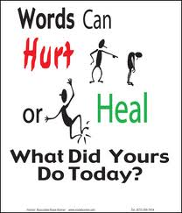
Forgiveness
Recognize that it is not your job — and you have no right — to repeatedly punish another person or yourself for making a mistake. As a human being, it is only your job to forgive, to love, to heal, and to grow and, of course, to forgive always.

Slide 7
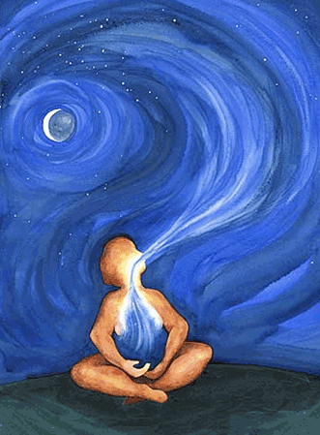
To forgive is to set a prisoner free and discover the prisoner was you.
Unknown

Slide 8
People who forgive others experience reductions in feelings of nervousness, restlessness and hopelessness.
Forgiveness and Health
Forgiveness lowers the blood pressure and heart rates, and reduces chronic pain and symptoms from anxiety, depression or stress.
Any mental or physical distress you feel now about a situation or grudge comes from current hurt feelings, not from the original offense or hurt experienced in the past.

Slide 9
Negative emotions are recorded in our cellular memory. They remain constantly in the background affecting our health, producing traumas and emotional blockages

Slide 10
Nutritional health, Physical Health Emotional Health = FORGIVENESS

Slide 11
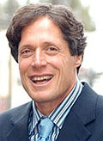
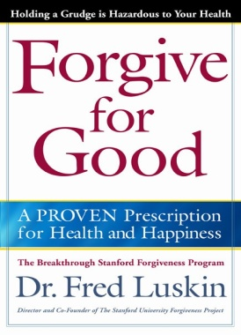
Research on Health Benefits of Forgiveness
Counseling & Health Psychology from Stanford University
www.learningtoforgive.com
FORGIVENESS: PRESCRIPTION FOR HEALTH AND HAPPINESS

Slide 15
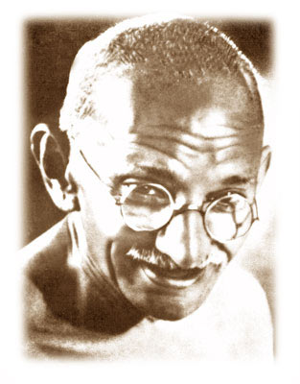
An eye for and eye will make the whole humanity blind. Mahatma Gandhi (1869 – 1948)
Notes:
Mahatma Gandhi (1869 – 1948) A British educated lawyer, major political and spiritual leader. Gandhi practiced and advocated non-violence and truth, even in the most extreme situations.
The weak can never forgive. Forgiveness is the attribute of the strong.

Slide 16
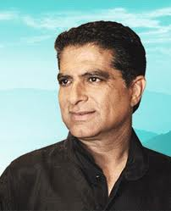
Dr Deepak Chopra – Prophet- Poet of Alternative Medicine
FORGIVENESS
How to Release Toxic Emotions
“Forgiveness is a powerful tool for
personal healing and spiritual transformation,
But it is a skill that must be learned.
By practicing the STEPS for releasing toxic emotions,
We can make forgiveness a functional part of our growth
Instead of just a moral dictate.”
North American doctor, born and trained in India with specialization in the USA in Internal Medicine and Endocrinology.
He brings together theoretical, practical, philosophical and spiritual knowledge in a scientifically proven context.

Slide 18
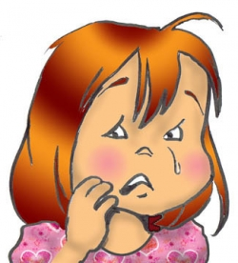
Who is most damaged by holding on toxic energy? The answer of course is obvious:
You are hurting yourself
more than you are hurting another.

Slide 19
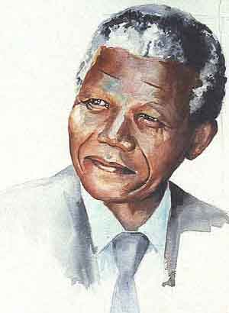
Nelson Mandela once said: “Resentment is like drinking poison and then hoping it will kill your enemies.”

Slide 21
7 – STEPS PROCESS TO RELEASE TOXIC EMOTIONS:
Taking responsibility for your emotion.
Witnessing the emotion.
Defining or labeling the emotion.
Expressing the emotion.
Sharing the emotion.
Releasing the emotion through ritual.
Celebrating the release and MOVING ON.
Notes:
The fourth step is to express what you are feeling in writing. It is suggested that you do this from three different perspectives. First, as you recall the experience, express in writing what you are feeling in the first person. Having done that, express it in the second person, pretending you are the other person in the conflict. And finally, express it in the third person as a neutral observer. When you express the conflict or emotion accompanying the conflict from three different perspectives you will find the toxic energy accompanying the emotion will begin to dissipate. In fact there are studies that show that when you express your emotions in writing in this way, your immune system gets an immediate boost. Immunoglobulins or IgE levels in the saliva show an immediate rise. The fifth step is to share this experience with a loved one. It could even be the person with whom you had the conflict. During the sharing you could also say that you feel ready to forgive and be forgiven. The sixth step is to release the emotion through a ritual. You could burn the paper on which you have written these feelings and offer the ashes to the winds, to the Virgin Mary or to any deity. Ritual action is a way of trapping energy and releasing it effectively and bringing things to closure.Having released the emotion, celebrate and do something funRead more: http://blog.beliefnet.com/intentchopra/2008/12/tools-of-personal-transformati.html#ixzz10TjM5OTI

Slide 22
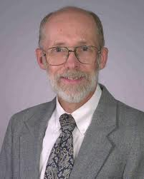
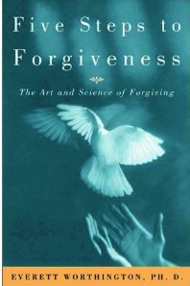
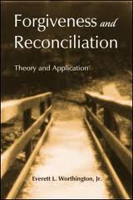
Everett L. Worthington, Jr., Ph.D., is professor of psychology at Virginia Common-wealth University, Richmond, Virginia.
Forgiveness is both a DECISION and a REAL CHANGE IN EMOTIONAL EXPERIENCE. That change in emotion is related to better MENTAL AND PHYSICAL HEALTH.
FIVE STEPS TO FORGIVENESS: REACH
www.forgiving.org

Slide 24
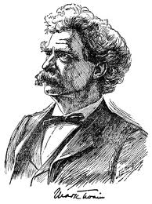
Mark Twain- Forgiveness
"Forgiveness is the fragrance the violet sheds on the heel that has crushed it."

Slide 25
FORGIVING OTHERS – SELF FORGIVENESS
Five Steps Process to Forgiveness
Five Steps Process to Self-Forgiveness
Indignation
Comprehension
Compassion
Mercy
Forgetfulness
Guilt
Remorse
Repentance
Self-acceptance
Renewed Behavior
3 R’s of Spiritism:
Repentance, Repair, Renewal

Slide 26
The more you know yourself, the more you forgive yourself. Confucius

Slide 27
MODERATION
Avoid extremes; forbear resenting injuries so much as you think they deserve.
Learn to forgive injuries, letting go of grudges, thus avoiding actions that could lead to greater damages.
"Moderation in all things -- including moderation."
Benjamin Franklyn

Slide 28
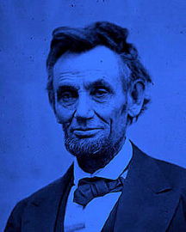
Abraham Lincoln - Forgiveness
Am I not destroying my enemies when I make friends of them?
Abraham Lincoln
(1809 – 1865)

Slide 29
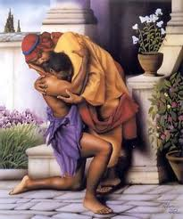
Parable of the Prodigal Son
“Let's have a feast and celebrate. For this son of mine was dead and is alive again; he was lost and is found.”
Luke 15:11-32
An example of forgiveness

Slide 30
Forgive seventy times seven
A lady once came to Chico Xavier complaining about her difficult family, saying she couldn’t stand them any longer. Her husband was too aggressive and her children drove her crazy.
Chico reminded her that Jesus recommended that we must forgive not only seven times, but seventy times seven.
But she replied to Chico: “Look Chico, I am aware of the amount and I have already forgiven my relatives over four hundred and ninety times.”
“Well, my daughter, Emmanuel is by my side and he asks me to tell you that we must forgive seventy times seven in each type of offence. There is still much more to forgive.”

Slide 31
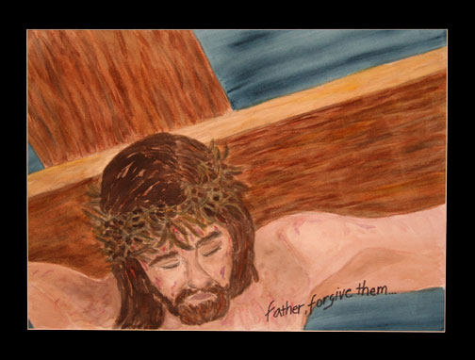
Jesus said, "Father, forgive them, for they do not know what they are doing.” Luke 23:34
Copyright © Linda Roberts, 2007.

Slide 32
United States Spiritist Council
Visit our website for
more information:
www.spiritist.us

