Slide 1
Inner Transformation
Lesson 7
MORAL PERFECTION – CLEANLINESS & CHASTITY
2011 © United States Spiritist Council

Slide 2
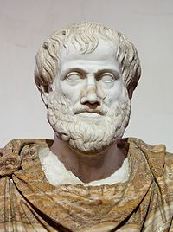
Perfection
Aristotle presents the oldest definition of Perfection
Aristotle (384 BC-322 BC)
which is complete — which contains all the requisite parts;
which is so good that nothing of the kind could be better;
which has attained its purpose.
To Aristotle, "perfect" meant "complete" ("nothing to add or subtract”)

Slide 3
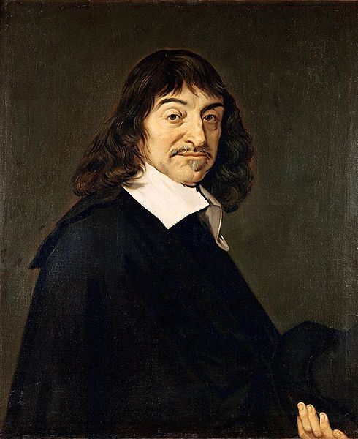
René Descartes (31 March 1596 – 11 February 1650)
The concept of perfection, as an attribute of God, entered into the theological purview only in modern times, through René Descartes — and in the plural, as the "perfections" of God.
Tatarkiewicz, "Ontological and Theological Perfection," Dialetics and Humanism, vol. VIII, no. 1 (winter 1981), pp. 190-91.

Slide 4
PERFECTION
There is a story of a disciple of a great Indian guru who asked the great master:
"How many lives must I live to achieve perfection?"
The master pointed to the great tree under which he was sitting and replied "You must live as many lives as there are leaves on this tree."
Upon hearing this answer the disciple began sobbing uncontrollably. When the master asked him why he was crying he exclaimed "So few! So few to reach perfection!"

Slide 5
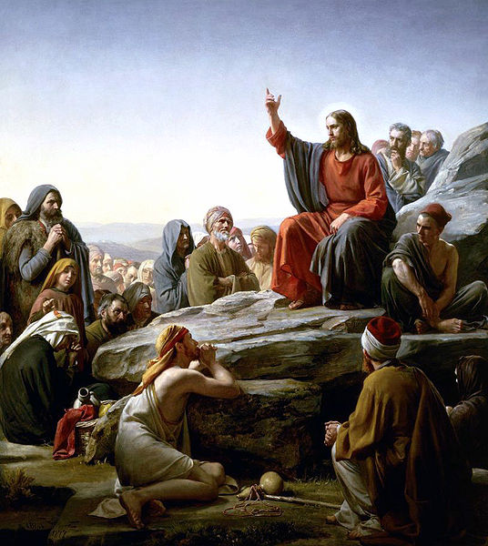
Blessed are the Pure in Heart, for they shall see God.
Sixth Beatitude of the Sermon on the Mount

Slide 6
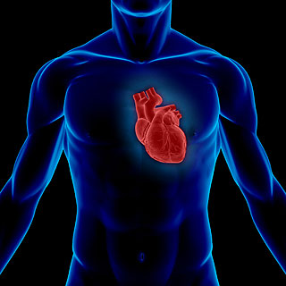
Definition of Heart
Definition
In today’s world the term heart is used mainly to describe the emotional aspect of the individual.
“the seat of the emotions: said of the moral side of human nature in contradistinction to the intellectual; as, he was all head and no heart.” (The Webster’s dictionary).

Slide 7
Definition of Heart
Bible Definition
In the Bible the term heart describes every aspect of the inner person.
It describes the whole self, i.e. the essence of personality.
There is no more comprehensive word used in the Bible to describe every aspect of the function of the individual’s mind, consciousness or self.
The heart is the very center and source of all that we are and all that we do. Therefore, the state of the individual’s heart is central to one’s relationship to God.

Slide 8
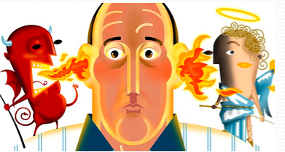
Pureness of Heart
When Jesus talks about pureness of heart, he is inviting us to work on our inner transformation so that we can reach moral perfection.
We know quite well what we, human beings, are capable of presenting in our hearts. From ill thoughts and greed, slander and arrogance, to love, compassion and fraternity.

Slide 9
Purity of heart is inseparable from simplicity and humility and excludes every thought of selfishness and pride.
Let the little children come to me, and do not hinder them, for the kingdom of heaven belongs to such as these. Truly I tell you, anyone who will not receive the kingdom of God like a little child will never enter it. Jesus

Slide 10
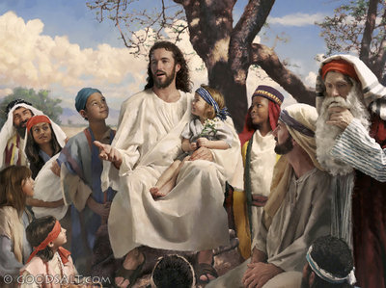
Let the little children come to me
Only a spirit who has reached perfection could give us a model of true purity.
But from the present life point of view, because, they have not yet manifested any perverse inclinations, little children offer us the picture of innocence and candor.
Jesus does not say that the kingdom of God is for them literally, but for those who are like them.(GAS Chap 8, item 3)
Stephanie Miles

Slide 12
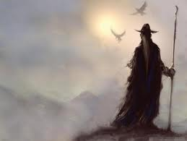
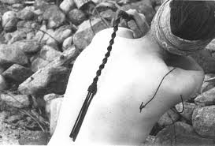
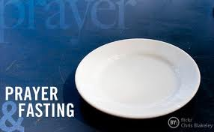
Many people have tried to purify themselves through asceticism or leading a life of complete self denial,
or by other methods such as going away from the world and living in solitude,
or permanent silence,
or beating their bodies with whips and clubs.
They have tried to cleanse themselves through celibacy, fasting, and prayers.
But such asceticism will not result in purity of heart.

Slide 13
Path to Pureness of Heart
The path to a pure heart begins with the realization that we are on the way to perfection and therefore we still harbor negative feelings in our hearts.
We learn from the teachings of Jesus and from the Bible that the way to God has nothing to do with our external appearance, our behavior, or our achievements.
It does not matter what level of education, intellect, business success, or social position, the person has achieved. These factors have no effect on pureness of heart.

Slide 14
Parable of the Wedding Feast (Mt 22: 1-14)
“The servants, after having invited and gathered together all those, both good and bad, whom they met in the streets, to sit at the tables and fill up the wedding hall, saw the King enter and ask a man:
“My friend, why have you come in without a wedding garment?”
The man remained silent.
Then the king told his servants, “Bind his hands and feet and cast him into outer darkness; where there shall be weeping and gnashing of teeth, for many are called but few are chosen.’”

Slide 15
Parable of the Wedding Feast (Mt 22: 1-14)
We learn from this parable that it is not enough simply to be invited; it is not enough simply to take the name of Christian, nor to sit at the table to take part in the heavenly banquet.
Before anything else and as an express condition, it is necessary to be dressed in a wedding garment, which means to have a pure heart and to practice the law according to its spirit. (GAS Chap 18, item 2)

Slide 16
919. What is the most effective means for improving ourselves in this life and for resisting the draw of evil?
“A sage of antiquity has told you: ‘Know thyself’.” (SB)

Slide 17
909. Could humans always overcome their evil tendencies through their own efforts?
“Yes, and sometimes with very little effort; what they lack is will power. How few of you make such an effort, however!” (SB)

Slide 19
“Above all else, guard your heart, for everything you do flows from it. ” (Pr. 4:23).

Slide 20
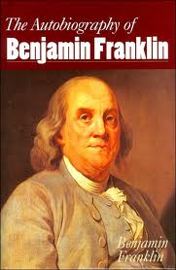
Benjamin Franklin – Thirteen Virtues
Benjamin Franklin wanted to achieve moral perfection.
Morality was a way of behaving that resulted in a balanced life composed of the best of all possible human experiences.
The purpose of Franklin’s list of virtues was to separate right from wrong by delineating boundaries around everyday activities so that people could avoid unhealthy trains of thought.
From his own experience, Franklin passed on an important lesson when he said that “contrary habits must be broken, and good ones acquired and established, before we can have any dependence on a steady, uniform rectitude of conduct.”

Slide 21
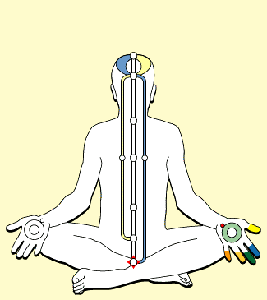
Cleanliness
Tolerate no uncleanliness in body, clothes, or habitation.
We know that the way we feel as spirits will be reflected in the care we are going to provide to our physical body and the environment around us. There is a natural connection between the order of our environment and the state of our mind, i.e. the progress of our spirit.

Slide 22
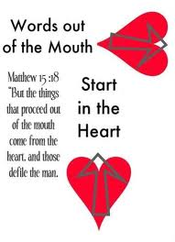
Cleanliness
Jesus once expressed that: What goes into someone’s mouth does not defile them, but what comes out of their mouth, that is what defiles them. But the things that come out of a person’s mouth come from the heart, and these defile them. For out of the heart come evil thoughts—murder, adultery, sexual immorality, theft, false testimony, slander.(Mt. 15:11, 18-19)
From this teaching we learn that true cleanliness starts from within, when we commit ourselves to remove all traces of the imperfections that fill up our hearts.

Slide 23
Chastity
Rarely use venery but for health or offspring, never to dullness, weakness, or the injury of your own or another’s peace or reputation.
Here we are not simply talking about chastity as it relates to celibacy and sexual relationships.
We can expand upon our understanding of this virtue to include seeing it as a means to attaining purity.
The Merriam Webster’s dictionary defines chastity as also being: purity in conduct and intention, and personal integrity. It is in this sense that we have to remain chaste as spirits to achieve pureness of heart.

Slide 24
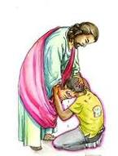
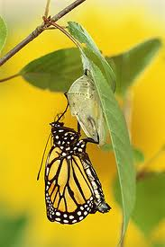
Spiritism’s 3 “R’s”
Repentance
Reparation
Renewal
Repentance is related to heart purity because it is an inward, sincere state of the heart or mind that sees the exceeding wrongness of an error committed.
We have to be willing to make amends and to repair the errors we have committed. It requires courage to face the consequences of our actions and to admit them publicly whenever necessary.
If we follow the inspiration of our hearts and also fulfill the needs of our hearts, we will reach the third stage, which is to find ourselves completely renewed in a process of regeneration.
I’ll make amends

Slide 25
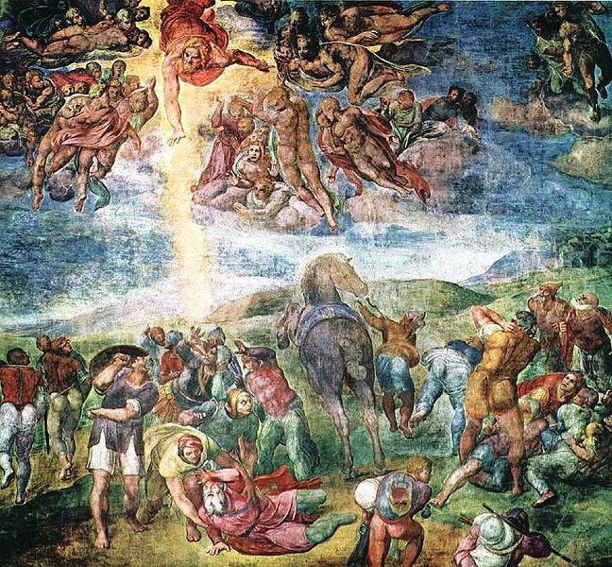
"It is no longer I that live, but it is Christ that is living in union with me". Paul (Galatians 2:20)
Michelangelo

Slide 26
Light from the Heart Nebula Credit & Copyright: Matt Russel

Slide 27
United States Spiritist Council
Visit our website for
more information:
www.spiritist.us

