Slide 1
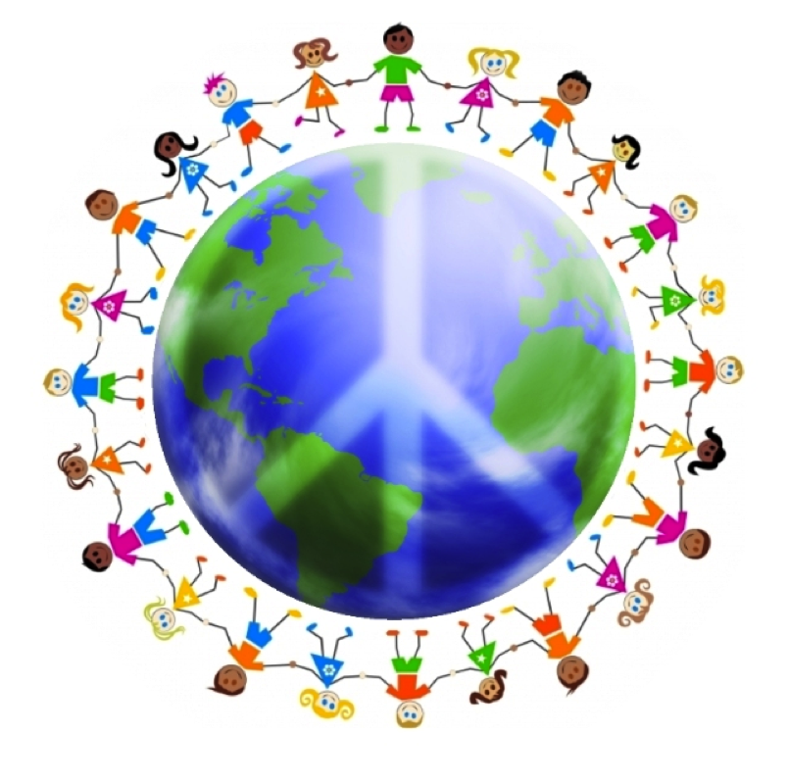
Inner Transformation
Lesson 8

Slide 2
Peace and peacemakers
In our common English usage the word “peace” ” is often associated with the meaning of words like serenity, quietness, and tranquility.
To understand this Beatitude from a biblical perspective, we need to contemplate the meaning of the word “Shalom”.

Slide 3
Peace and peacemakers
In Hebrew peace is not merely a negative state; it never means only the absence of trouble; instead it always means everything which makes for a person's highest good.
When one individual says to another, “Shalom,” the speaker does not mean to wish for the other only the absence of evil things but, rather, wishes for the other the presence of all good things.
In the Bible, as well, peace means not only freedom from all trouble but also enjoyment of all that is good.
Peacemaking is a far more encompassing term than it first appears to be. Since it means, "everything which makes for an individual’s highest good," it is another, more specific term for love, and to love, under any circumstance, is not easy.

Slide 4
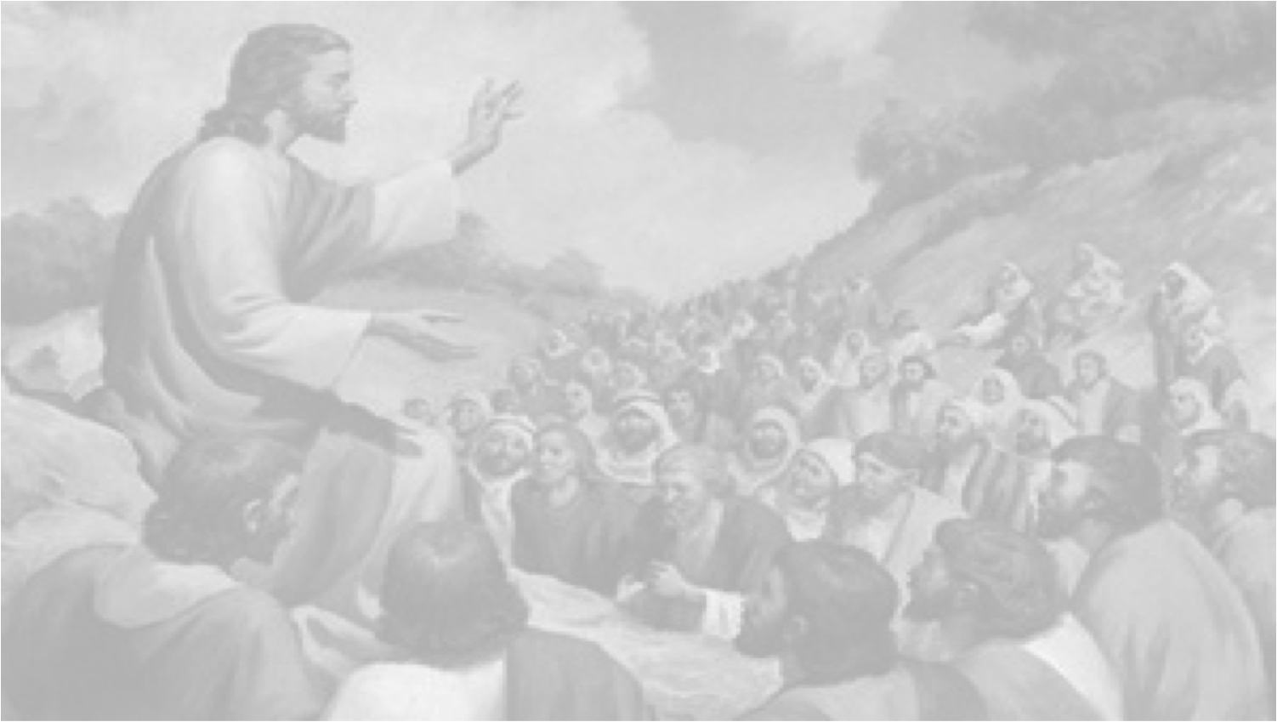
Blessed are the peacemakers, for they shall be called children of God. (Matthew 5:9)
Those who go about their lives intentionally doing what they can to promote, further and in every way bring about the highest good for others, including individuals, families, nations and even the world, may justly be called the “children of God.”
Jesus said a peacemaker is called “a child of God,” for the simple reason that peacemaking is a fundamental aspect of the nature of God, and, thus, it follows that peacemakers are doing the things that reflect God’s nature.
Notes:
<number>

Slide 5
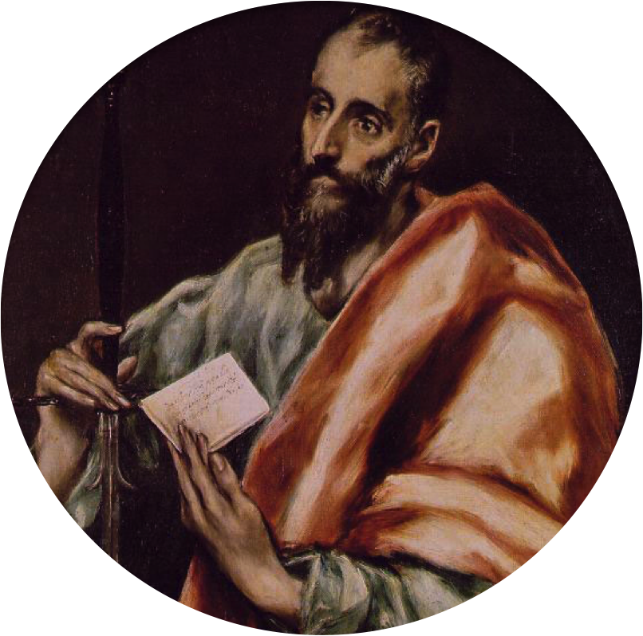
“As much as depends on you, live peaceably with all men.”
Paul of Tarsus

Slide 6
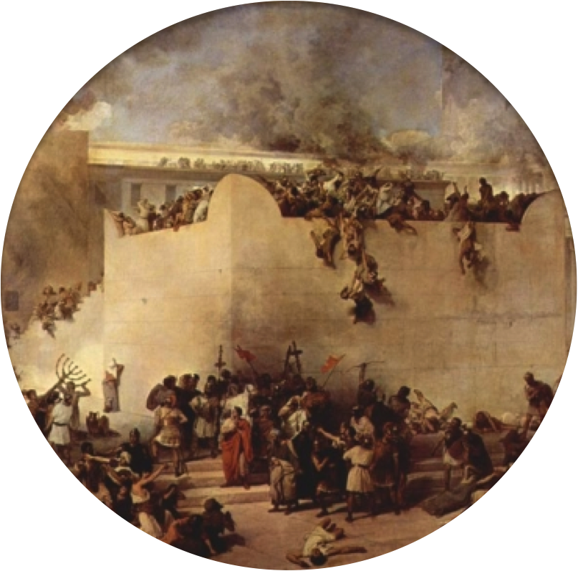
Jesus’ messages must have sounded odd to the people there. Those listening to Jesus that day were Jews struggling to live under the dominion of Rome. Many of them wanted to see Rome defeated and run out of their country. Most believed that the only way there would be peace in Israel was through hostility.
The Destruction of Herod’s Temple in Jerusalem by the Forces of Rome

Slide 7
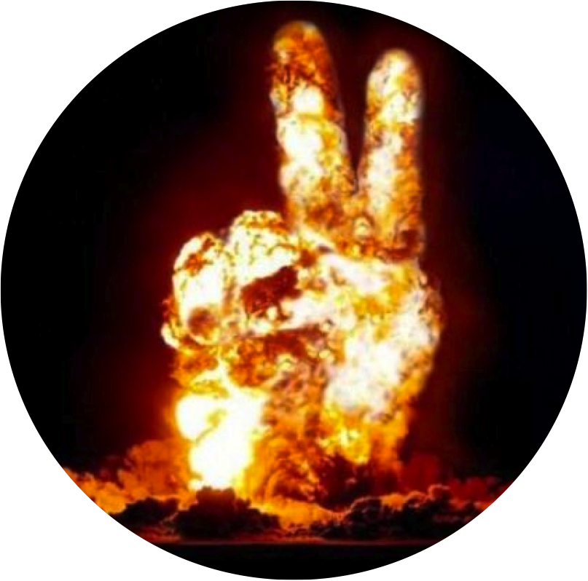
In 1968, a major newspaper reported that there have been 14,553 known wars from 36 BC to date. Since 1945, there have been over 70 wars and more than 200 significant outbreaks of violence. From 1958, to the present, over 100 nations have been involved in one way or another in armed conflicts of some kind.
Over recorded history of 4000 years, only 300 of them have passed without a major war. Peace, though it is the thing most desired by everyone, is also the most elusive goal to attain

Slide 8
Why is peace one of the most significant words in our human vocabulary, yet it's one of the most elusive words in human experience?
The answer is this - the human heart; the human heart is the heart of the problem!
Notes:
<number>

Slide 9
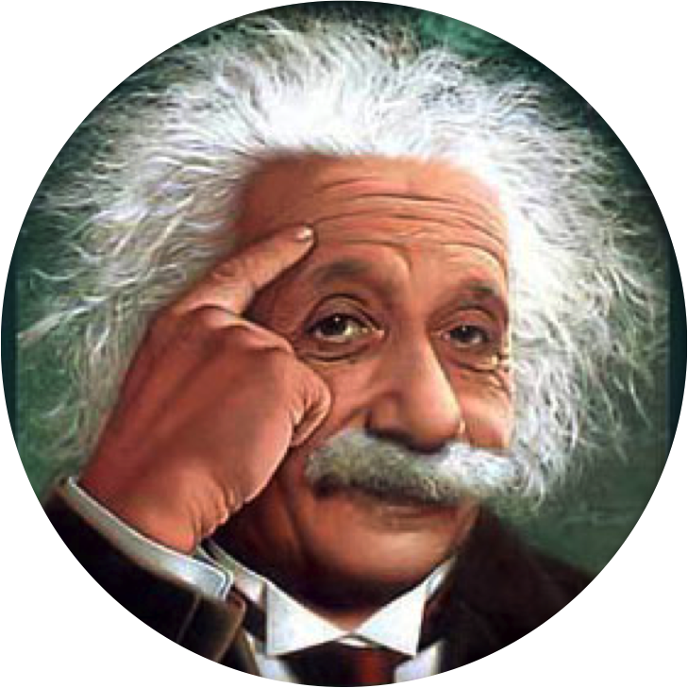
'It is not a physical problem, but an ethical one. What terrifies us is not the explosive force of the atomic bomb, but the power of the wickedness of the human heart - its explosive power for evil'!
Albert Einstein, in one of his lectures (in 1948) commented on the threat of nuclear warfare, and this is what he said:

Slide 10
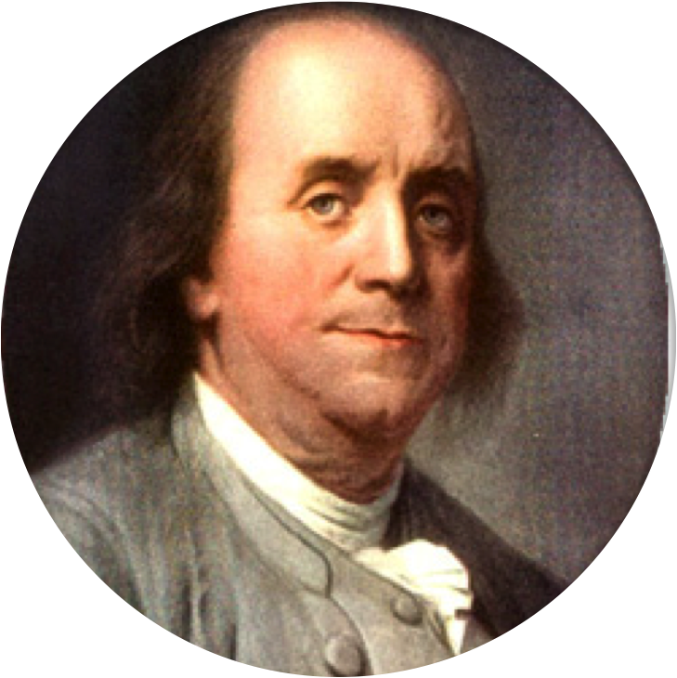
“There was never a good war or a bad peace.”
Benjamin Franklin

Slide 11
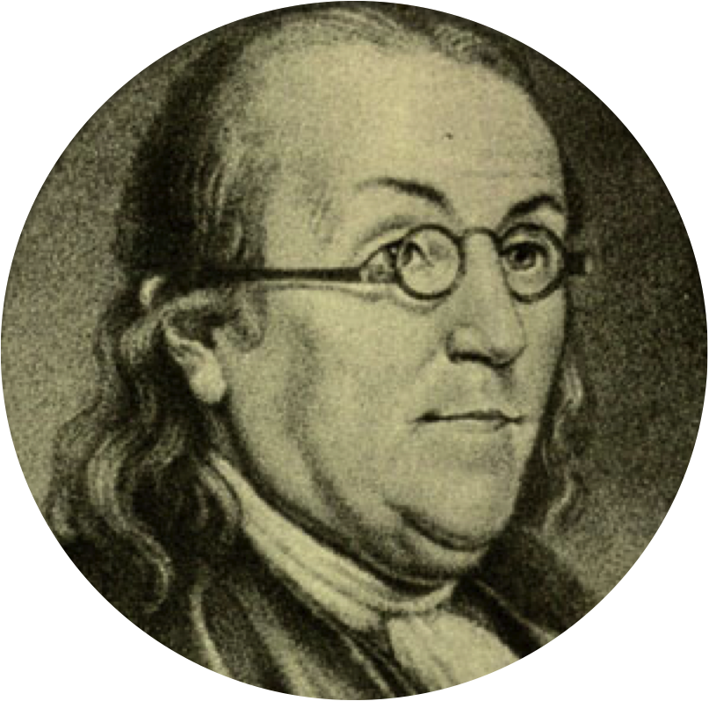
Thirteen Virtues: Resolution
Resolve to perform what you ought; perform without fail what you resolve.
Benjamin Franklin

Slide 12
Resolution

Slide 13
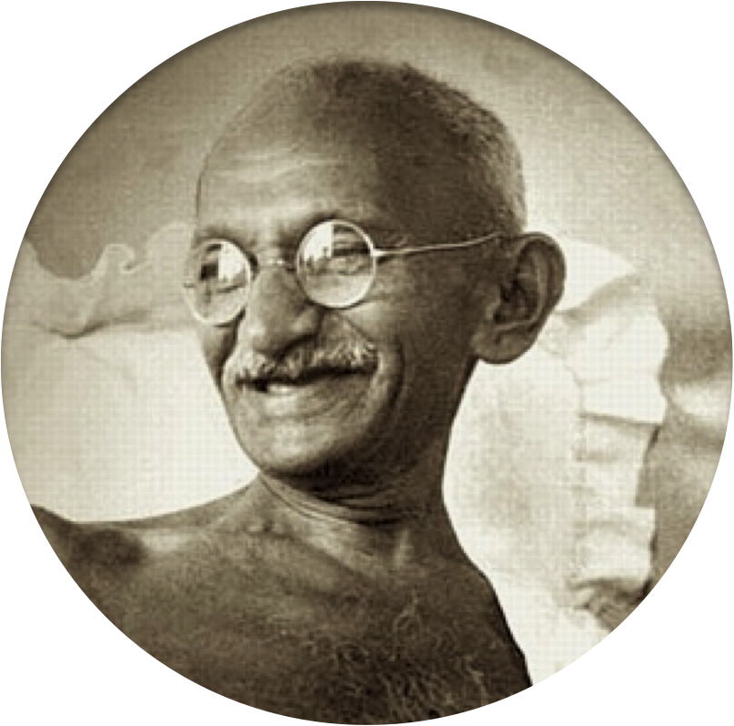
A true peacemaker uses one’s good resolution to to become a force for positive change. Mahatma Gandhi once said:
We must become the change we wish to see in the world.

Slide 14
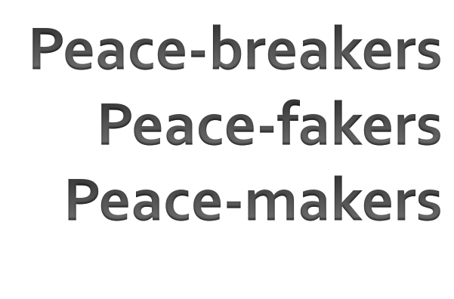
There are THREE TYPES OF PEOPLE:

Slide 15
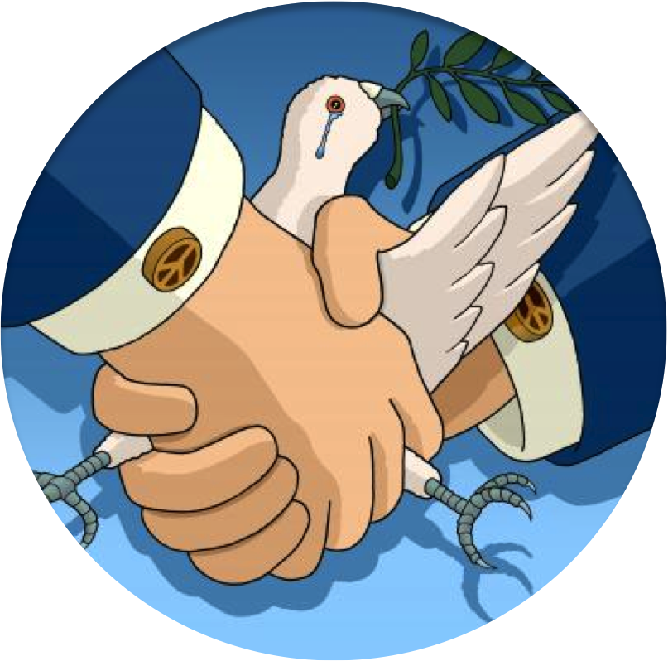
PEACE-BREAKERS
Peace-breakers are those people who go out of their way to break down relationships; thus causing trouble and division.
They’re those who like deliberately confronting others
They have to disagree with everything.
But their motivation is selfish; they are manipulative and self-seeking.

Slide 16
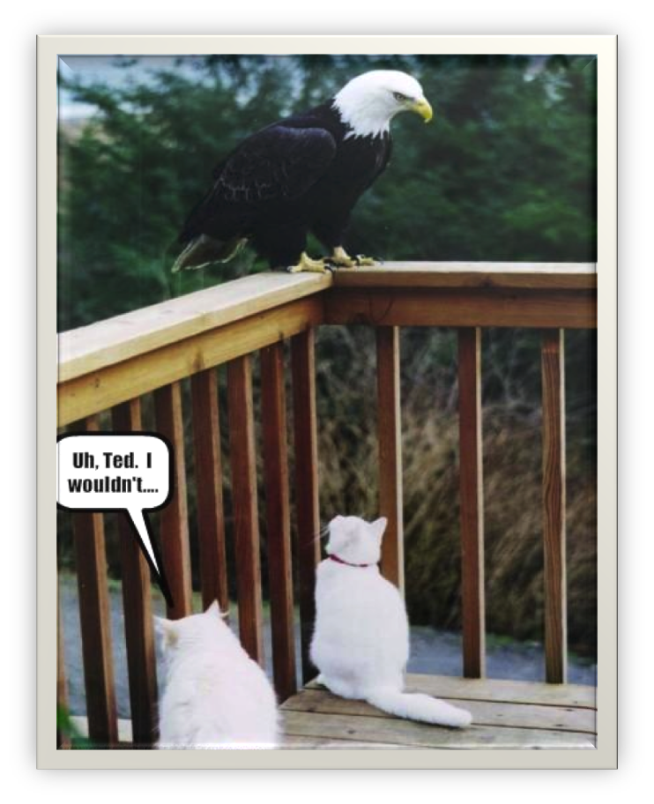
Peace-fakers are those who prefer “peace” over truth. Peace-fakers see “peace” as simply the absence of any kind of argument or discord. They will go to great lengths to avoid any kind of conflict/confrontation/unrest. In doing so they settle for a counterfeit peace that is based on avoiding the real issues.
Peace-fakers
We may have a close friend whose life may be taking a bad turn, and we avoid the issue, and talk about more agreeable subjects. But when we do that we may see our friend’s life go down the drain. So, instead of backing off and saying, “SORRY, I’ll never mention this again.” We should say: “I don’t care if you are going to be mad at me I’m going to stay on your case because I’m concerned about your future, my friend”.

Slide 17
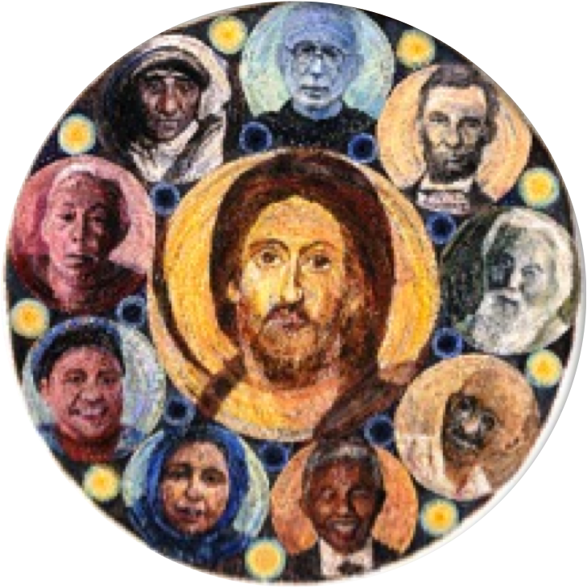
PEACE-MAKERS
Peace-makers are prepared to put others’ well-being above their own need for comfort.
They deal with the real issues and don’t avoid them.
Peacemakers build bridges between people.
Peacemakers are motivated by love - real love. If there is any other motivation behind what one is doing or saying then one is NOT acting as a peacemaker.

Slide 18
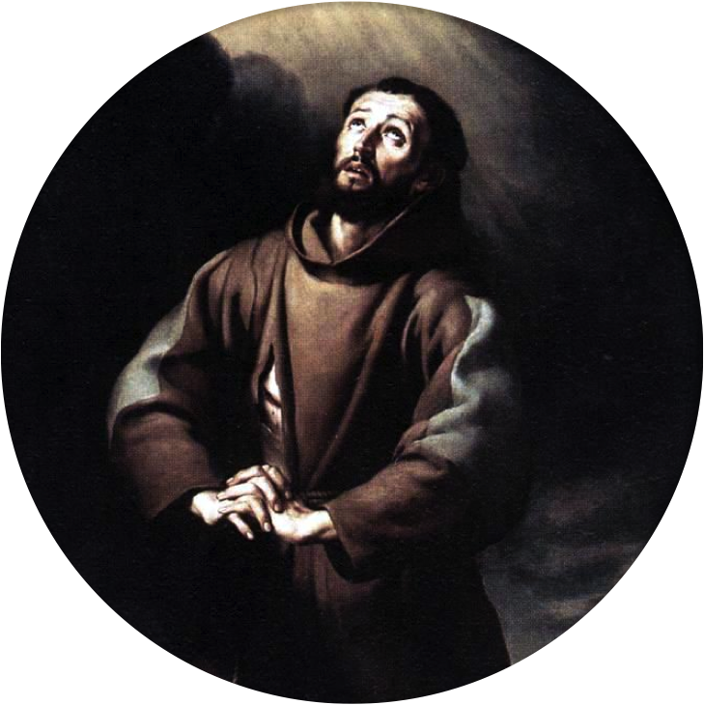
“Lord, make me an instrument of your peace; Where there is hatred, let me sow love; Where there is injury, pardon; Where there is doubt, faith; Where there is despair, hope; Where there is darkness, light; and where there is sadness, joy. O Divine Master, grant that I may not so much seek to be consoled as to console; To be understood, as to understand; To be loved, as to love; For it is in giving that we receive, it is in pardoning that we are pardoned, And it is in dying that we are born to eternal life.”
Saint Francis of Assisi

Slide 19
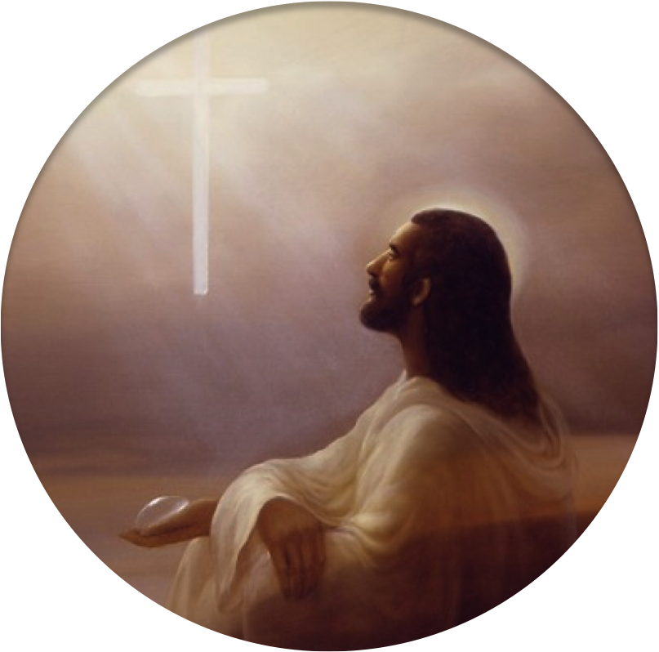
“Do not suppose that I have come to bring peace to the earth. I did not come to bring peace, but a sword.” (Mathew 10:34)

Slide 20
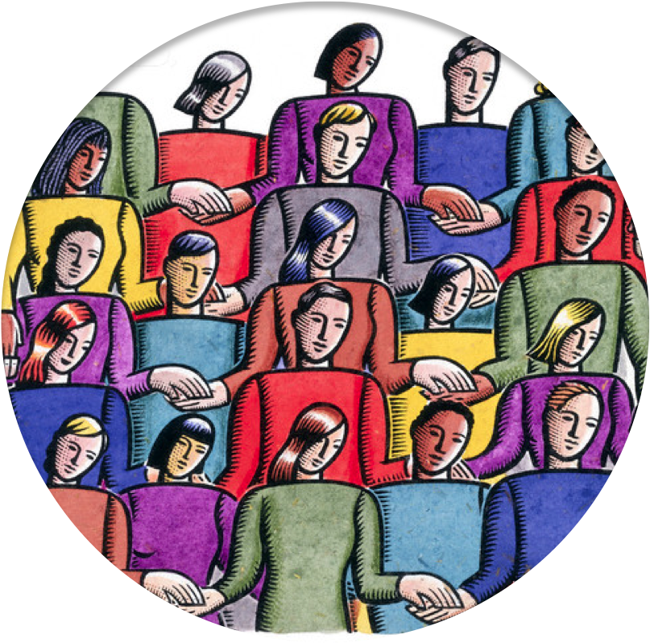
“Do not believe that my doctrine will be established peacefully; it will bring bloody battles, using my name as a pretext, for humans will not have understood me or will not have wanted to understand me.
Peace will follow war; universal fraternity will follow sectarian hatred; the light of faith will come after the darkness of fanaticism.
Weary of a combat without result, which has left only desolation in its wake and has brought trouble into the midst of families, human beings will realize where their true interests lie regarding this world and the other.

Slide 21
United States Spiritist Council
Visit our website for
more information:
www.spiritist.us

